Slide 1
How to Bring Fall Prevention Awareness to your Community
Show Me Falls Free Missouri, August 29, 2023
Presented by: Kelsey Weitzel & Tina Uridge
Sources: Developing the Capacity to Support Clinical Older Adult Fall Prevention and CDC data

Slide 2
Why is falls prevention awareness important?
Falls are a leading cause of injury and fatality among older Missourians. By creating awareness about fall risks and providing education around fall prevention, we can take proactive steps to protect health, safety, and independence of our older adults.
Notes:
KW

Slide 3
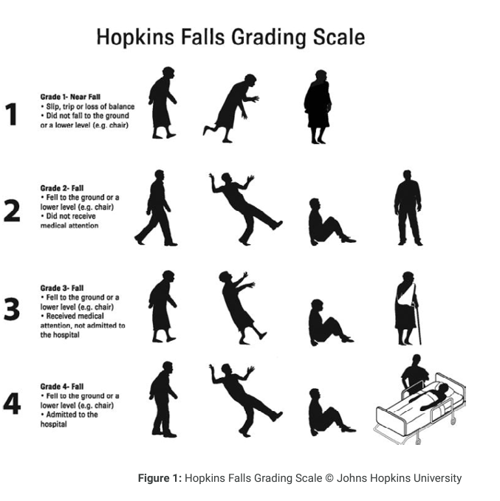
What is a fall?
A fall is defined as an event in which a person unintentionally comes to rest on the ground or another level. The development of the Hopkins Fall Grading Scale (HFGS) prevents ambiguous definitions of falls from being reported in clinical settings.
Notes:
KW

Slide 4
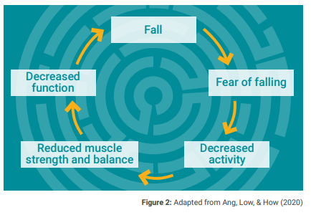
Why Prevent Falls?
One Fall can start a cycle that leads to more falls
Notes:
KW

Slide 5
How can I Make a Difference?
Falls are not a normal part of aging
$50 billion annually in health care costs are associated with falls.
A leading reason for institutional care…… SO
Notes:
KW- $50 billion is spent on medical costs related to non-fatal fall injuries and $754 million is spent related to fatal falls

Slide 6
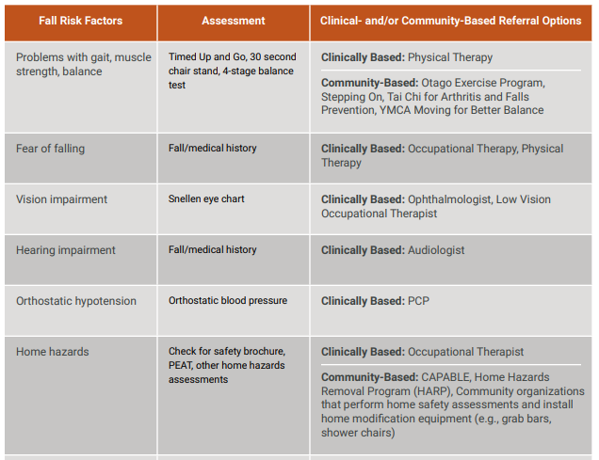
What fall risk factors might you address with a community program?
What community partners can help you make an impact?
What existing programs can you build on or work with?
What steps could you take today to work toward decreasing falls in your community?
Notes:
KW- We learned at our last meeting from the PT professionals that there are 3 systems that contribute to balance: visual, vestibular, and proprioceptive or somatosensory systems.
Vision: our eyes provide feedback of where you are in relation to the world around you.
Vestibular: part of your inner ear, which is a complex system. your vestibular system helps you sense a variety of movement and provides our brain information about spatial orientation and equilibrium. Various parts of the inner ear help detect gravity, linear movement (forward, backward, up, down), and rotational movement
Somatosensory: special sensors in our skin, muscles, and joints respond to stretch and pressure, and give our brain information on how our body is positioned in space. Particularly, sensors in our neck help us sense head movement and head position, and sensors in our feet and ankles help us sense what type of surface we are standing on and our body’s sway.

Slide 7
Small—Awareness & Education
Offer Fall Prevention Education Sessions: non-profit organizations, health providers, senior housing sites, and churches educate their constituents.
Utilize your organizations social media platforms, websites, and newsletters to share tips and information on Falls Prevention.
Utilize resources from the CDC, National Council on Aging, or the Missouri Show Me Falls Free State Coalition to develop flyers and tip sheets.
Notes:
Share basic info, social media,
TU

Slide 8
Medium-Programming
Offer evidence-based Falls Prevention programs including Matter of Balance, Stay Strong Stay Healthy, T ’Chi, Stepping On, Walk with Ease etc.
Funding may be available through your Area Agency on Aging for materials, facilitators, and completers.
Gather stake-holders in your area to develop a falls prevention coalition to help with outreach, networking, referrals, and programming.
Offer an annual Falls Prevention Health Fair with other health providers. Celebrate Falls Prevention Awareness week in September with community presentations, Falls Prevention Bingo, mobility and health screenings
Notes:
Fall prevention screening, webinars, health fairs
TU

Slide 9
Current Healthy Aging Programs and Services
Programs
Boost Your Brain and Memory
WITS Workout
Stay Strong, Stay Healthy
A Matter of Balance
Chronic Disease Self-Management
Tai Chi for Arthritis and Fall Prevention
Eat Smart, Live Strong (SNAP-Ed programming, if income eligible)
Walk with Ease
Mental Health First Aid for Older Adults
Keep Your Keys
Alzheimer’s 101
Understanding Alzheimer’s and Dementia
10 Warning Signs of Alzheimer’s
Aging Mastery
CAPABLE
Fitness Assessments
-6 stage or 4 stage balance tests (measures static balance)
-TUG 10 ft up and go (measures dynamic balance and agility)
-30 second sit to stand (measures strength, endurance)
-Back scratch and sit and reach (lower and upper body flexibility)
Others?
Notes:
TU, and KW

Slide 10
Large: Partnerships
Sustainability of a local falls prevention coalition: commitment of 1-2 key agencies/staff: monthly meeting agenda, compelling speakers/presentations, setting goals and activities for the coalition members.
Partnership with local FIRE/EMS departments-takes training, staff, and referral process to sustain partnership.
Support of evidence-based classes to maintain trained facilitators, marketing and outreach to promote classes.
Notes:
Long term program and approaches to falls prevention, evidence based program
TU

Slide 11
Planning
Notes:
https://health.mo.gov/seniors/showmefallsfreemissouri/fallsprevention.php, updated resources here.

Slide 12
Six Steps to Starting a Program/Coalition
Step 1
Step 1
Assess community needs and context
Step 2
Step 2
Identify a population of focus
Step 3
Step 3
Assess existing cycles of care
Step 4
Step 4
Set Goals and Objectives
Step 5
Step 5
Identify stakeholders and seek buy-in
Step 6
Step 6
Begin designing the program
Notes:
TU

Slide 13
Step 1: Assess community needs and context
Who will take the lead for this program?
What does the data say about falls in your community?
Fall-related 911 calls, emergency department visits, and hospitalizations
Are falls addressed in a recent community health assessment or community health improvement plan?
Are other organizations in your community already focusing on falls?
If a program is well established, can you join it?
If a program is just starting, can you help build it?
If a program addresses a different area, can your programs complement each other?
Demographic trends in your community
Available resources and funding
Other agencies and organizations supporting older adults
Notes:
TU

Slide 14
Step 2: Identify a population of focus
What age range will you target?
Is there a portion of the population in your community that is at greater risk from falls?
Is funding available for a specific population?
Notes:
TU

Slide 15
Step 3: Assess existing cycles of care
Identify the medical providers in your community
Primary care providers, pharmacists, physical therapists, occupational therapists, trauma centers, behavioral health providers, EMS, etc.
How are medical providers responding to falls in your community?
Are adults over 65 screened for fall risk annually?
Are older adults who have fallen connected with community resources?
Is there any follow-up for older adults who are discharged after a fall?
Notes:
TU

Slide 16
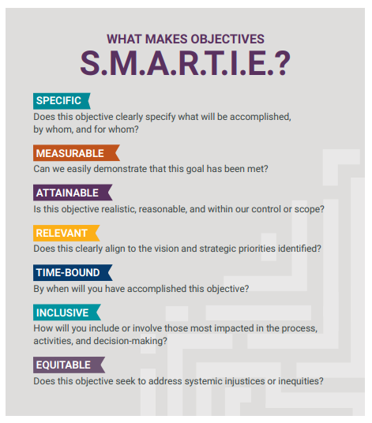
Step 4: Set Goals and Objectives
Goals: identify broad outcomes or aims for how you envision the program’s long-term impact
Objectives: define measurable actions to help achieve the overall goals in the short- and intermediate-term
How do these goals and objectives fit into the larger strategic priorities of my organization?
Notes:
KW

Slide 17
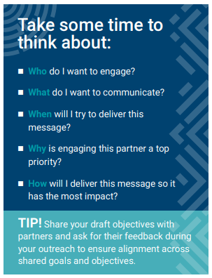
Step 5: Identify stakeholders and seek buy-in
Who could you talk to?
Older adults
Caregivers
Senior Centers/AAAs
Centers for Independent Living
YMCAs
MU and/or LU extension office
Local falls coalition
Senior tax levy board
Medical professionals
Others?
Notes:
KW

Slide 18
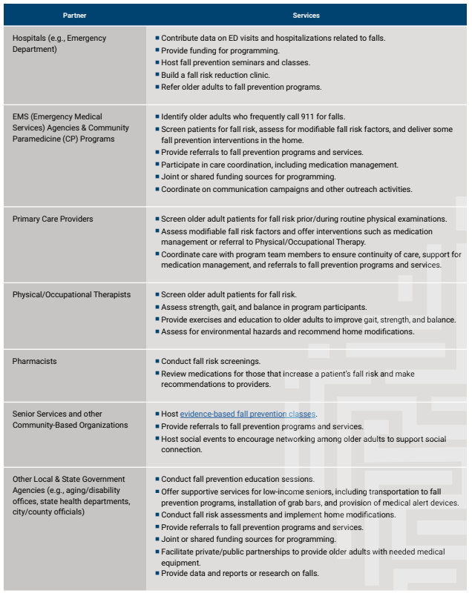
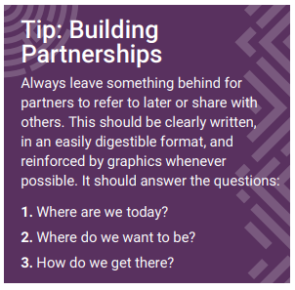
Source
Notes:
KW

Slide 19
Notes:
TU

Slide 20
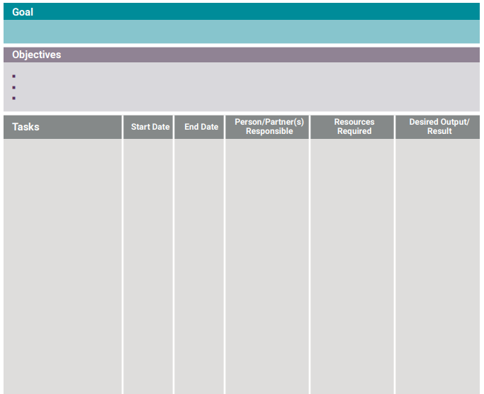
Step 6: Begin designing the program
Make sure all tasks are moving toward your desired goal/outcome. It is not just about output; it is about impact.
Notes:
TU

Slide 21
Resources
-Data By County
All things Missouri
-CDC data falls by state
-NCOA
FPAW toolkit
-Developing the Capacity to Support Clinical Older Adult Fall Prevention
-OASIS Fall Prevention Virtual Event September 20th 12-3pm CT.
-To join the Missouri Fall Prevention Coalition email preventmofalls@gmail.com

Slide 22
Discussion and Sharing

