Slide 1
2023 Home Care Conference
Bureau of Home Care & Rehabilitative Standards
Michael Fields, RN, Bureau Administrator

Slide 2
Bureau Staff Putting the Pieces Together
David Atkinson
Susan Conner
Rita Craighead
David Dresel
Mike Fields
Kelli Hart
Abigail Henson
Vikki Henson
Tammy Lene
Melissa McBee
Sharon Raithel
Shanna Matheney
Beverly Rex
Debi Siebert
Debi Siebert
Tonya Strauss
Kim Wilkerson
Kellie Schaefer
Robin Swarnes

Slide 3
Objectives
Describe Home Health Certification and Licensure
Describe What a Survey Looks Like
Identify the Top Five Home Health Deficiencies in MO
Identify the Top Five Hospice Deficiencies in MO
Review Statistics of HH & HO Agencies
OASIS Topics With Rita Craighead

Slide 4
Describe Home Health Survey / Certification and Licensure.
All new home health and hospice providers come into the program (certification) through an initial survey by an accrediting organization (CHAP, TJC, ACHC). Missouri issues a license to operate in Missouri based on this initial AO survey
Your agency can elect deemed status after your certification
Deemed - routine surveys (36 month window) completed by an accrediting organization (AO)
Non- Deemed – routine surveys (36 month window) are completed by the bureau. (State Agency - SA)

Slide 5
Deemed Providers FYIs (Page 1)
Missouri may conduct a licensure survey, even though your federal surveys are completed by an AO.
Complaints are usually investigated by the state surveyors.
Substantiated complaints at a condition level results in loss of your deemed status until you are back in substantial compliance.
Administrative Changes: You are required to report administrative changes to the Bureau of Home Care and Rehabilitative Standards. (Home Health: Administrator and Pre-Designated Alternate Admin, Hospice: Administrator and RN Coordinator).

Slide 6
Deemed Providers FYIs (Page 2)
Service area expansion, or adding a branch / multiple location there is a specific process and requirements. (Call our office or email David)
Your agency is required by statute to submit a statistical report about your operations. These reports are due by Feb 28th, on an annual basis.
Change of ownership process (Call our office or email Debi)
Missouri specific staff background check requirements: Missouri requires an employee disqualification list (EDL) check to be conducted, as well as a criminal background check through the Missouri state highway patrol, before offering employment to new staff. For home health agencies a family care safety registry (FCSR) check must be completed.

Slide 7
Surveyor 101: Regulations
CMS Conditions of Participation (CoPs)
State Operations Manual (SOM)
State Statutes
State Rules (Regulations)
Medicare Benefit Manual
HIPAA
OSHA

Slide 8
SURVEYOR 101 - TYPES OF HOME HEALTH SURVEYS
Recertification Survey: Standard survey every three years. Begins as a standard survey, may be converted to partial/or extended.
Standard Survey: Standard survey is a routine, patient-centered survey that gathers information about the quality of service furnished in a agency to determine compliance with the high priority patient centered CoPs (Level 1 Tags primarily in Comprehensive assessment, Plan of Care, Skilled professional services, Aide services)
Partial Extended: After one or more tags are found in Patient centered areas (Level 1 tags), the team will move to a partial extended survey and will look at Level 2 tags. The partial extended survey evaluates additional info and additional lower priority areas. (This ends up being the most common type of survey).

Slide 9
SURVEYOR GUIDE - TYPES OF HOME HEALTH SURVEYS (cont.)
Extended Survey: The Extended Survey is conducted when the survey team determines more evidence is needed to get to the extent of a system problem related to substandard quality of care (patient outcomes). Extend the sample such as reviewing extra records / additional home visits.
Abbreviated Survey: Complaint/Revisit- looking at only those CoP’s authorized by CMS during a revisit, deemed complaint, or Cops related to complaint allegations (focused survey).

Slide 10
SURVEYOR GUIDE - TYPES OF HOME HEALTH SURVEYS (cont.)
Complaint Survey: Looking at the regulatory issue (tags) that were identified in the complaint allegations. (A complaint survey always starts as an abbreviated survey). If an IJ jumps out in another CoP area, call your supervisor for guidance.
Validation Survey: CMS Regional office sends notice to SA (BHCRS) to complete a full survey after an AO completes a survey to ‘validate” the findings of the AO. This survey begins as a Standard Recertification Survey. (FYI: You must complete the number of home visits and record reviews from the SOM). If findings warrant, move to partial extended or extended.

Slide 11
Surveyor 101: survey process flow
Pre-survey (offsite work).
Entrance.
Information gathering phase (chart reviews, home visits, interviews).
Findings compiled and reviewed with the agency.
Exit.
Plan of correction / revisit.

Slide 13
Trying to put the Pieces together
Robin
Mike

Slide 14
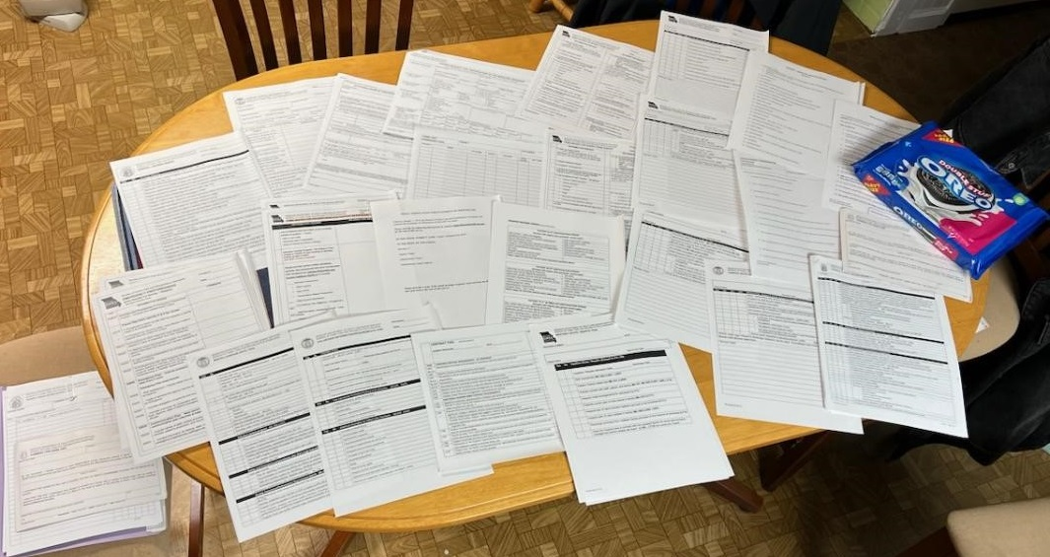
What a survey looks like

Slide 15
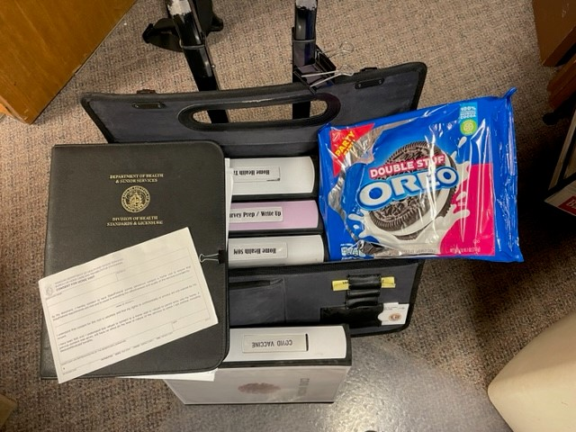

Slide 16
Entrance
Roller Bag
Brigade
Entrance Conference

Slide 17
ITEMS NEEDED for Survey (Page 1): Provided on Entrance 1. Set up home visits – Have clinical manager(s) bring visit schedules for current week for all disciplines and work with surveyor to set up home visits. - Focus on multi-discipline, high skilled nursing need (involved wound care, IVs, unstable diabetes, new CVA, unstable CHF etc)
2. Current Patient List (include start of care date, diagnosis, and services provided)
3. Complaint Log
4. Patient Admission Folder
5. Discharge List – last 3 months (include start of care and discharge dates)

Slide 18
ITEMS NEEDED for Survey (Page 2):
6. Alzheimer’s and Dementia Training content for new hire and annual orientation
7. Current Employee List – include discipline and date of hire
8. List of staff (include all contract staff), include each position and vaccinated status.
9. The agency percentage of vaccinated staff
10. Policies and Procedures regarding staff vaccination
11. Contracted Services: – List of contractors - List of individuals and discipline who provide services under contract

Slide 19
ITEMS NEEDDED For Survey (Page 3):
12. Branch offices : prepare a list that includes for each branch office: - Location - Person in charge of branch location - Telephone number - Services provided from the branch location
13. Organizational Chart : - Must show lines of authority from governing body to patient level - Include branch offices (if applicable)

Slide 20
ITEMS NEEDDED For Survey (Page 4):
14. Infection Control: - Tracking information and committee meeting notes. - Infection control education provided to staff at orientation. - Infection control education provided to patients.
15. QAPI program: Provide documentation of the program. 16. Governing Body: Minutes for current and past year: (if your agency is a large multi-provider corporation, please flag the information in the minutes pertinent to your agency and QAPI program) 17. High Risk Drug List: please make a copy for each surveyor

Slide 21
ITEMS NEEDED For Survey List (Page 5):
18. Written documentation identifying predesignated person to act in the absence of administrator
19. Email Verification returned by administrator
20. State License Expiration Date: ___________________________
21. See separate list for Emergency Preparedness – Items Needed for Survey
22. All checked-off surveyors signed the Tri-fold (CMS-1572) form.

Slide 22
Sample Selection:
Medically complex patients selected
Patients with multiple disciplines
Treatments (IV therapy, etc)
Patients with wound care
Education requirements
Patients served out of branches
Home Visit Arrangements (call ahead - permission)

Slide 23
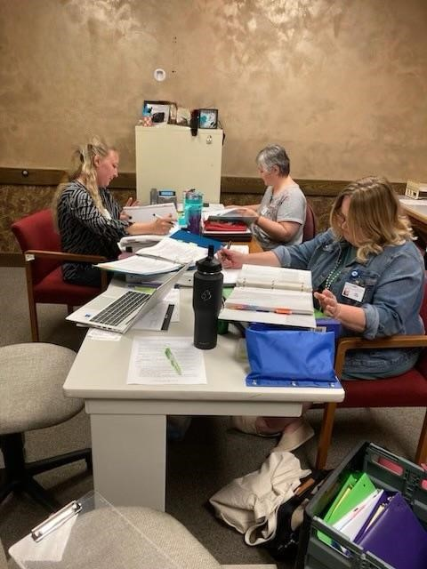
Susan Conner
Kelli Hart
Vikki Henson

Slide 24
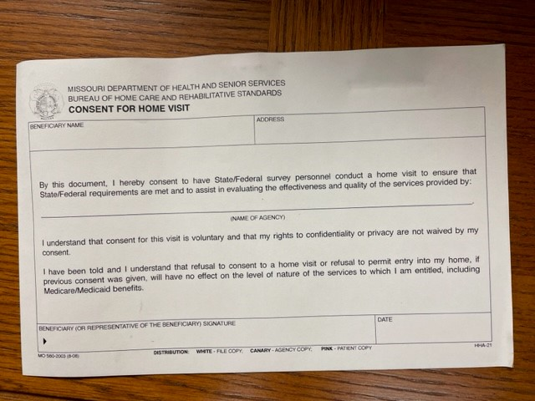

Slide 25
Home Folder Review Form:
____Written statement of patient rights in a language the patient understands (G412)
____Discharge / transfer policy information (G412 or G452)
____ OASIS privacy notice (Medicare/Medicaid only) (G416)
____ Written financial liability information at SOC (G440)
____ Written financial liability information for services started after the SOC (G440)
____ Missouri Hotline number with correct hours of operation (G444) ____ Contact information for the HHA administrator to lodge complaints (G414)

Slide 26
____ Advance directive information (G984)
____ Visit schedule, including frequency of visits for all disciplines seeing patient (G614)
____ Patient medication schedule/instructions, including medication name, dosage and frequency (G616)
____ Medication to be administered by the HHA must be identified (G616)
____ Treatments to be administered by HHA personnel, including therapy services (G618)
____ Any other pertinent instructions related to the patient's care and treatments and needs (G620)
____ Name and contact information of the clinical manager (G622)

Slide 27
What Do We Observe on Home Visits?
Surveyors review the plan of care before the home visit to get a picture of the expected care.
Interaction with the patient/caregivers?
Staff following the Plan of Care?
DME being used included in POC?
Medication review system?
Infection Control being followed?
Patient educated on the Plan of Care / new interventions?
Assessment of patient relevant to the need?

Slide 28
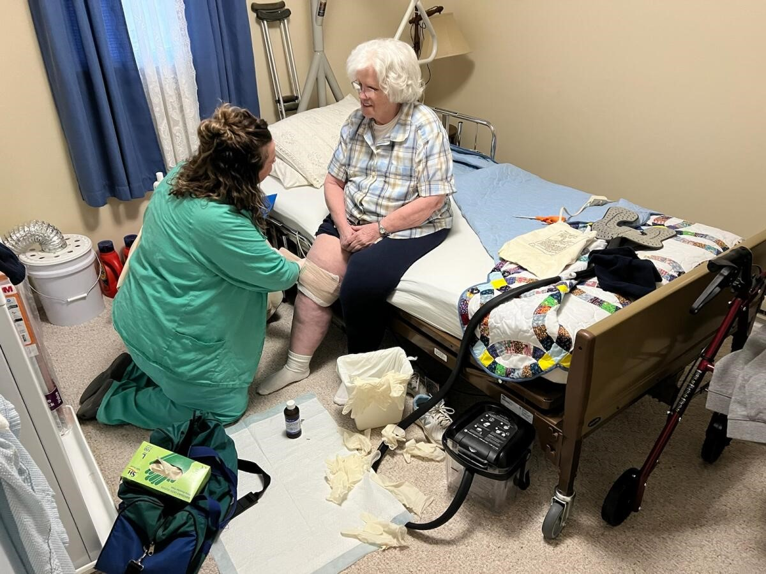

Slide 29
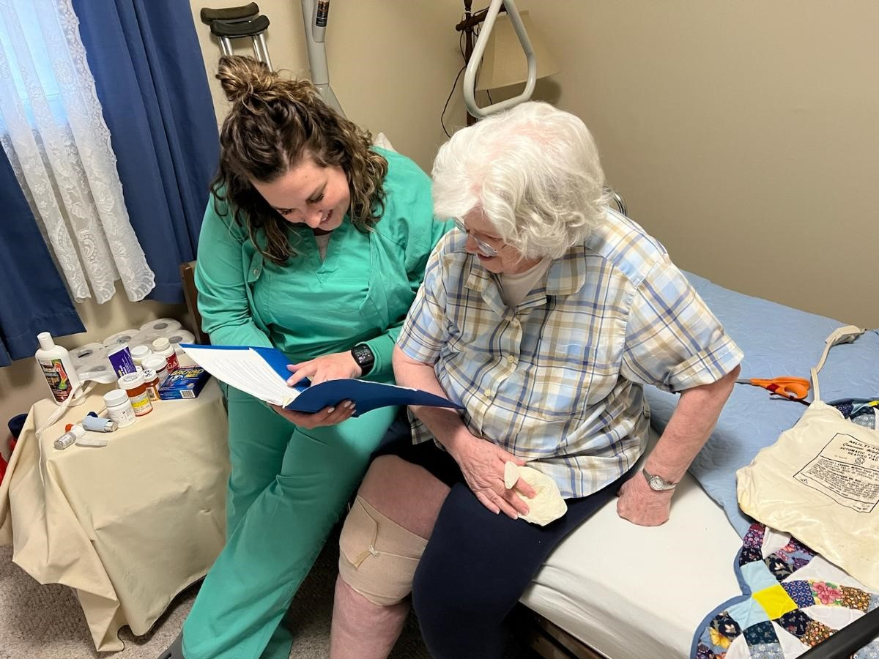

Slide 30
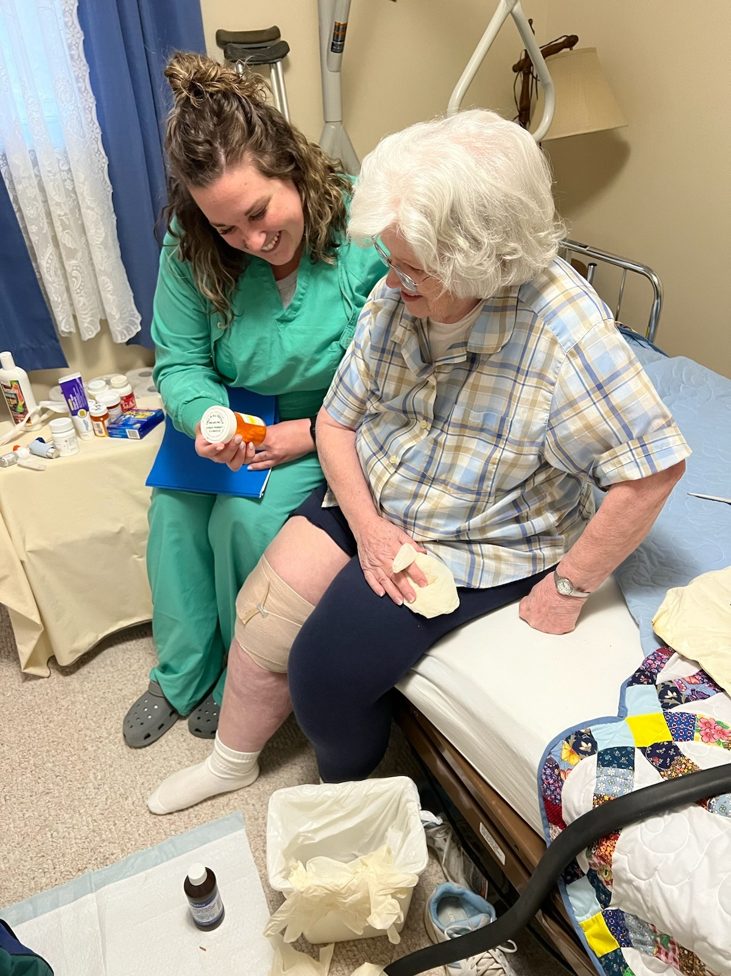

Slide 31
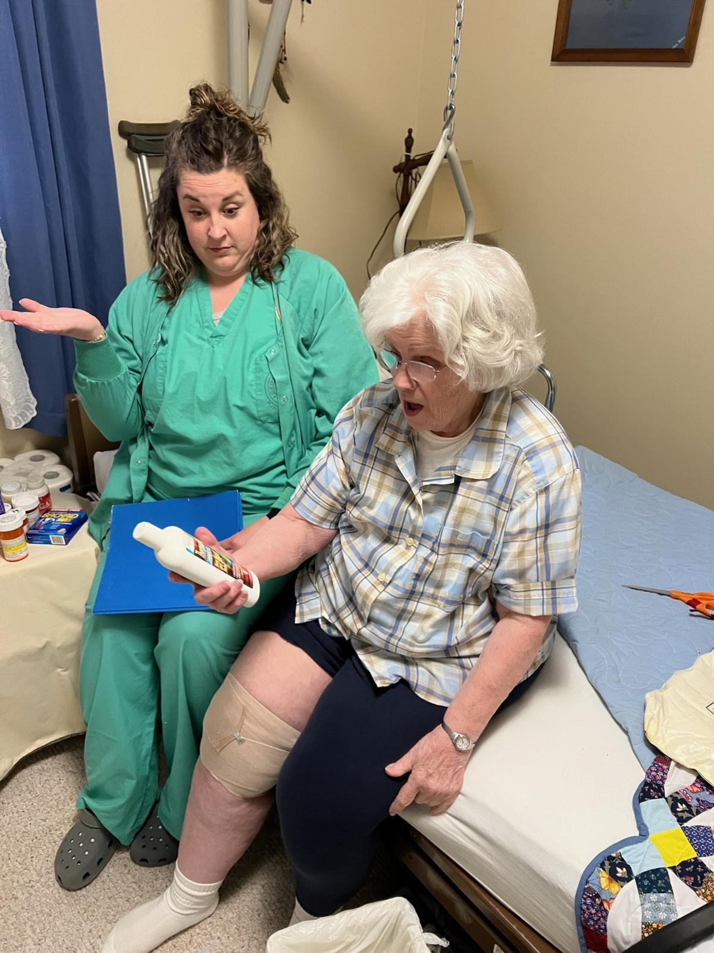

Slide 32
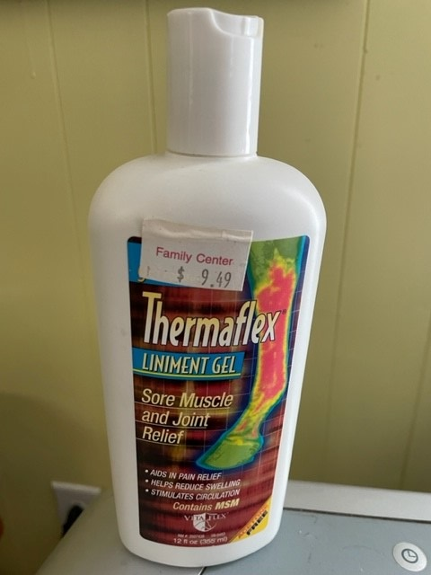

Slide 33
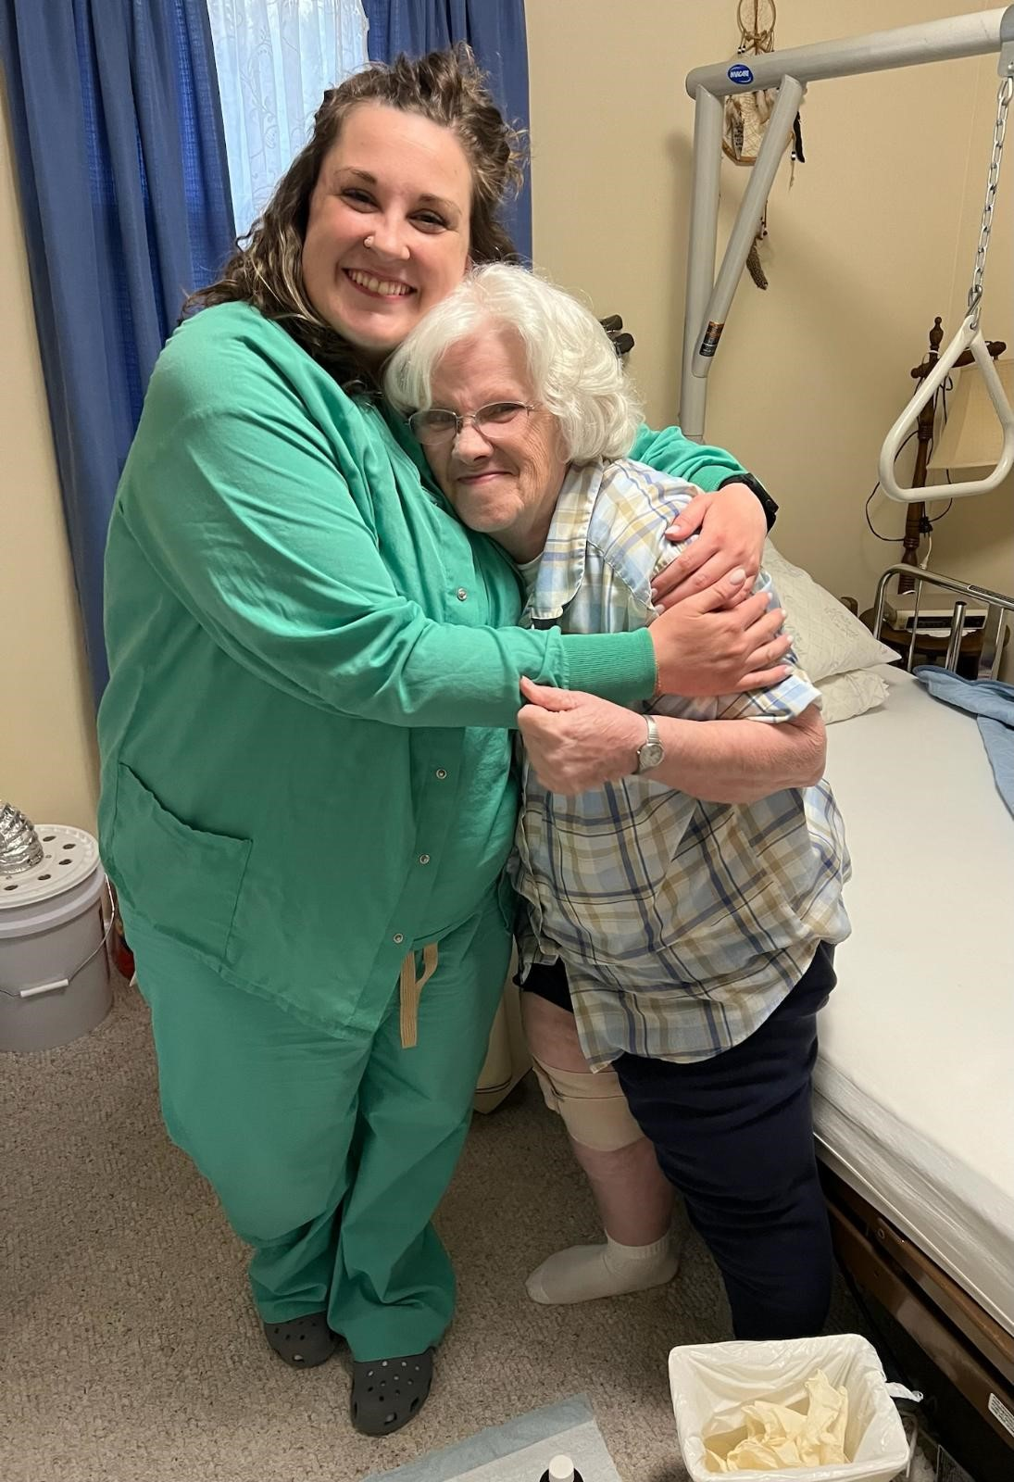

Slide 34
Questions we ask Caregivers/Patients
(after the clinician is finished)
Had any complaints, did you call the agency about it? Did you hear back from someone in the agency about your concern?
Involved in your care planning? (Is there verbal or written evidence that the patient is aware of and participates in the plan of care and changes to the plan of care)?
Is the care being provided as you were told it would be? Has the agency met your needs?

Slide 35
Questions we ask Caregivers/Patients
(after the clinician is finished)
Have there been setbacks or problems during your episode of home care and has the agency addressed them? Are you concerned about problems that have not been addressed by the staff to your satisfaction?
Were you instructed about: medications, wound care, treatments, home exercise program, safety, etc.?
Does the agency provide you a home health aide? - Are you satisfied with the aide care provided? - Review aide assignment with patient/caregiver. Does the aide provide care according to the aide assignment?

Slide 36
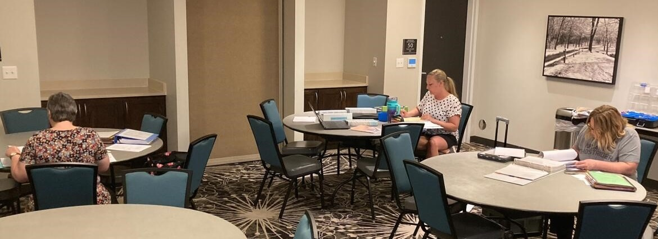
Identify the Top Five Home Health Deficiencies in MO

Slide 37
Top Five Home Health Deficiencies (Missouri)
G536 Review of all Current Medications
G574 Individual Plan of Care
G580 Only as Ordered by a Physician
G590 Promptly Alert Relevant Physician of Changes
G682 Infection Prevention

Slide 38
G536- Top Reasons Why Deficient Review of all Current Medications
On admission: Med profile discrepancy with meds on discharge instructions, no documentation of physician notification/clarification.
All prescription meds and over-the-counter medications not included on the med profile.
Physician not notified of med discrepancies to obtain med clarification orders.

Slide 39
G536- Top Reasons Why Deficient Review of all Current Medications
Staff ask the patient if there was any medication changes and do not look at the meds to verify, so med profile incorrect.
The patient went to physician, med changes made and the medication profile was not updated to show changes.
Clinicians fail to ask about med regimen, effectiveness after meds were added.

Slide 40
G574- example Individual Plan of Care
The POC is not addressing and individualizing care to address the needs identified on assessments.
Example: The assessment shows the patient had 2+ edema in right arm. The POC showed goal was to decrease edema in right arm with no interventions listed. During the home visit OT provided lymphedema drainage (not on the plan of care).
The discharge summaries often include treatments and interventions which are not included on the POC.

Slide 41
G580- Top Reasons Why Deficient: Only as Ordered by a Physician
All drugs, services and treatments are administered only as ordered by the physician.
Examples:
Lidocaine patch for pain management and no order for patch.
POC showed wound care twice weekly to patient’s left elbow using NS, adaptic, and foam adhesive. The SN treated the left elbow with coban, kerlix and ABD (did not provide ordered treatment). Visits were done weekly not twice a week as ordered.
POC showed to obtain urinalysis with urine culture. The SN used a straight cath to obtain urine specimen and there was no order for a straight cath.

Slide 42
G590- Top Reasons Why Deficient: Promptly Alert Relevant Physician of Changes
The home health agency must promptly alert the relevant physician(s) to any changes in the patient’s condition or needs that suggest that outcomes are not being achieved and/or that the plan of care should be altered.
Examples:
The patient exhibited s/s of UTI, the nurse and OT discussed the possibility of an UTI, the physician was not notified and the next day the patient was admitted to the hospital with an UTI
The patient reported a fall and sustained abrasions to elbows and the physician was not notified

Slide 43
G682- Top Reasons Why Deficient Infection Prevention
Hand hygiene not performed between glove changes, dirty to clean, and prior to entering supply bag:
Example: Removing a dressing from a wound and changing gloves without washing hands
Placing supply bag on surface without cleansing the surface and/or putting down a barrier
Placing tablet down on surface without cleansing the surface and/or putting down a barrier leave without cleaning it or place back into the supply bag

Slide 44
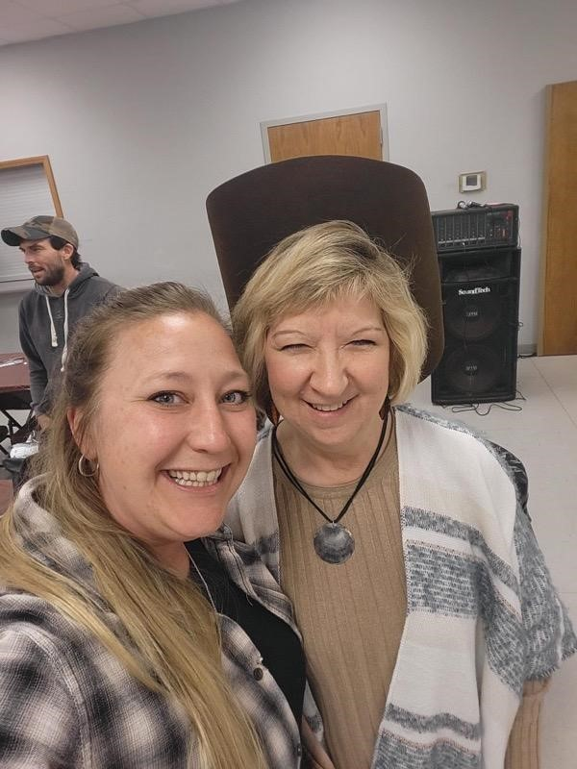
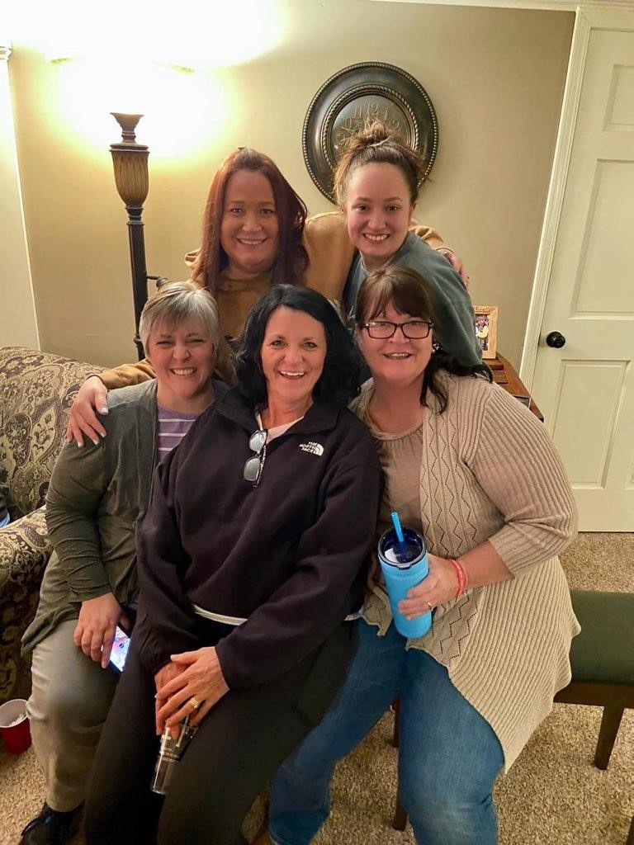

Slide 45
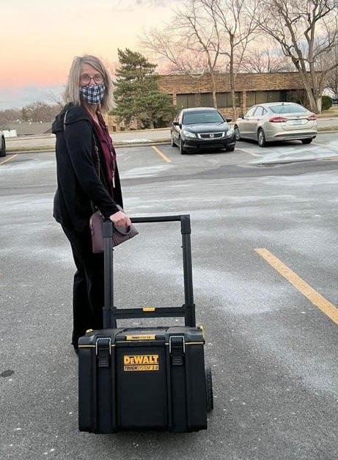
Identify the Top Five Hospice Deficiencies in MO

Slide 46
Top Five Hospice Deficiencies (Missouri)
L530 - Drug Profile
L543 - Plan of Care
L545 - Content of the Plan of Care
L591 - Nursing Services
L678 - Physician Orders

Slide 47
Drug Profile L530
Staff failed to check all medications the patient is taking on admission & compare with discharge orders from the hospital, inaccurate profile.
All over-the-counter (OTC) medications are not included on the medication profile (example OTC cough medications that interfered with blood pressure and blood sugars).
Staff failed to notify the physician of medication discrepancies for clarification orders, inaccurate profile.
Staff failed to physically compare medication bottles to the medication profile during visits in homes, and failed to compare MARs in LTC facilities, inaccurate profile.

Slide 48
Plan of Care L543 Top Reasons Why Deficient
Staff failed to provide discipline services at the frequency ordered on the POC. (example POC order for SN twice weekly, SN only visited once)
Staff failed to collaborate with the patient’s attending physician to ensure the individualized POC is accurate and includes all orders. (co-morbidities such as diabetes management , anticoagulant therapy are not addressed on POC)

Slide 49
Content of the Plan of Care L545
Staff failed to list goals and interventions on the POC related to the patient’s problems to individualize the POC. (example: patient has pressure area on coccyx and uses a low air loss mattress, this was not included on the POC)
Staff failed to list individualized interventions including education on the POC. (example: patient family needed education about med administration, no intervention on the POC for the education)

Slide 50
Nursing Services (Hospice) L591
Staff failed to notify the patient’s physician with changes in patient’s condition. (Example: Patient had no anxiety or shortness of breath previously, new onset of these symptoms were not reported to the physician)
Staff failed to follow the providers policies (Example: failed to measure wounds and document them in the patient’s record according to agency policy)

Slide 51
Physician Orders (Clinical Records) L678
Staff failed to write an order after receiving a verbal order from a physician (Example: medication changes, treatment changes.)
Hospice failed to follow agency policy in getting physician orders signed or entered into the EMR in a timely manner.

Slide 52
Preliminary Findings Review
(Agency may provide additional info before exit)

Slide 53
Exit Conference

Slide 54
PLAN OF CORRECTION
The Statement of Deficiencies is due by email to the agency from BHCRS within 10 working days
The agency's Plan of Correction (POC) is due by email to BHCRS within 10 calendar days
POC Guidelines:
Address each deficiency (tag) and identify title of the staff member responsible.
Develop corrective actions that address the root cause of the deficient practice. Actions should be specific and realistic, stating exactly how the deficiency will be corrected.
Include monitoring actions to ensure ongoing compliance.
Use the same completion dates for all the deficiencies.
Administrator Name: Date: Time:

Slide 55
PLAN OF CORRECTION Cont.
For standard-level survey, the completion date must be within 60 days from exit.
For condition-level survey, the completion date must be within 45 days from exit.
Do not include any patient or employee identifiable information in the POC.
Do not attach forms, policies or other documents with the POC.
Make sure the POC shows the title of the person responsible for implementation.
Sign and date the first pages of the federal and state SODs.
You will receive a survey monkey link to provide feedback on the survey.
We routinely conduct on-site revisit surveys for condition level surveys.

Slide 56
Immediate Jeopardy (IJ)

Slide 57
Immediate Jeopardy (IJ)
A situation in which an agency’s non-compliance with a Condition of Participation (CoP) has placed the health & safety of patients at risk for serious harm, serious injury, serious impairment or death
It represents the most severe and egregious threat to the health and safety of the patient
It carries the most serious sanctions for the providers

Slide 58
Key Components of an IJ
Non-Compliance: An entity has failed to meet one or more federal health, safety, and/or quality regulations.
And
Serious Adverse Outcome or Likely Serious Adverse Outcome: As a result of the identified non-compliance, serious injury, serious harm, serious impairment or death has occurred, is occurring or is likely to occur.
And
3. Need for Immediate Action: The non-compliance creates a need for immediate corrective action by the provider to prevent serious injury, harm, impairment or death from occurring or reoccurring.

Slide 59
If the survey team Identifies an IJ at your agency
Template – An IJ template will be provided to the administrator describing the IJ. At this point CMS has already had input about the IJ determination.
Removal Plan - You will develop a removal plan that has to be accepted and initiated within 48 hours of the template being provided. This plan is sent to the lead state surveyor and reviewed by the state and CMS.
Follow-up – If the removal plan is accepted then the surveyors will be back before 45th day to revisit all the condition level tags found on the survey. If the removal plan is not accepted, the team will be back ~23 days.

Slide 60
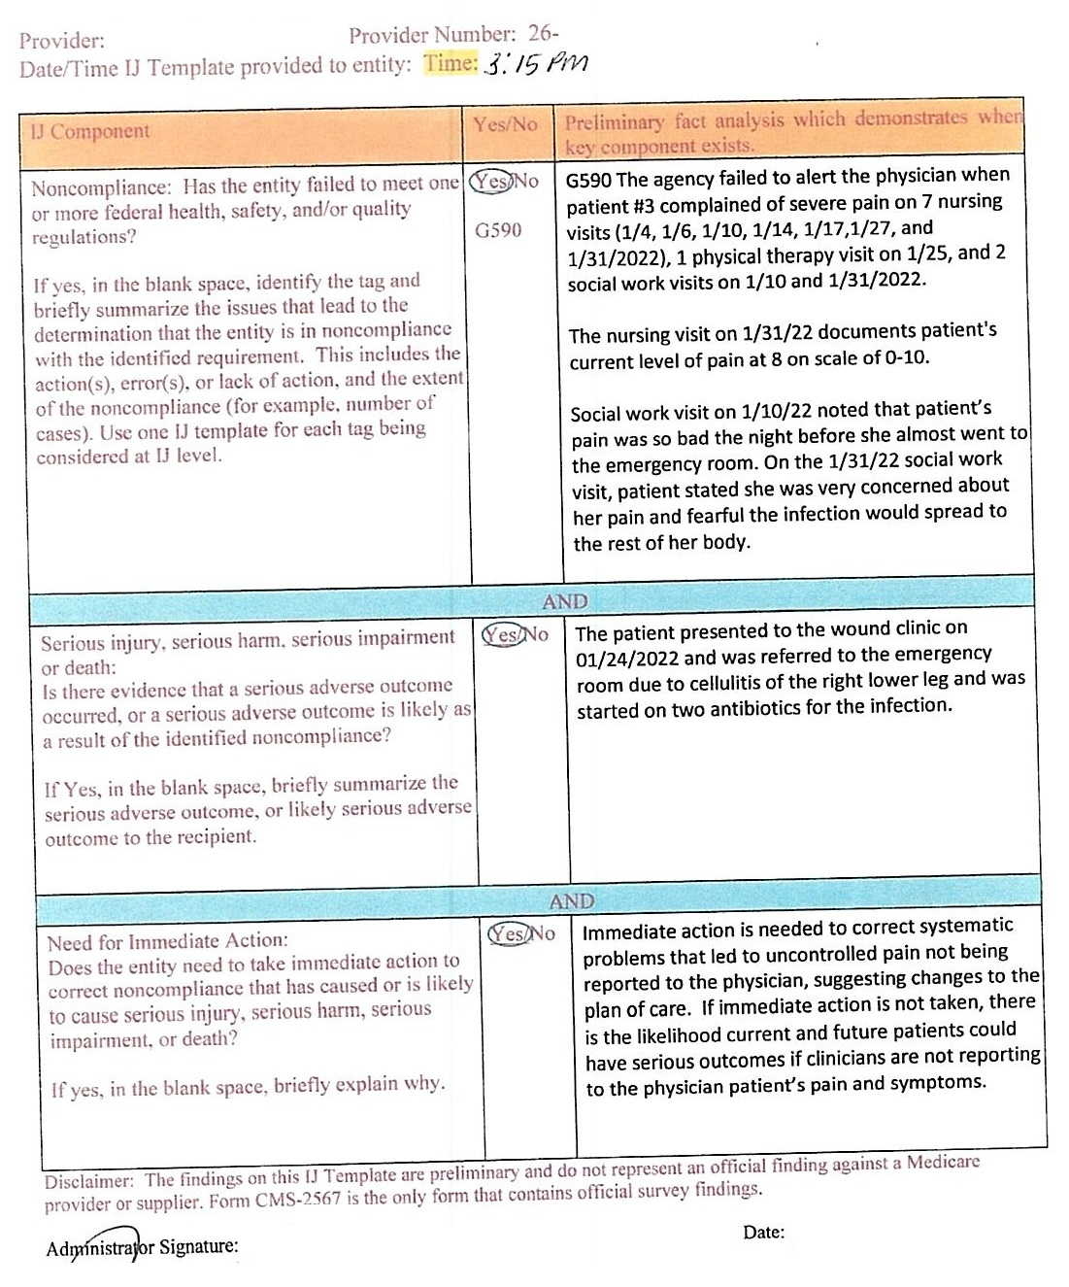

Slide 61
Key Points in Appendix Q (IJ)
An agency may state that they properly train and supervise staff and that it was a (Rogue) employee that violated the regulation; however an agency cannot disown the acts of its employees and disassociate itself from the consequences of their actions to avoid a finding of non-compliance.
Surveyor accepting the written removal plan does not mean the IJ did not occur.
If the removal plan cannot be accepted and implemented prior to the exit conference, the IJ continues until an onsite revisit is completed.

Slide 62
BUREAU STATISTICS

Slide 77
Rita Craighead: Next up to talk about OASIS

Slide 79
www.health.mo.gov/safety/homecare
Thank You
(573) 751-6336
Option #3

