Slide 1
Epidemiology of Candida Auris
George Turabelidze MD, PhD
State Epidemiologist
Missouri DHSS
December 20, 2023

Slide 2
Overview
First identified in Japan in 2009 from ear drainage, although subsequently determined it was unknowingly isolated in 1996 from patient’s blood culture in South Korea
First US cases in May 2013 and August 2016 among 7 patients from IL, MD, NJ, NY
WGS identified 4 major clades based on location first isolates were found: South Asian (Clade I), East Asian (Clade II), South African (Clade III), South American (Clade IV)
Exact origin of C. auris and why this organism appeared in different parts of the world almost simultaneously still remains unknown
C. auris is first and only fungal pathogen categorized as urgent health threat by CDC

Slide 3
Overview
Because C. auris requires compromised host immune system, comorbidities such as immunosuppression, advanced age, recent surgery, diabetes, indwelling medical devices, or use of broad-spectrum antibiotics/antifungals are major drivers of infection
C. auris has multiple virulence factors (proteinase, phospholipase) enabling organism to cause invasive disease
C. auris can form biofilms which enhance its ability to inhabit human skin and act as barrier to antifungal treatment. Biofilms form in the hospital environment and on implanted medical devices and withstand desiccation and desinfectants.
Genetic and molecular mechanisms of C. auris resistance to major classes of antifungal drugs (azoles, echinocandins, polyenes) remain incompletely understood
Notes:
C. auris produces biofilms, surface-adherent communities that resist antifungals and withstand desiccation. These biofilms form when C. auris is growing on skin or in conditions expected in the hospital environment and on implanted medical devices.

Slide 4
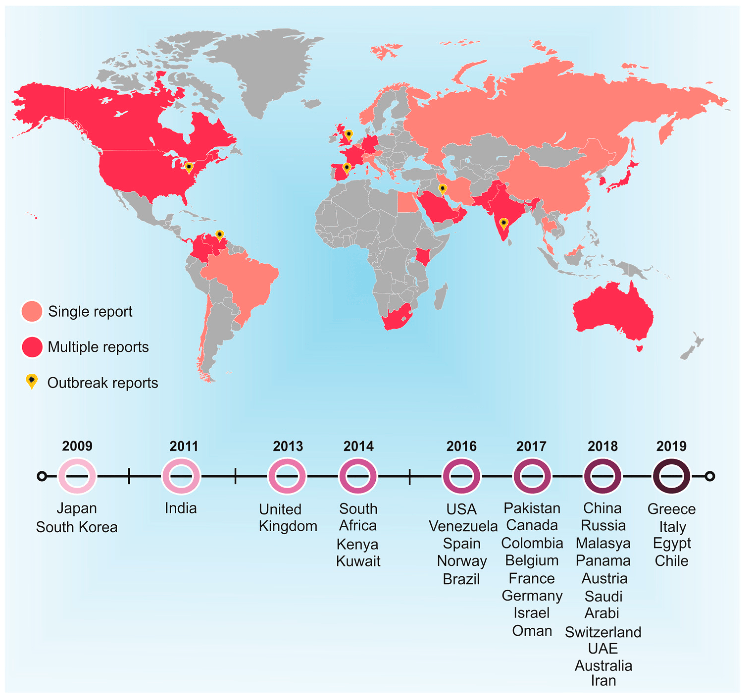
Global distribution of Candida auris between 2009 and 2019
J. Fungi 2020, 6(3), 185; https://doi.org/10.3390/jof6030185

Slide 5
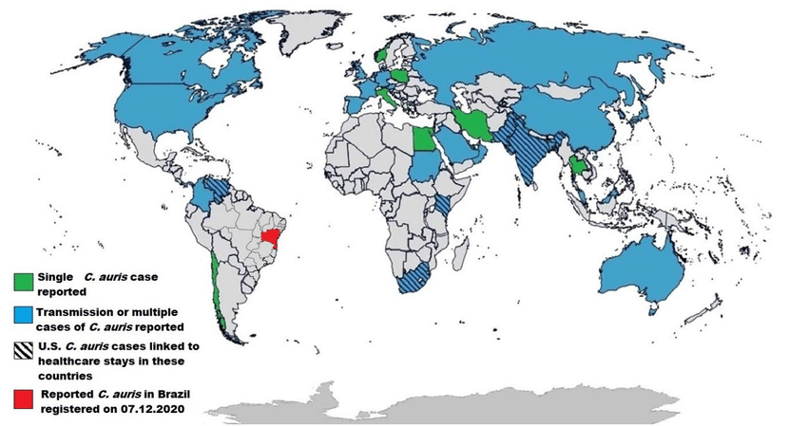
Source publication: Diniz Pereira Leite et al, 2020

Slide 6
“Worsening Spread of Candida auris in the United States, 2019 to 2021” Lyman et al, An Int Med, 2023
3270 clinical cases and 7413 screening cases of C. auris reported in U.S. through 31 December 2021
Clinical cases grew each year, from 44% increase in 2019 to 95% increase in 2021
Colonization screening volume and screening cases increased in 2021 by more than 80% and more than 200%, respectively
From 2019 to 2021, 17 states identified their first C. auris case
Number of C. auris cases resistant to echinocandins in 2021 was about 3 times that in each of the previous 2 years.

Slide 7
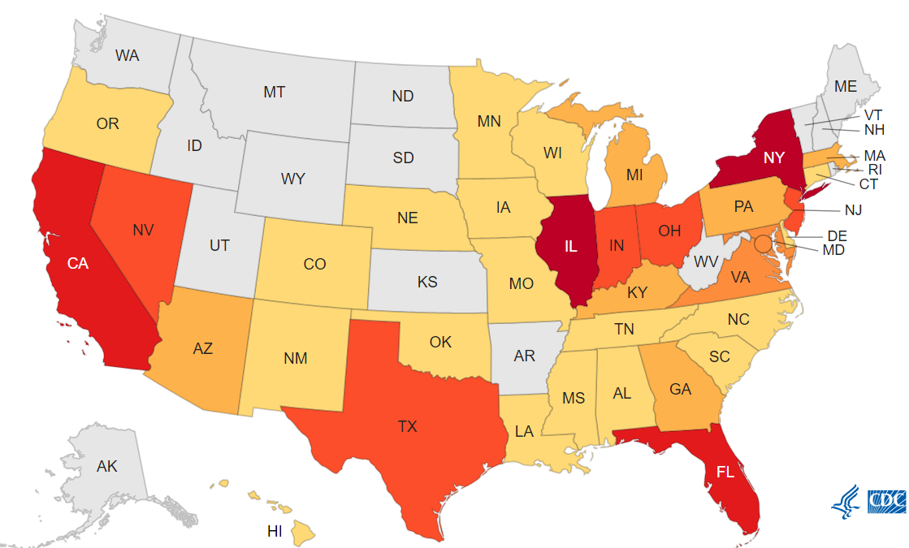
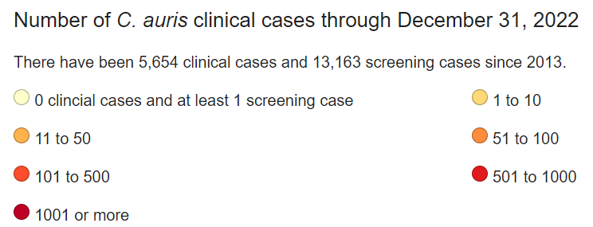

Slide 8
Epidemiology
Review of 4733 cases from 33 countries found that overall mortality associated with C. auris was 39%, and 45% with C. auris fungemia. Chen J et al, 2020
Case control study of residents in NY SNFs identified risk factors for colonization: mechanical ventilation, receipt of carbapenem antibiotics preceding 90 d, having ≥1 acute care hospital visit 6 months prior, and receipt of systemic fluconazole in prior 90 d. Southwick K et al, 2018
They estimated that ~5%–10% of colonized patients will eventually develop invasive disease.
In Chicago, IL study majority of patients with C. auris colonization or infection had serious medical conditions requiring hands-on care and indwelling medical devices (IV devices, feeding tubes, tracheostomies), and resided in long-term acute care hospital or ventilator capable SNFs prior 3 months. Pacilli M et al, 2020
Notes:
Robust antimicrobial stewardship programs at skilled nursing facilities or long-term care facilities are currently needed to optimize antibacterial and antifungal usage in a concerted effort toward C. auris prevention.

Slide 9
Transmission
Contamination of the healthcare environment with C. auris is likely a major driver of transmission to patients/residents
In Chicago SNF, frequent contamination of the environment was found: 70/100 positive environmental samples from doorknobs, windowsills, and bed handrails. Sexton DJ, 2021
C. auris contamination was common in rooms of colonized residents (29%–38%). After room disinfection, recontamination of room surfaces occurred quickly (within 4–12h) and was associated with the number of patient body sites colonized with C. auris. Sansom S et al, 2022
Colonization in humans is seen in axilla, groin, nares and rectum.
Shared medical equipment may be important vectors of transmission

Slide 10
Transmission
For every known resident identified through clinical culture testing, there could be several more unknown C. auris-colonized residents.
Recent outbreaks in healthcare facilities linked to persons colonized with C. auris who remained asymptomatic or contaminated reusable equipment (temperature probes).
In Chicago SNF, point prevalence survey of ventilator unit after one resident was identified as C. auris colonized found an additional 28 residents positive for C. auris. Pacilli M et al, 2021
There is no consensus on decolonization protocol at this time.
In general, C. auris is not a threat to healthy people. Healthy people without risk factors, including HCWs and family members, have a low risk for getting infected with C. auris.
Notes:
Screening typically occurs via a composite swab from bilateral axillae and groin sites and may be targeted at skilled nursing facility residents at time of admission or as a part of an outbreak response (e.g., testing close contacts or testing an entire ward or facility)

Slide 11
Clinical symptoms
There is no distinctive feature of C. auris infection: clinical signs can vary based on the affected organ system(s) and/or device(s).
Bloodstream infections, otomastoiditis, skin and wound infections, device and catheter infections, UTIs, and CNS infections.
Symptomatic disease can manifest with or without constitutional symptoms.
Both recurrent and persistent C. auris bloodstream infections have been documented.

Slide 12
Diagnosis
Use of traditional phenotypic methods for yeast identification can lead to misidentification of C. auris. (VITEK-2 YST, API 20C, BD Phoenix yeast identification system, and Microscan)
C. auris may be mistakenly identified as other yeast species including other Candida species, Saccharomyces, and Rhodotorula (5/7 initial US cases identified as C. haemulonii)
MALDI-TOF (matrix-assisted laser desorption/ionization time of flight) and real time PCR have sensitivities and specificities nearly 100% for C. auris
Differential and selective growth media can be used in resource-limited settings before sending specimen to reference laboratory for confirmation
Notes:
Differential media, which include CHROMagar Candida Plus and CandiSelect, allow for the growth of multiple fungal species with distinctive colony coloration. C. auris grows as white to cream colonies on CHROMagar Candida Plus supplemented with Pal’s medium.69 Selective media, such as Selective Auris Medium, are able to preferentially grow C. auris over other Candida species, with sensitivities and specificities reported to be 100%

Slide 13
Treatment
CDC does not recommend treatment of C. auris identified from noninvasive sites (respiratory tract, urine, skin colonization) when there is no evidence of infection
Treatment is generally only indicated if clinical disease is present
Invasive infections can develop at any point after patients become colonized
Echinocandins (micafungin, caspofungin, or anidulafungin) are empiric treatment of choice for invasive C. auris infections
C. auris appears to develop resistance quickly. In U.S., 85% of C. auris isolates resistant to azoles, 33% to amphotericin B, and 1% to echinocandins
Evaluating appropriateness of antibiotics, especially antifungals, and discontinuing them when not needed may help prevent C. auris colonization and infection.
Notes:
Data are lacking about the most appropriate therapy for pan-resistant strains. Combination antifungal treatment yielded promising results in laboratory testing but has not been evaluated in clinical settings. Investigational drugs have been tried against C. auris and may be considered for patients with echinocandin-resistant isolates.

Slide 14
Cleaning and Disinfection
Environmental control is challenging
C. auris can survive at least one week on dry steel and 2 weeks on plastic surfaces
Study in 4 LTCFs and one acute care demonstrated recolonization of C. auris within 4h of cleaning on the over bed table, handrail of the bed, and remote control. C. auris contamination of surfaces outside of resident rooms was much less common. Sansom SE et al, 2022
Many routine healthcare environmental disinfectants, such as quaternary ammonia, etc. are NOT active against C. auris; some products with C. albicans or fungicidal claims may not be effective
Negative environmental sampling for C. auris does NOT confirm absence of this organism and is not recommended by CDC other than specific scenarios in which it could be useful, e.g investigation of an outbreak.
Notes:
Alcohol and chlorine-based disinfectants are effective in clearing C. auris provided the recommended duration of contact is allowed.Products with activity against C. auris are registered with the United States Environmental Protection Agency (EPA) (‘List P’; see Table 1).58 This list should be consulted when establishing local guidelines on selection of antimicrobial products and applying the product for the correct contact time. Infection control recommendations for residents in shared rooms include maintaining a minimum of three feet of separation, use of privacy curtains and high-quality environmental cleaning.

Slide 15
