Slide 1
Winter Fall
Prevention
Videos, Images, and Articles

Slide 2
Videos
3:23 video from Mayo Clinic: “Safety Tips for Walking in Icy Conditions”
2:51 video from SFM: “Avoid winter slips and falls: Icy parking lot safety”
1:17 video from SFM: “The Safety Adventures of Skip: Prevention winter slips and falls”

Slide 4
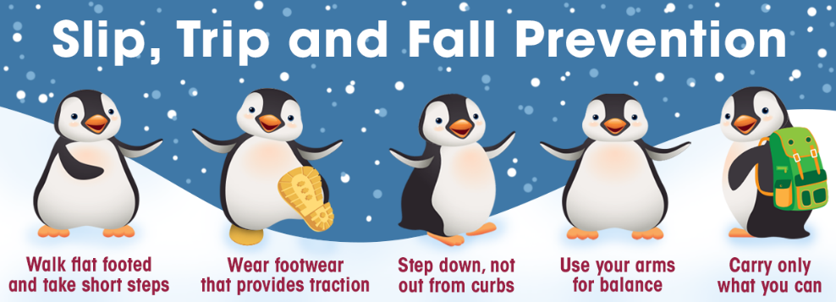

Slide 5
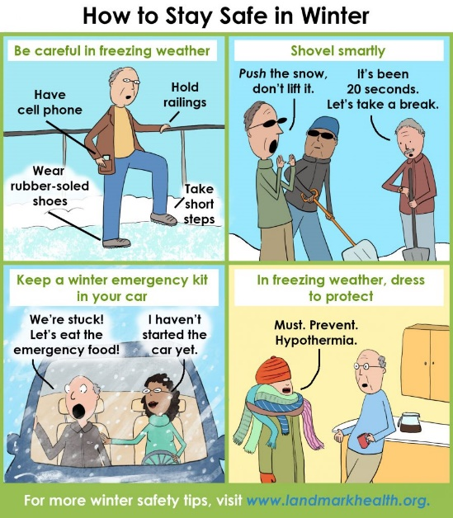

Slide 6
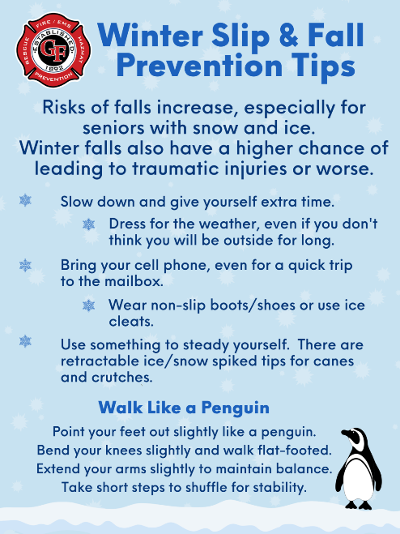

Slide 7
Articles
“How to Avoid Winter Slips and Falls” The Mayo Clinic
“Winterize to Prevent Falls” NCOA
“Tips to Prevent Falls During Winter Months” Bone Health & Osteoporosis Foundation
“Winter Safety: Slips, Trips, and Falls Prevention” University of Wisconsin Eau Claire

