Slide 1
Show Me Falls Free Missouri Coalition
July 11th, 2023

Slide 5
What is Physical Therapy and how does it relate to fall prevention?
Dr. Evan Prost, PT, CEEAA, DPT
Associate Teaching Professor, University of Missouri, Columbia

Slide 6
When might an older adult need physical therapy-how do they access PT services?
Teresa Graff, PT
Director of Therapy Services, Mizzou Therapy Services

Slide 7
Regional Falls Panel
What should someone working with any older adult in the community-based setting know about physical therapy to help older adults be successful?
Karl Schafer PT, CAPS

Slide 8
Agenda
Introduction
Different Levels of Physical Therapy Care
Accessing Programs
Community Collaboration

Slide 9
Introduction
About Me
Home Health Physical Therapist with North Kansas City Hospital since 2003
Direct patient care over last 35 years in acute care, skilled nursing level of care, in patient rehab and ou patient PT settings
CAPS certified and LSVT Big certified
Evolution of Physical Therapy Entrance Level Education:
Evolved from Bachelors Level to Masters Level to Doctor in Physical Therapy over the last 35 years
Additional specializations in orthopedics, neurology, geriatrics among others through APTA
Other certifications in: vestibular rehab, CEEAA CAPS among others

Slide 10
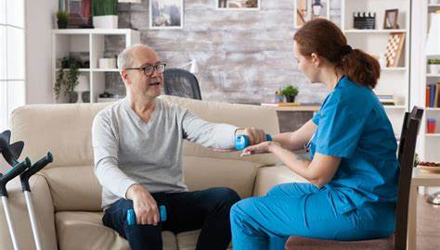
Different Levels of Care
Accessing Physical therapy
This Photo by Unknown Author is licensed under CC BY

Slide 11
Where to access Physical Therapy
Different levels of care where patients can access physical therapy
In patient acute care hospital stay
In-patient rehabilitation units: 3 hours of therapy of day from all therapies
Skilled nursing level of care: assessment determines how often they receive therapy
Home health – homebound requirement involved
Out-patient therapy
½ day and day long rehab programs (eg St Luke’s and Ability KC in Kansas City metro area)

Slide 12
Reason to Recommend Physical Therapy
Recommendation to physical therapy may be because of the following:
pain related issues
loss over overall mobility
loss of motion at specific joints (ankle, knee, hip, spine)
balance deficits; dizziness/vertigo – PTs specializing in vestibular rehab
FALLS!
Physical-Therapy-For-Seniors1.jpg (635×900) (asccare.com)

Slide 13
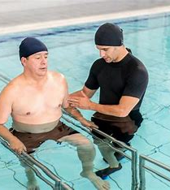
Specialized Community Based Therapy Programs
Some specialized programs that are community based or provided with therapists with advanced training/certifications:
Parkinson’s Disease clients –
Rock Steady (boxing program)
LSVT/Big and Loud program
Water based programs in the community - or some therapy sites offer water/pool therapy
Aquatic Therapy: A Safe Way to Exercise and Ease Back Pain - Atlanta Brain and Spine Care

Slide 14
Other Community Based Programs
Matter of Balance courses
Tai Chi, Yoga – traditional or chair level yoga
CAPABLE program in Platte and Clay counties
Programs that are offered outside of Physical Therapy clinics.

Slide 15
How is current work tied to fall prevention efforts? Currently collaborating with any community falls prevention programs?
Its about all I do; every day …. And yes! Collaborating constantly!!!
Collaborate with many entities within our Senior Falls Prevention coalition:
Platte County and Clay County Senior Services
Rebuilding Together KC
The Whole Person
Mid America Regional Council
local private duty caregiver agencies
DME – stair lift companies

Slide 16
Home Health On Admission
Room by room safety assessment
Complete review of medications including which may have side effects that put patient at risk of falls
Review of fall history (how many in the last year or 3 months; location of falls; mechanism of falls)
Current DME being used/condition/appropriateness – need for other DME – teaching of proper use of DME
How they exit the home; do they use more than one level of the home; is home health appropriate level of care

Slide 17
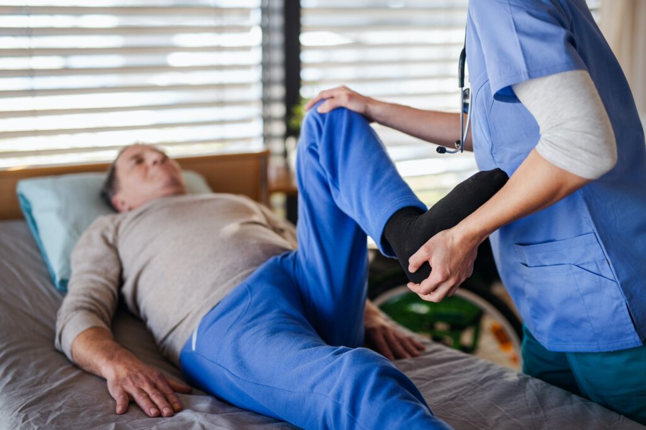
Home Health Follow up Visits
Ask about falls each visit
Ask about any medication changes with eye towards possible fall risk or risk for re-hospitalization
See if they followed up on safety recommendations
Constantly assessing if other agencies or home health disciplines needs to be pulled in to case

Slide 18
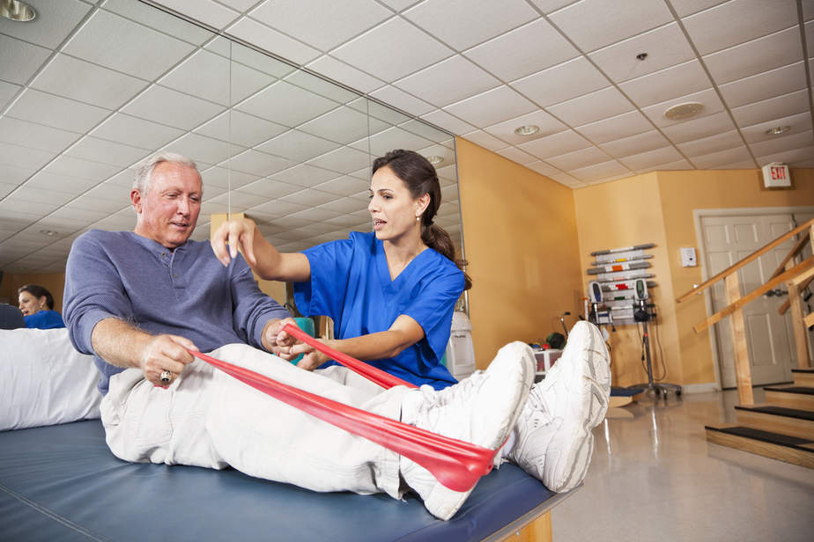
Discharge from Home Health
Referrals
Outpatient therapies
Community Based Programs
CAPABLE
DME follow up referrals
https://santecares.com/wp-content/uploads/2017/11/iStock-639858168.jpg

Slide 19
Thank you
Karl Schafer
Karl.Schafer@NKCH.org

Slide 20
What barriers have you seen to accessing physical therapy? Has telehealth provided any assistance?
Nancy Lock, PT
Director of Rehab Services Carroll County Memorial Hospital

Slide 21
Contact Information
SMFFMO
Email:
preventmofalls@gmail.com
website:
https://health.mo.gov/seniors/showmefallsfreemissouri/
Panelist
Evan Prost: proste@missouri.edu
Teresa Graff: grafft@health.missouri.edu
Karl Schafer: karl.Schafer@nkch.org
Nancy Lock: nancyl@ccmhospital.org

