Slide 1
Vision Screening Guidelines for the School Nurse
August 2014

Slide 2
Objectives
Discuss the purpose and evaluation of any
screening program
State the purpose of vision screening in the school
Identify the recommended vision screening procedures and equipment
Explain the importance of follow up and tracking of vision referrals

Slide 3
Purpose of A Screening Program
To identify or detect….
Commonly occurring diseases/entities/health problems or conditions in order to facilitate…
Early intervention that will be…
Significantly beneficial to the client…
Proctor, 2005

Slide 4
Characteristics of Screening Programs
Brief or limited evaluation of a group of individuals presumed to be normal
Results must be communicated
Follow-up on referrals for those “at risk” key component of screening
Follow-up continued until problem is resolved

Slide 5
Referral Process
Parents
Notify by phone/visit any student who meets the referral criteria following the screening and the rescreening
Parental understanding
Elicit need for additional resources/assistance
Provide information on community resources

Slide 6
Referral Results
Follow with written referral communicating results of the screening
– Request written report with results/recommendations
Contact parent periodically and provide assistance as needed
Track referrals made
Notify classroom teacher

Slide 7
Evaluation of Screening Program
To determine the effectiveness of any screening program, careful evaluation of the planning, implementation, referral process, and referral outcomes must be completed with each screening.

Slide 8
Evaluation
Evaluate in terms of:
Validity—ability to identify those who have condition
Reliability—consistency of results
Yield—number of persons identified
Cost—personnel and equipment
Acceptance—informed parents agree to value
Follow up—communicating results to parents who respond with appropriate actions to get necessary diagnosis and treatment if indicated

Slide 9
Vision Screening Guidelines

Slide 10
Purpose and Objective of A Vision
Screening Program
Ability to see impacts on student’s ability to learn
Estimated 80% of learning occurs through visual senses
Influences student’s performance and adjustment in school, society, as well as overall health and behavior

Slide 11
Purpose and Objective of A Vision
Screening Program
Identify children with possible visual defects at earliest possible stage allowing time to refer for diagnosis and treatment
Earlier identification results in improved outcomes

Slide 12
Screening Program Schedule
Grade | Screen | Type of Screening
All students new to district | Recommended | Age Appropriate
K | Recommended | Near & Distance Acuity, Random Dot E
₁st | Recommended | Near & Distance Acuity, Random Dot E
₂nd | Recommended | Near & Distance Acuity, Random Dot E
₃rd | Recommended | Near & Distance Acuity, Random Dot E
Every other year after 3rd grade | Recommended as time permits | Near & Distance Acuity

Slide 13
Visual Acuity
Visual acuity refers to the sharpness of one’s eyesight. Acuity is reported in a fraction.
Numerator – distance from the subject to the chart
Denominator – size of the symbol the person can see at 20 feet
Example – 20/40, at 20 feet the eye sees at a 20 foot distance what a normal eye sees at 40 feet

Slide 14
Childhood Vision Disorders
Condition | Negative Impact | Intervention
Myopia | Blurry distance vision Poor school performance | Glasses Contact Lenses
Hyperopia | Blurry near vision Eye strain Difficulty reading Poor school performance | Glasses Contact Lenses
Astigmatism | Blur at distance and near Eye strain | Glasses Contact Lenses

Slide 15
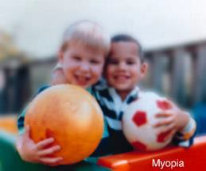
Myopia
The most common of the refractive errors. Formerly called “nearsightedness”. Unable to see clearly at distance.

Slide 16
Hyperopia
A refractive error in which the light rays from an incoming visual image have not converged by the time they reach the retina. Formerly called “farsightedness”. Near vision is blurry.

Slide 17
Strabismus
A manifest deviation of one or both eyes from the visual axis of the other so they are not simultaneously directed to the same object. Also referred to as heterotropia, or tropia.

Slide 18
Amblyopia
An ocular condition in an otherwise healthy eye, in which there is an abnormality of corticol response in the occipital lobe of the brain due to insufficient or inadequate stimulation of the fovea, neural pathway, and cortex that may result in unilateral vision loss if untreated.

Slide 19
Amblyopia
Good eye
Amblyopic eye

Slide 20
Distance Visual Acuity Screening
Purpose
Screen for clearness of vision when looking in the distance
Detect
Myopia (nearsightedness)
Amblyopia (weakness of sight, lazy eye)
Astigmatism (blurred vision)

Slide 21
Distance Visual Acuity Screening
Equipment
Distance chart for 10 or 20 feet (should include 20/25 line)
Choose according to student’s developmental level
HOTV, Snellen, Sloan, Tumbling E, LEA Symbol, Lighthouse
Occluder (e.g., paper cup, paper patch, palm of hand with tissue)
Antibacterial wipes

Slide 22
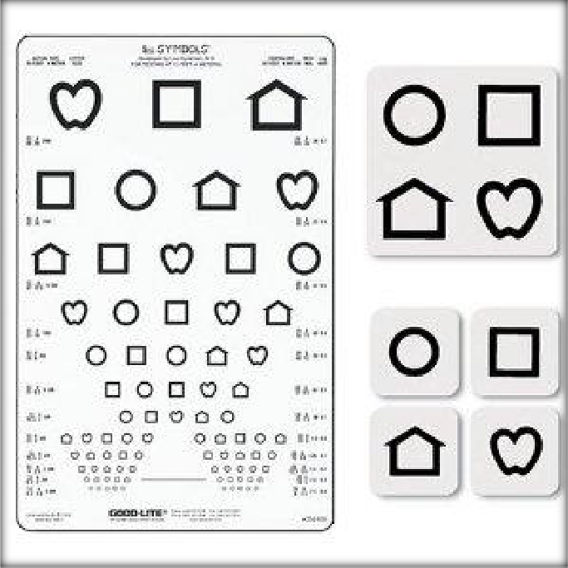
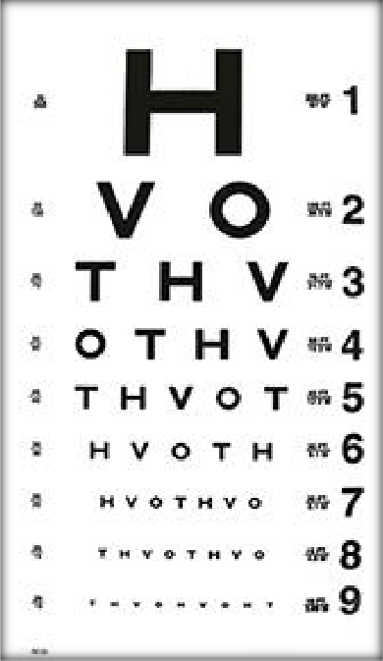
Examples of Vision Charts

Slide 23
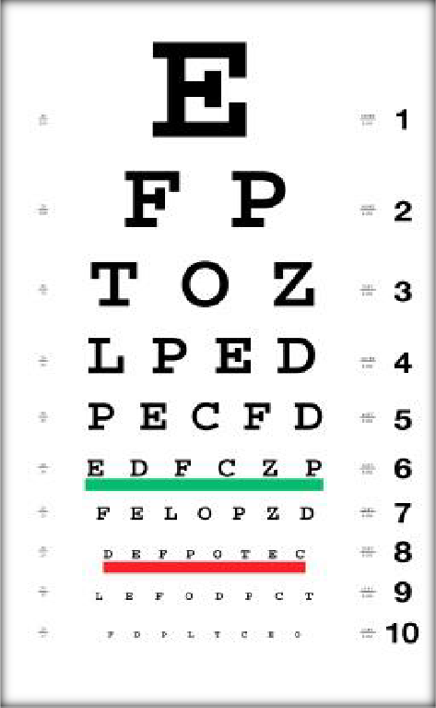
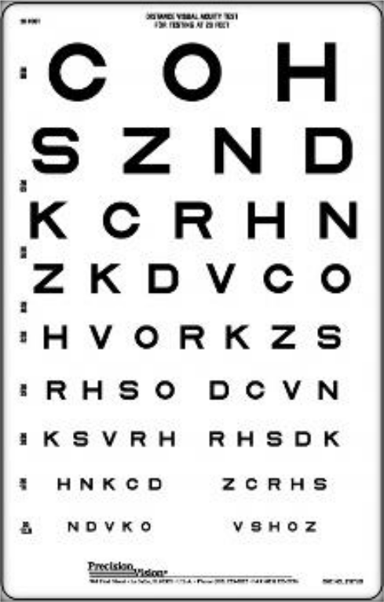

Slide 24
Distance Visual Acuity Screening
Location
Quiet with no distractions
Well lit and free from glare
Suggestions
Room 5 feet longer than distance for screening tool
Minimum of 8-10 feet between stations if multiple
stations

Slide 25
Distance Visual Acuity Screening
Setup
Chart at student’s eye level
May be seated or standing
Mark off a 10-20 feet distance with tape
Position heels or back legs of chair on tape
Eyes should be in direct line above tape

Slide 26
Distance Visual Acuity Screening
Procedure
Orient student to the screening
Demonstrate use of occluder
Ask if student wears glasses. If yes, screening should be
done with glasses on (be sure to mark the form)
Watch carefully that student is not peeking, tilting head, squinting or leaning head or torso forward
Begin by screening right eye with left eye occluded
Instruct to keep both eyes open and read the selected
letter or line of letters with the uncovered eye.
Begin at 20/50 line and move down to 20/20 line

Slide 27
Distance Visual Acuity Screening (cont.)
Procedure (cont.)
Move upward if student unable to read 20/50 line
Do not use marking device as pointer to avoid leaving distracting marks on chart
Student must identify or match one more than half of
the letters/symbols on a line
Record results including the line number for the last line read correctly with each eye
Repeat procedure for left eye
If student is unsuccessful, he or she should be rescreened within 14-21 days

Slide 28
Distance Visual Acuity Referral Criteria
A failed screening followed by a
failed rescreening should be referred for further evaluation
Grade | Criteria
Kindergarten | Each eye must see at least the 20/40 line.
1st – 12th grade | Each eye must see at least the 20/30 line.

Slide 29
Distance Visual Acuity Referral Criteria –
Important Exception
Refer if there is a two-line difference
One Eye | Other Eye | Results
20/20 | 20/20 | Pass
20/25 | 20/25 | Pass
20/30 | 20/30 | Pass
20/20 | 20/25 | Pass
20/20 | 20/30 | Refer – 2 line difference

Slide 30
Near Visual Acuity Screening
Purpose
Screen for near visual acuity
Detect excessive hyperopia (farsightedness)
Equipment
Near vision chart chosen according to student’s developmental level (should include 20/25 line)
Occluder (e.g., paper cup, paper patch, palm of
hand with tissue)
Antibacterial wipes

Slide 31
Near Visual Acuity Screening
Location
Quiet and no distractions
Well lit and free from glare
Suggest--minimum of 8-10” between stations if multiple stations

Slide 32
Near Visual Acuity Screening
Procedure
Orient student to the screening
Demonstrate use of occluder
Ask if student wears glasses. If yes, screening should be done with glasses on (be sure to mark the form)
Watch carefully that student is not peeking, tilting head, squinting or leaning head or torso forward

Slide 33
Near Visual Acuity Screening
Procedure (cont.)
Begin by screening right eye with left eye occluded
Instruct to keep both eyes open and read the selected
letter or line of letters with the uncovered eye.
Begin at 20/50 line and move down to 20/20 line
Ask the student to name or read the letter or symbols
on each line as directed.

Slide 34
Near Visual Acuity Screening
Procedure (cont.)
Move upward if student unable to read 20/50 line
Do not use marking device as pointer to avoid leaving distracting marks on chart
Student must identify or match one more than half of
the letters/symbols on a line

Slide 35
Near Visual Acuity
Procedure (cont.)
Record results including the line number for the last
line read correctly with each eye
Repeat procedure for left eye
If student is unsuccessful, he or she should be rescreened within 14-21 days

Slide 36
Near Visual Acuity Referral Criteria
A failed screening followed by a
failed rescreening should be referred for further evaluation
Grade | Criteria
Kindergarten | Each eye must see at least the 20/40 line.
1st – 12th grade | Each eye must see at least the 20/30 line.

Slide 37
Near Visual Acuity Referral Criteria – Important Exception
Refer if there is a two-line difference
One Eye | Other Eye | Results
20/20 | 20/20 | Pass
20/25 | 20/25 | Pass
20/30 | 20/30 | Pass
20/20 | 20/25 | Pass
20/20 | 20/30 | Refer – 2 line difference

Slide 38
Binocularity/Stereoscopic Vision Screening
What is Binocular Vision
Includes ocular alignment and stereo acuity
Screening determines how well eyes function together

Slide 39
Binocularity/Stereoscopic Vision Screening
Purpose of Screening
to determine if student has adequate binocularity
Equipment
Random Dot (RDE) Stereotest Kit
Antibacterial wipes

Slide 40
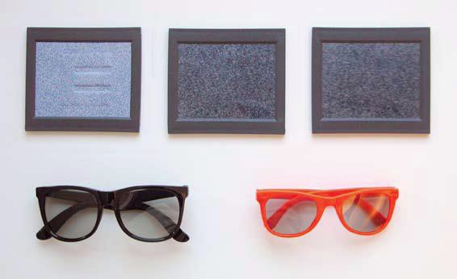
Random Dot E Kit Equipment

Slide 41
Random Dot E
Constructed of cardboard with a large raised, embossed “E”
Used only for training purposes as it is easy for the student to see
Model E Slide

Slide 42
Random Dot E
Presents an array of dots that appear to be randomly oriented.
When viewed through polarized glasses, an E appears in the test plate if the student has normal binocular vision.
Used for screening purposes only
Raised/Recessed E Slide

Slide 43
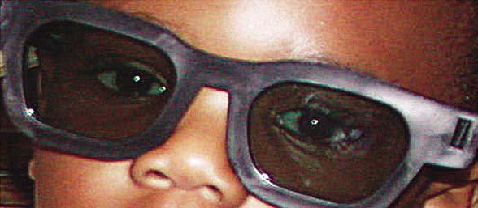
Random Dot E
With the glasses in place, children with good alignment and normal binocular vision will be able
to see the stereo “E” in 3-dimensions.

Slide 44
Random Dot E
Presents a random array of dots. No “E” appears even with the polarized glasses in place.
Used for training purposes
Stereo Blank Slide

Slide 45
Random Dot E
Is also used for screening purposes when paired with the Raised/Recessed E Slide
Stereo Blank Slide

Slide 46
Random Dot E
Location and Setup
Make sure that the test distance between the student and the cards is carefully measured at 40 inches.
Make sure that there is bright room lighting.

Slide 47
Random Dot E
Procedure
Have student put on stereo glasses.
If the student wears glasses, the stereo glasses
should be placed over the student’s own glasses. (Indicate on form)
Be sure the student keeps head straight when viewing slides

Slide 48
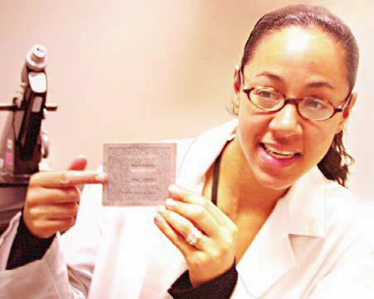
Random Dot E
Hold model E
demonstration plate
at a distance of a 40 inches in front of student.

Slide 49
Random Dot E
Point to the “E” and say to the student, “Tell me what you
see.”

Slide 50
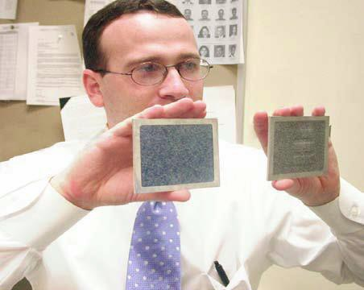
Random Dot E
Pick up the blank test plate and hold it next to the demonstration plate.
Ask the student to point to the plate with the
raised, embossed “E”.

Slide 51
Random Dot E
Shuffle the plates behind your back and repeat the procedure 4 more times, holding the plates side by side or above and below each other. Vary the position.

Slide 52
Random Dot E
Replace the Model E slide with the Raised/Recessed Stereo slide when you determine that the student understands the procedure
Repeat the procedure
Student passes the stereo screening if he/she correctly identifies the location of the stereo E on at least 4 of the 5 presentations.

Slide 53
Random Dot E
Be careful to hold the stereo test plate with the E upright. Tilting the top of the stereo test plate may be helpful.
It takes a few seconds to see the stereo “E”, --- encourage the student to “keep looking”.
You can tell the student that the “E” is hiding and that they need to look hard to find it.

Slide 54
Random Dot E
Do not let the student see the plates without the stereo glasses.
The student should be referred if he or she refuses to wear the glasses, even after watching another student being screened.

Slide 55
Random Dot E Screening Results
Let the parents know the results of the screening, include type of screening and date. The eye care professional wants to know the screening methods.

Slide 56
Re-Screening Guidelines
Indicated for any student failing any part of the initial screening (distance, near or binocularity)
Eliminates students who failed initial screening due to factors such as fatigue, illness, anxiety, misunderstanding or distractions

Slide 57
Re-Screening Guidelines
Should be done within 14-21 days after initial screening
Rescreening procedures are the same as initial screening procedure

Slide 58
Referral
Indicated if student fails any portion of the rescreening
Notify parent/guardian in person or by phone prior to sending written referral

Slide 59
Referral
Written referral should be sent to the parent/guardian within one week after the rescreening
Important to notify classroom teach if referral sent so that classroom accommodations can be implemented

Slide 60
Follow-Up and Tracking Guidelines
Most important component of any screening
Tracking system
Assures students referred receive appropriate
treatment/services
Follow-up with phone call if no information about the referral received after 3-4 weeks

Slide 61
Follow-Up and Tracking Guidelines
Continue to contact parent/guardian periodically until notified of disposition of referral
Important for nurse to be familiar with community
resources for those needing financial assistance
Document all aspects of process in health record

Slide 62
For additional information, resources, and sample forms, go to:
School Health Vision Screening Guidelines

