Slide 1
Supporting Students with Diabetes
The School Nurse Role
Katherine Park, MSN, RN, NCSN
kpark@parkwayschools.net

Slide 2
I, Katherine Park, disclose the absence of personal financial relationships with commercial interests relevant to this educational activity within the past 12 months.
The purpose of this presentation is to assist school nurses during the complex process of managing type 1 diabetes.
This will help support student learning by promoting safe and effective diabetes management for students at school.

Slide 3

My Background: Beginnings
Personal interest in diabetes
Experience working with students with type 1 diabetes (Pre-K through 12th grade) for past 18 years
Great diversity and complexity – hard to achieve a perfect plan of care with diabetes
Master’s degree focus
Current doctoral degree focus
Continually working to address this topic district-wide, with a focus on elementary-age students
Why is having a plan so important?

Slide 4


Diabetes management is 24/7 and does not go away while a child attends school
More than 15,000 youth under age 20 are newly diagnosed each year in the U.S. with type 1 diabetes
Poor diabetes control in youth is linked to increased health complications (kidney, neurological, etc.)

Slide 5




Outdated school policies, lack of school cooperation, lack of qualified nursing staff, and poorly trained school staff contribute to the daily difficulties youth encounter while trying to manage their diabetes care at school
Medical care providers don’t always address school-specific issues on orders

Slide 6

Results of not having a plan…
Dangerous hypoglycemic episodes at school
Poor parent confidence in school’s ability to manage care for their children with diabetes
Lack of consistency in care across health care and educational settings

Slide 7
School Nurse Responsibilities
Due to the clinical knowledge required, school nurses must take ultimate responsibility for implementing a program for diabetes management at school
Program should include meeting with parents; assessing student skills; educating staff; communicating with PCP; and utilization of outside resources/agencies
Promote a culture of diabetes education, awareness, and sensitivity within the school climate
Be knowledgeable about federal, state, and local laws and regulations that pertain to managing diabetes at school

Slide 8
School Nurse Should…
Inform building principal, set schedule for an immediate briefing of all building staff on signs/ symptoms of diabetes, if this has not been done recently
Organize in-depth, student-specific briefing for staff who will work directly with student
Meet with classroom teacher to discuss student’s needs
Bus drivers should be included in briefing, if student will be using transportation services

Slide 9

School Staff Responsibilities
Although school staff will likely not be responsible for performing daily diabetes care tasks, he or she should have a basic understanding of diabetes and should be able to make decisions based on that understanding:
What to do for blood sugar highs/lows
How diabetes can affect a student’s ability to learn
Why accommodations are needed for diabetes, such as access to drinking water, bathroom privileges, and unplanned snacks

Slide 10

Training Non-medical Staff:
An Overview

Slide 11

American Diabetes Association
Safe at School Campaign begun in 2006, supports training of non-medical staff and believes:
  All children with diabetes deserve to feel safe at school
  All school staff members should receive training that provides a basic understanding of diabetes
  A small group of school staff members should receive training in student-specific routine and emergency care

Slide 12
Steps for an Effective TDP Training Program
Gain approval/support for training program
Solicit volunteers (minimum 1-2 if full-time nurse; 3 or more if no full-time nurse)
Obtain training equipment
Conduct training of volunteers
Provide volunteers with informational binder/handouts/completion certificate
Document training
Provide information for buildings
Periodic review/skills practice/train new volunteers as needed

Slide 13
Gain Approval/Support for Training Program
Discussions with health services director/district superintendent
Meetings with representatives from the ADA
Surveys sent out to nurses/nurse assistants/sub nurses to assess for knowledge gaps and readiness for a training program within the district
Presentations to district nurses, school board

Slide 14
Solicit Volunteers
With proper supervision and training, and where state laws do not prohibit it, non-medical personnel can be trained as TDP
Trained diabetes personnel may include school staff secretaries, teachers, principals, health aides, licensed practical nurses, etc.
If a school has a nurse, the nurse will continue to take the lead in providing diabetes care (both routine and emergency)
Nurse should retain the right to deny training to anyone who does not willingly want to be trained

Slide 15

Obtain Training Equipment
ADA training modules (CD/DVD) should be obtained
It is recommended that trainers utilize hands-on equipment that correspond to the modules (i.e. glucagon trainers, syringes, glucose meters, etc.)
Practice supplies may be available through a variety of venues, including school districts, school health services departments, Missouri Department of Health and Senior Services, the American Diabetes Association, local area hospitals, pharmaceutical companies, and private donations

Slide 16
Conduct Training: Module Topics
Diabetes Basics
Diabetes Medical Management Plan
Hypoglycemia
Hyperglycemia
Blood Glucose Monitoring
Glucagon Administration
Insulin Basics
Insulin by Syringe and Vial
Insulin by Pen
Insulin by Pump
Ketones
Nutrition and Physical Activity
Legal Considerations

Slide 17
Recommended Training Guideline
Full-time school nurse available:
  It is recommended that 2-hour (at minimum) training sessions per building be done with up to four volunteer TDP at one time
  Training topics:
    Diabetes Basics; Glucagon; Insulin by Syringe/Vial; Hypoglycemia; Insulin by Pump; Blood Glucose Monitoring

Slide 18
Recommended Training Guideline
Full-time school nurse not available:
It is recommended that 3-4 hour (at minimum) training sessions per building be done with up to four volunteer TDP at one time
All 13 of the training modules and corresponding videos should be used

Slide 19

Provide Information to TDPs
Training binders containing copies of PowerPoint handouts should be distributed
Completion certificate and documentation of training
List of phone numbers of trainer and nurse(s) to call for guidance
Student-specific information
Protocols

Slide 20

Protocol: Check Blood Sugar
Allow and encourage free use of bathroom and extra fluids
Number is above target range (will be in doctor’s orders)
Record number here:_______
If number is above 300, call Diabetes Trainer for further instruction
RN called________________________
Time______________Date__________
Student feels “low” OR
routine time to check.
Insert strip in meter, confirm control number, help student obtain blood sample.
Number is within target range (will be in doctor’s orders)
Record number here:_______
No further action
Have student eat immediate juice or snack
Re-check blood sugar after 10-15 minutes
Number is below target range (will be doctor’s orders)
Record number here:_______
Call Diabetes Trainer
RN called______________________
Time_____________Date_________
Don't forget to record blood sugar number!
Have student resume class or send to lunch (if applicable) once number within target range

Slide 21
Document Training
Document, document, document! This is the number one most essential component to the delegation process
A staff training form should be completed and signed by the school nurse to document training

Slide 22
Provide Information for Buildings
Provide appropriate buildings that have TDP with a certificate to be prominently displayed in a visible place, recognizing those staff which have been trained in diabetes care tasks in that building.

Slide 23

Periodic Review/Skills Practice/Train New Volunteers
Nurse should work with district officials to determine an appropriate way to conduct on-going and annual training
Skills practice/Giving Diabetes Care weeks may be considered as an effective way to reinforce learned skills

Slide 24

In some situations, it may be beneficial to invite a diabetes educator or PCP to visit student’s school
In-person PCP visit may be necessary to train school nurse on intricate or cutting-edge pumps, equipment, or procedures

Slide 25
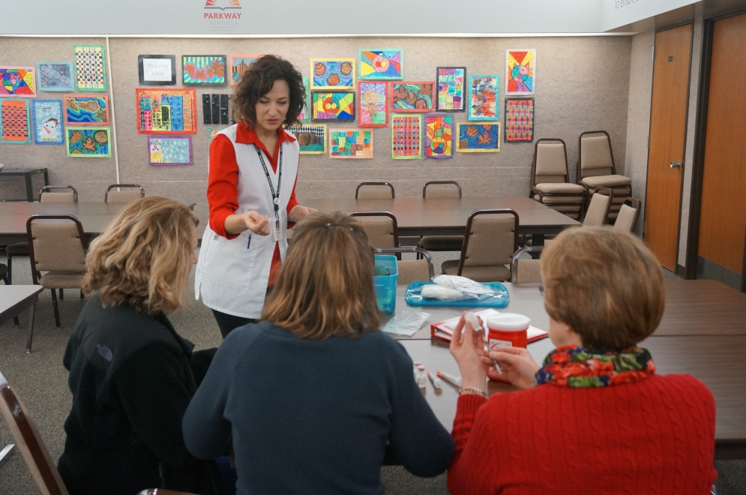
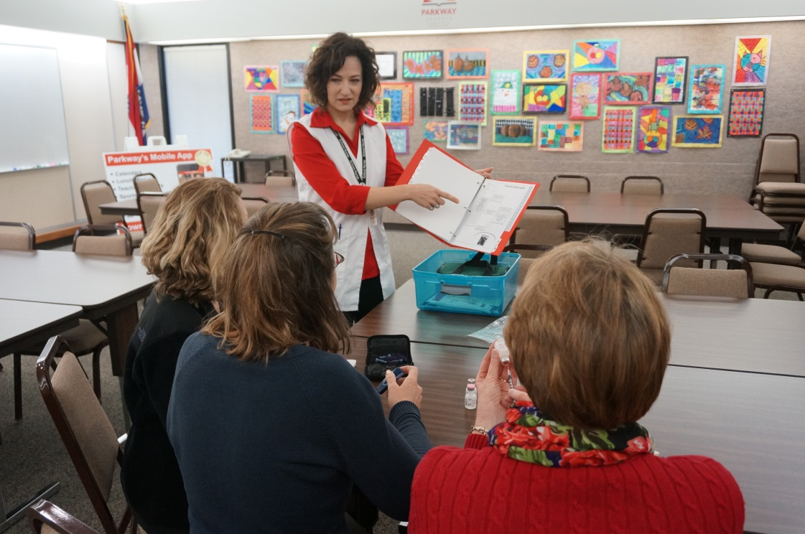
Training Non-Medical Staff

Slide 26
