Slide 1
Rural Immersion
Rural Scholars Program
Rural Health Day Summit
November 16, 2023
Bai Xiong, M.S Nutrition, MU-Extension Community Health Field Specialist, CHEO, Rural Scholars Program​
Notes:
DHSS, MAHEC, MU School of Medicine

Slide 2
Rural Immersion Team
Kathleen Quinn – Associate Dean for Rural Health
Jana Lee –Sr. Program Director for MU Rural Scholars Program
Bai Xiong- MU-Extension Field Specialist
Samantha Wells- Business Support
Dina Nichols- Business Support

Slide 3
Questions we will address
What is Rural Immersion?
Why do this?
What do we do?
Where do we do it?
What are the results?

Slide 4
What is Rural Immersion
The Rural Immersion Program is an interdisciplinary, non-clinical program that works to highlight the social and communal aspects of life as a rural healthcare provider.
The goal of the program is to give health professional students the opportunity to envision whether living and working in a rural community might be right for them. The program also gives students the opportunity to work with students from disciplines that are not their own.
Students will explore four areas within the community:
government and employment
agriculture/tourism/natural resources
arts/culture/education
healthcare and public safety
Notes:
Med School Mapper 42.7% of MU SOM graduates practicing in Missouri.

Slide 5
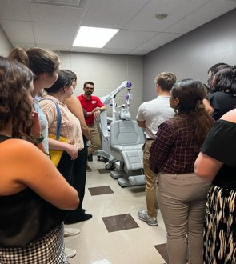
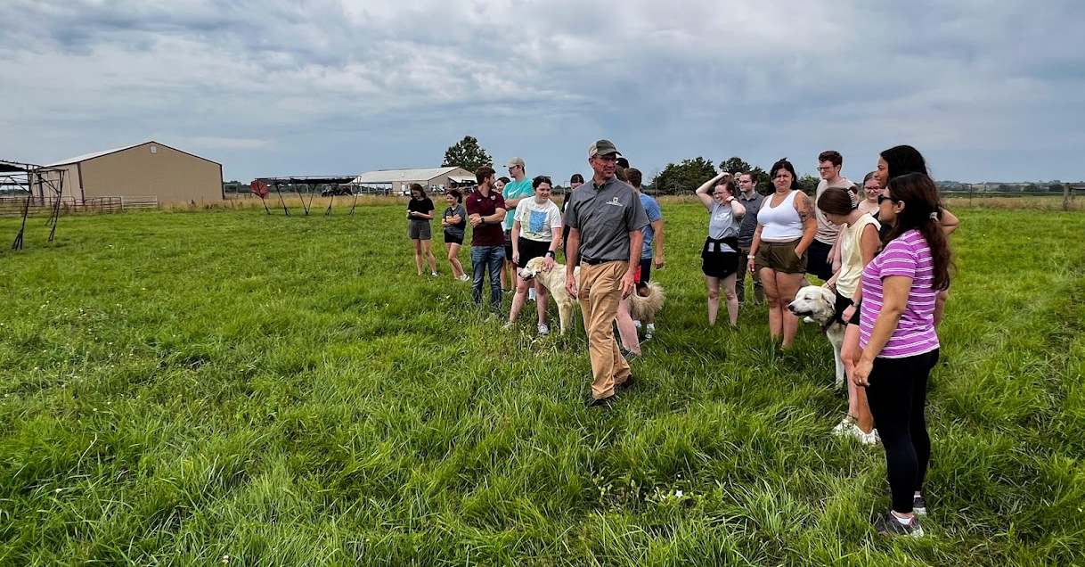
Why do we do this?
Our students have a stated interest in rural life and work
Provide insight to rural communities compared to rural backgrounds students come from.
Enable students to test their assumptions and put themselves in the place of a healthcare professional in a small town
Expose students to a different perspective on how healthcare and other aspects of community life interact

Slide 6
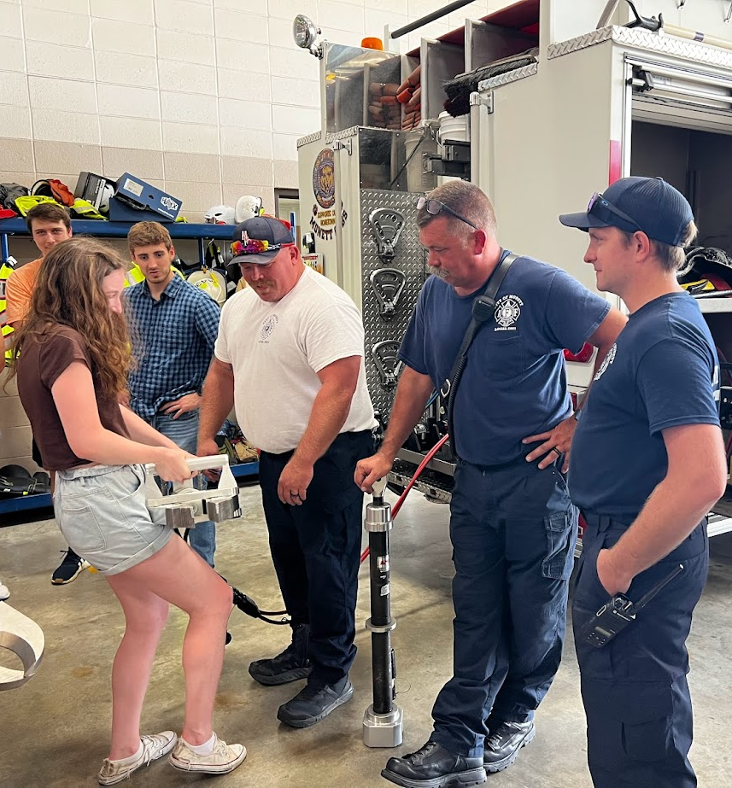
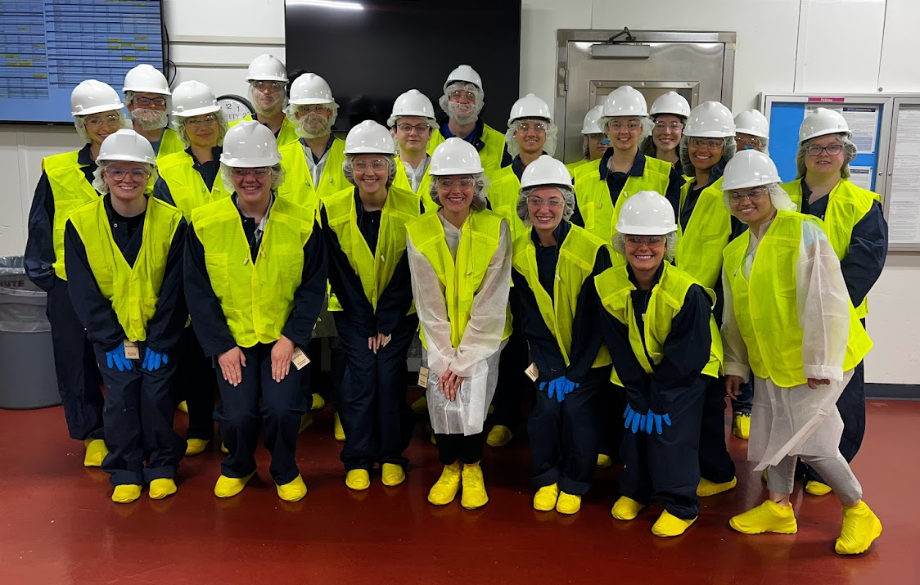
Learning Objectives
Learn about industries and organizations in a rural community
Build a network of colleagues from other health professions
Examine personal perspectives on living and working in a rural community
Identify experiences or information health profession students need to prepare for rural practice
Experience day-to-day activities in a rural town
Explore the non-clinical aspects of life as a healthcare professional

Slide 7
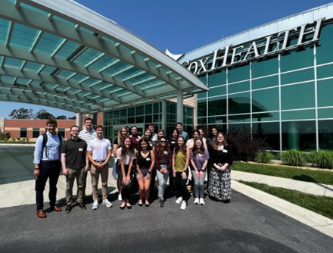
Participants
First and second year pharmacy students
Graduate and undergraduate (Jr./Sr.) public health students
Undergraduate (Jr./Sr.) health sciences students
Clinical undergraduate nursing students
First year medical students
Nursing, Physical Therapy, Dietetics Students
Notes:
Recruitment done by MAHEC: Missouri Area Health Education Centers

Slide 8
Program Schedule
June 25th: Students arrive
June 26th: Healthcare, Education and Culture
June 27th: Agriculture, Natural Resources, Tourism, and Art
June 28th: Business, Government, Public Safety, Self-exploration day
June 29th: Rural Immersion Presentation Day

Slide 9
Where do we do this?
2017
2018
2019
1. Chillicothe (pop. 9,668)
2. Hannibal (pop. 17,590)
3. Sedalia (pop. 21,568)
2021
4/5. West Plains* (pop. 12,248)
2022-2023
6/7. Monett (pop. 9035)
8. Union (pop. 12,458)
2024
*2020 program (year 4) canceled due to COVID-19.
*Sites are typically rural clinical training sites
Good local support and coordination!
119 mi
98 mi
68 mi
100 mi
Union
231 mi
192 mi

Slide 10
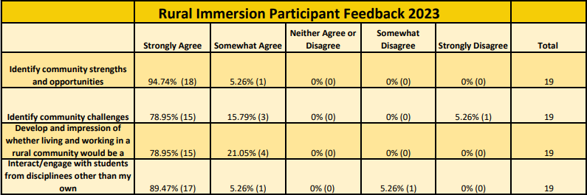
Student Feedback

Slide 11
Student Experiences
"Rural Immersion Program renewed my love and passion for rural communities. Compared to my roots on a small cattle farm in Northwest Missouri, this program allowed me to look at a rural community from a fresh perspective as a future healthcare professional in a small community. I am eager to serve a rural community in Missouri upon graduation in a few years!"

