Slide 1
6+++++
Mindy Ulstad, Chief
Bureau of Senior Programs
Notes:
Good afternoon, my name is Kristin Davis. I am a Senior Program Specialist with the Bureau of Senior Programs. Today I will be sharing information about Missouri’s Master Plan on Aging.
I want to be clear, that while it is called a Master Plan on Aging, we are focusing specifically on older adults, adults with disabilities, and caregivers. We just used the common name of Master Plan on Aging, which was used in the Governor’s proclamation.

Slide 2
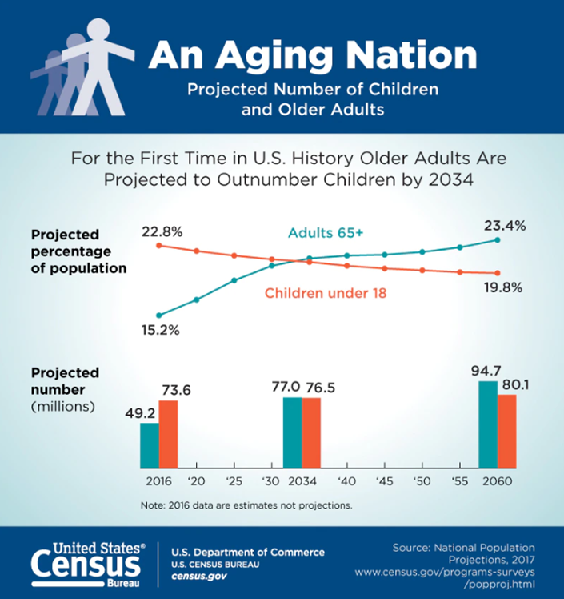
Background
Missouri seniors age 65+ make up 22.88% of the population
By 2034, Missouri seniors will make up more than 25% of Missouri’s population (for the first time there will be more older adults than individuals younger than 18 years of age).
This gap will continue to widen as the population continues to age with Missouri seniors predicted to greatly outnumber children by 2060.
Missouri’s Population is Aging
Notes:
Why have we decided to do this now? I’ll begin by offering some background information. The nation’s population is aging. Missouri’s population is aging. Currently, 22.8% of Missouri’s population is age 65+. By 2034 that percentage will jump to 25%. For the first time in history, those 65+ will represent a larger percentage of the population than those 18 and under. That gap will widen with the passage of time.

Slide 3
What is a Master Plan on Aging?
A Master Plan on Aging is a living document that:
Provides a clear framework to plan for ten years or more;
Enables governors to communicate a clear vision and priorities for their state;
Guides state and local policies of public and private programs toward aging with dignity;
Reflects extensive input from the community, including people of all ages and abilities; and
Allows the state to allocate funding or resources to implement initiatives from the Master Plan vs. reacting to individual stakeholder needs
Notes:
With the growing population of aging Missourians, how can we address their needs?
Hit the bullet points

Slide 4
Differences between the State Plan on Aging and a Master Plan on Aging
Metric | State Plan on Aging | Master Plan on Aging
Requirement | ACL Requires for Funding | Not Required
Timeframe | 4-Years (In effect October 1, 2023) | 10-Years
Roadmap For | Aging Network (SUA, AAAs and their Contractors) | All State Departments, State and Local Governments to work toward aging with dignity
Focus | Older American Act Funded Programs/Services Supportive Services (Access, In-home, legal) Nutrition (Congregate & Home-delivered meals) Disease Prevention Health Promotion Family Caregiver Services | All Relevant Social Determinants of Health Transportation Housing (Universal Design/Home Modification) Mental Health and Substance Abuse Aging with Developmental Disabilities Assistive Technology Healthcare Access Employment
Coordination/Input | Aging Network Providers (AAAs and their contractors) | All Providers of Programs and Services (all State Departments, State and Local Governments, All Contractors of these entities)
Notes:
You may be aware that Missouri has a state plan on aging and wonder what the difference is between the current state plan and a master plan.
Address the state plan and then the master plan

Slide 5
Executive Order 23-01
On January 19, 2023, Governor Parson signed EO 23-01 ordering the commencement of the Missourians Aging with Dignity Initiative. The order further required the following:
Executive agencies shall make their best efforts to ensure that all Missourians have access to services and supports they are eligible for in order to age safely and independently.
Each state agency shall use best efforts to ensure programming includes older Missourians and adults with disabilities when possible with the ultimate goal of ensuring older Missourians and adults with disabilities have a safe and healthy environment and avoid unnecessary institutionalization.
DHSS shall, with the assistance of the Advisory Council described below, develop a Master Plan on Aging that addresses the needs and health outcomes for older adults and individuals with disabilities.
The Department of Health and Senior Services shall finalize the Master Plan on Aging by December 31, 2025.
The Director of the DHSS shall designate stakeholders to be a part of the Advisory Council for the Master Plan on Aging. These stakeholders shall be diverse in nature, and represent a cross-section of interests including groups concerned with aging in place, supporting those with disabilities, local governments, healthcare providers, and health research institutions and associations. Stakeholders may help lead subgroups representing the needs identified in the statewide needs assessment.
The director or commissioner of each state agency shall designate, within 30 days of the request of the Director of the Department of Health and Senior Services, an employee or employees who will participate on the Advisory Council and provide data, information, and support for developing and implementing the Master Plan on Aging.
Notes:
How did Missouri’s Master Plan on Aging come to be? Read the top. Paraphrase the 6 items.

Slide 6
Executive Order 23-01
Through the executive order, DHSS was tasked with the following activities:
Reviewing and assessing the current state of aging services in Missouri;
Coordinating and completing at least ten listening sessions with key stakeholders in the Area Agency on Aging regions with at least two listening sessions available statewide;
Completing a statewide senior citizen and adults with disabilities needs assessment;
Establishing priorities for each state agency and communicating those priorities to key stakeholders; and
Developing the Master Plan on Aging.
Notes:
DHSS was specifically tasked with the following activities:

Slide 7
Components of a Master Plan on Aging
New Needs Assessment
A state-wide assessment
of older adults, adults
with disabilities and caregivers
needs
Advisory Council
Appointed by DHSS Director Paula Nickelson.
Master Plan
on Aging
A coordinated state-wide plan to prepare state, county, and local governments for the aging population.
The final plan is due to the governor and legislature by
December 31, 2025
Subcommittees
Will focus on key issues identified
by needs assessments, surveys,
and town halls.
Town Halls
Ten in-person and two virtual town halls will be held to gather input.
Current Needs Scan This will include a scan
of currently completed needs assessments state-wide.
State Department Scan
A scan of current programs and services to determine overlaps and gaps in services.
Media Outreach
We would like to procure media to help us reach every Missourian to educate them and invite participation.
Notes:
There are a number of components to the Master Plan on Aging. As directed by Governor Parson, DHSS Director Paula Nickelson named members to serve on the Advisory Council. The advisory council consists of the leaders of all state departments and a number of other leaders in the aging and disability network. The seven subcommittees, which I will explain in more detail shortly, were developed based on the known needs of the aging and disability populations. Each subcommittee is working on assessing current needs and identifying programs and services that are currently available to determine where gaps exist. We have looked at the needs assessments required by other entities in order to receive their funding to see what kind of needs they were finding. These needs assessments included information from hospitals, community action agencies, centers for independent living, area agencies on aging, and others. In addition, we have reviewed all of the programs and services available through Missouri’s state agencies to see if there were any overlaps or gaps in services. In early 2024, a series of ten in-person town hall meetings will be held across the state and an additional two virtual town hall options offered for those who could not attend in-person. The purpose of the town halls is to gather additional input around the needs of older adults, adults with disabilities and their caregivers. In addition to the town halls, there will be a comprehensive statewide needs assessment to gather input from those three target groups: older adults, adults with disabilities and their caregivers.

Slide 8
Notes:
To make the Master Plan on aging successful as a true forward thinking framework that really addresses the needs of the aging and disability community, it will take everyone’s input.

Slide 9
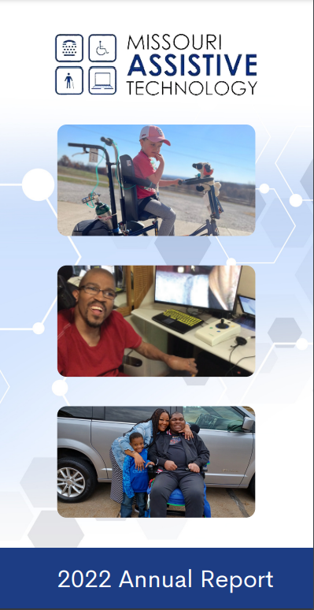
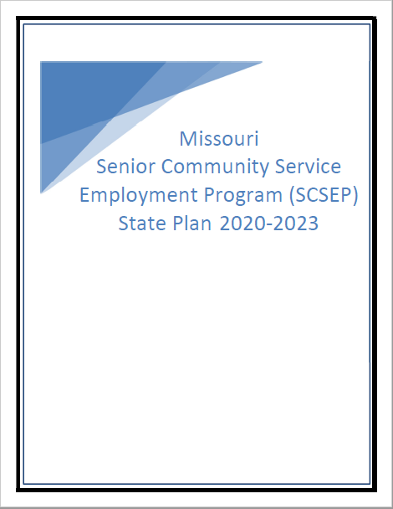
Building on recent related work
Notes:
While there is much work to do on the Master Plan on Aging, we have a great foundation to build on. Partnership and collaborations already exist. The Master Plan will bring each of these together to build a larger collaborative with the focus on aging with dignity.

Slide 10
Missouri’s Master Plan on Aging
Advisory Council
Cabinet Members
Administration Members
Ken Zellers, Office of Administration
Chris Chinn, Agriculture
Sara Parker Pauley, Conservation
Anne Precythe, Corrections
Maggie Kost, Economic Development
Margie Vandeven, Elementary & Secondary Education
Paula F. Nickelson, Health & Senior Services
Leroy Wade, Higher Education & Workforce Development
Chlora Lindley-Myers, Commerce & Insurance
Anna Hui, Labor & Industrial Relations
Val Huhn, Mental Health
Dru Buntin, Natural Resources
Sandy Karsten, Public Safety
Wayne Wallingford, Revenue
Robert J. Knodell, Social Services
Patrick McKenna, Transportation
Lieutenant Governor Mike Kehoe
Legislative Members
Senator Mike Moon Representative Yolanda Fountain Henderson
Notes:
All of the state departments are participating, as well as legislative representative and Lt. Governor Kehoe.

Slide 11
Missouri’s Master Plan on Aging
Advisory Council (continued)
Subject Matter Experts with Statewide Associations
Lana Johnson, Aging Matters and President of ma4 Deb Hobson, Centers for Independent Living
Tiffany Bayer, DHSS Centers for Local Public Health Services Tina Uridge, Senior Tax Levy Boards Cindy Shultz, Missouri Association of Councils of Governments Tim Brinker, County Commissioners Association of Missouri Richard Sheets, Missouri Municipal League Sheli Reynolds, UMKC Institute for Human Development Jon Doolittle, Missouri Hospital Association Jay Hardenbrook, Missouri AARP Beth Brown, MERS Goodwill & Senior Community Services Employment Program
Sarah Lovegreen, Alzheimer’s Association Greater Missouri Chapter
Nancy Pennington, Missouri Association of County Developmental Disability Services
Paul Kirchoff, Missouri Veterans Commission LaTasha Barnes, Legal Services of Eastern Missouri Angel Surdin, DHSS Office of Minority Health Jamie Opsal, Missouri Council on Aging Jennifer Carter Dochler, Missouri Foundation for Health Angela Williams, Health Forward Foundation Jenni Miller, Missouri Housing Development Commission Craig Escude, M.D., IntellectAbility
Notes:
Then leaders in the aging and disability networks were appointed based on their expertise in the fields of aging, disability, or caregiving.
Specific mention that each of these organizations are statewide.

Slide 12
Subcommittees
Transportation and Mobility
04
03
05
Housing and Aging in Place
Safety and Security
02
06
Family Caregiving
Long-term Services and Supports
01
07
Daily Life and Employment
Whole-Person Health
Notes:
The 7 areas that have been identified as integral to aging well serve as subcommittees.
Daily Life and Employment
Family Caregiving
Housing and Aging in Place
Transportation and Mobility
Safety and Security
Long-term Services and Supports
Whole Person Health
Daily Life and Employment
Missourians will live the lives they desire as they age with access to employment options, recreational activities, and opportunities to engage in civic and social opportunities.
Family Caregivers
Family caregivers in Missouri will be adequately trained and have access to resources to provide effective care in support of the care recipient’s choices and their own well-being.
Housing and Aging In Place
Missourians will live where they choose in communities that respect their desire to age with dignity in environments that are safe, healthy, and allow for maximum independence.
Transportation and Mobility
Missourians will have access to safe and reliable transportation and mobility options so they can get to the places they need or desire to go.
Safety and Security
Missourians will have education and resources available to them to keep them safe; free from abuse, neglect, and exploitation; and to help them plan for their financial security in retirement.
Long-Term Services and Supports
Missourians will have access to information to assist them in making an informed choice regarding a continuum of home and community based services; which help them stay safely in their homes for as long as they desire and will also have access to safe, healthy, and inviting options for necessary institutional care.
Whole Person Health
Missourians will have access to the care and services needed to help them live a safe, healthy life with maximum independence as they age.

Slide 13
Workgroups Deeper Dive into the Work
Daily Life & Employment
Family Caregiving
Housing & Aging In-Place
Daily Life
Employment
Family Caregiver Support
Family Caregiver Policy and Procedures
Affordable Housing
Universal Design
Home Modification/ Repair/Maintenance
Rental Issues
Transportation & Mobility
Safety & Security
In-Home Care
LTC (Institutional)
Navigating LTSS
Long-Term Services & Supports
Whole-Person Health
Rural
Urban
Financial Security
Education and Awareness
Public Safety
Survivor Advocacy
Physical Health
Healthy Eating
Behavioral Health
Social Connection
Cognitive Health
Health Equity
Notes:
Each subcommittee has broken down into specific workgroups. The members of each of these groups are doing a deep dive into identified needs, programs that currently exist and gaps in programs and services. Based on their research, each of the workgroups are developing recommendations to pass up to the larger subcommittee and then to the Advisory Council. These recommendations will assist the Advisory Council in developing a framework for the upcoming town hall meetings.
If you are interested in joining a subcommittee or a workgroup, please email Mindy Ulstad at Mindy.Ulstad@health.mo.gov.

Slide 14
Overarching Work on the Master Plan on Aging
Notes:
Each of the workgroups and subcommittees have three cross-cutting principles that are considered with each of their recommendations. ALL Missourians should be able to access programs and make choices for themselves about how they want to age with dignity.

Slide 15
Early Wins from the Master Plan on Aging
Changes are already happening!
The work of the MPA has brought together entities that have never worked together before.
This has already started new collaborations outside of the MPA work.
One group mentioned that the process for filing for the Shared Care Tax Credit could be daunting for an older adult, an adult with disabilities, or caregivers who are already overburdened
DHSS was able to review the process, determine partners to work with, and trained them to be able to assist with completing the process to apply for the Shared Care Tax Credit
Another group mentioned that there was not enough information for caregivers on support services for them
We worked with members of the committees to develop a caregiver resource list
Older workers are an important part of the workforce but often face age discrimination due to old ageist beliefs
We are restarting the Outstanding Older Worker Week recognition to highlight the qualities of older workers and their value in the workplace
Master Plan on Aging Advisory Council, Subcommittees, and DSDS staff trained on Reframing Aging
Notes:
Missouri’s Aging with Dignity initiative was announced on January 19, 2023, less than a year ago, and already we see positive changes taking place.

Slide 16
MPA Website
Master Plan on Aging Website
Background Information, Meeting Agendas, and Past Meeting Notes
A new master plan on aging website is available. You can find the website at this link:
https://health.mo.gov/seniors/master-plan-aging.php
This website contains a short description/background information
Upcoming meeting agendas
Past meeting minutes
Additional Resources and Information
Notes:
There is a Master Plan on Aging page on the DHSS website. On that page you can access upcoming meeting agendas, past meeting minutes and additional resources and information.

Slide 17
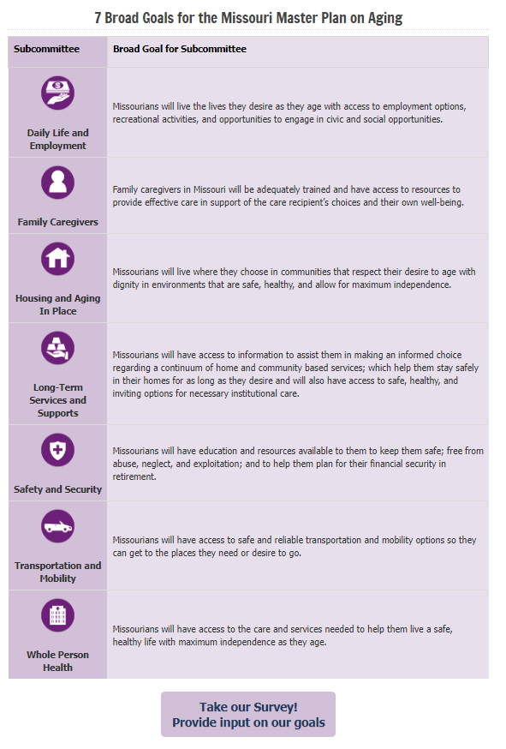
We need your input
7 Broad Goals for the Master Plan on Aging
We need input from all Missourians, regardless of age or ability.
Please consider taking the short survey on the Master Plan on Aging webpage:
https://health.mo.gov/seniors/masterplanaging/
Notes:
Most recently, each of the seven subcommittees has developed broad goals. We encourage everyone to take the survey (linked at the bottom) to share their thoughts on the goals.

Slide 18
QUESTIONS?
Mindy.Ulstad@health.mo.gov
573-526-4542
Health.Mo.Gov/Seniors/
Notes:
What questions do you have?
If you are interested in joining one of the subcommittees, please reach out to Mindy Ulstad. She will get you added to the group.
Thank you for your time. I appreciate you having me today.

