Slide 1
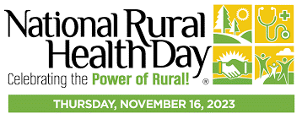
2023

Slide 2
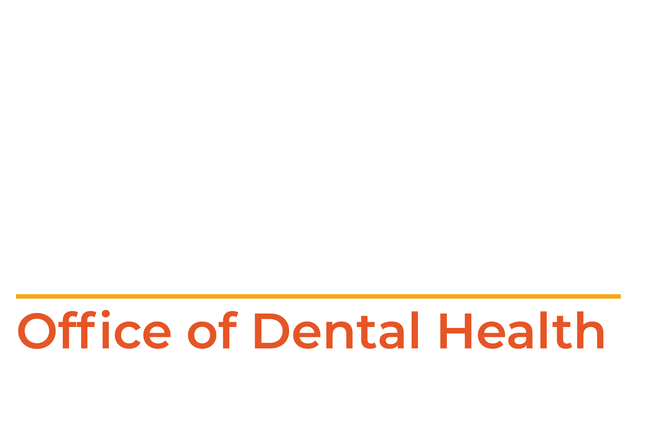
Options to Improve Oral Health
in Rural Areas in Missouri
Jacqueline Miller DDS, MS, MPH, Dental Director
Notes:
Good Morning, I am Dr. Jackie Miller, the State Dental Director for the Office of Dental Health which is part of the Department of Health and Senior Services. Tooth decay (cavities) remains the most chronic disease to affect people across the United States. It is also completely preventable. The Office of Dental Health (ODH) along with its community partners, contractors and stakeholders continue to be leaders with new, innovative programs that provide oral health education, preventive public health measures and help increase access to care across the state to help improve the oral health landscape of Missouri.

Slide 3
Office of Dental Health Mission
We are committed to improving the oral health of all Missourians through education, prevention and leadership.
Notes:
Good Morning, so excited to be here at the Rural Health Day to highlight a few of the programs and initiatives at the Office of Dental Health (ODH) that can impact and improve access to oral health care. Here at ODH, we are committed to improving the oral health of all Missourians through education, prevention and leadership. We work alongside our community partners, contractors and stakeholders and continue to be leaders with new, innovative programs that provide oral health education, preventive public health measures and help increase access to care across the state to help improve the oral health landscape of Missouri.

Slide 4
PREVENTING TOOTH DECAY—WHY IS IT IMPORTANT THROUGH A LIFETIME?
Poor oral health is linked to diabetes, heart disease, stroke and pre-term birth.
Children and adults with poor dentition can’t eat a healthy diet due to difficulties chewing.
Abscessed (infected) teeth can spread bacteria to the brain leading to death.
Poor oral health limits your ability to successfully get a job; dental pain makes it hard to work or concentrate in school.
Nationally children miss 51 million school-hours annually due to dental-related issues.
Notes:
Just this morning in the news from the American Dental Association: Lawmakers are asking Congress to pass the Medicaid Benefit Act to cover adult dental care, they point to an analysis by the ADA Health Policy Institute, that found if Medicaid adult dental benefits are extended, $273 million could be saved each year on medical costs related to diabetes, heart disease and pregnancy. In addition, Medicaid adult dental benefits could reduce states' spending on dental care in hospital emergency departments.

Slide 5
Preventive Services Program (PSP)
Oral Health Education
Oral Health Screening
(0-18 years of age)
Fluoride Varnish Application (2)
Referrals
This program prevents an average of 1.5 cavities / year / child.
For every $1 spent it returns $4 in averted care.
Community Based
Notes:
Let’s start with the Preventive Services Program (PSP) is a community based oral health program dedicated to promoting healthy smiles for all of Missouri’s children through education and preventive treatment. It was started in 2005 and consists of local dental providers administering an oral health screening, which includes a fluoride varnish application on the day of the screening and a follow up application at a later time. PSP includes oral health education, toothbrushes and toothpaste all at no charge. It also provides a referral, which consists of a note going to the school nurse and parent that the child requires treatment and a time frame as to when the treatment needs to be sought. Many times the dental professional conducting the screening is affiliated with a local dental clinic and will give priority to a child they saw through a PSP event so they can receive treatment.
We are actually up to over 59,000 PSP Participants after a low of just about 20,000 during COVID. We are working hard to regain the numbers of a high of 92,692 in the 2016-17 school year. This program prevents an average of 1.5 cavities / year / child. For every $1 spent it returns $4 in averted care.

Slide 6
Notes:
These statistics are from the 2022-2023 school year.

Slide 7
Impact of PSP Program - Fluoride Varnish Program (based on 2022 data)
Estimated reduction of dental decay of Medicaid patients is about 7%. Overall reduction of 4%.
Identification of schools and areas that are having problems accessing dental care by the Untreated Decay rate.
JADA: Topical Fluoride Impact in Future Restorative Dental Procedures. The application of fluoride varnishes and gels increased the time to future restorative and extraction dental claims and decreased the number of future restorative and extraction dental claims.
Jackson HJ, Yepes JF, Scully AC, Vinson LA, Jones JE, Eckert G, Downey T, Maupomé G. 2023. Journal of the American Dental Association. DOI: 10.1016/j.adaj.2023.06.012.
Notes:
Background: Caries is one of the most prevalent diseases affecting children. Topical fluoride is used to decrease the incidence of caries. The purpose of this study was to investigate the impact of fluoride varnish and gel applications on future restorative dental treatment claims. ethods: The data were obtained in conjunction with a dental data warehouse through a partnership agreement. A retrospective analysis of dental claims made from 2010 through 2018 was completed. Data were extracted for patients aged 1 through 8 years with topical fluoride application and its subsequent impact on restorative dental claims. Results: Data for 672,889 patients were included in the analysis. Patients who received topical fluoride had significantly lower numbers (P < .001) of restorative procedures and extractions per year and significantly increased time (P < .001) to their first restorative procedure or extraction after the index visit than patients who did not receive topical fluoride. Conclusions: The application of fluoride varnishes and gels increased the time to future restorative and extraction dental claims and decreased the number of future restorative and extraction dental claims.

Slide 8
AHR Ranks MO as 41st in Maternal Oral Health —Healthy Teeth = Healthy Pregnancy
43.4% of Missouri Medicaid participants don’t use pregnancy dental benefits —MO HealthNet provides comprehensive dental care for pregnant women and one year post-partum.
Provide oral health education as well as information for infant oral health.
Express importance of good oral health is good for the baby.
Make dental appointment at clinic.
Educate obstetricians on importance of dental care during pregnancy.
If gum inflammation is treated during pregnancy, the risk of a baby being born preterm is reduced by approximately 50 percent.
Notes:
43.4 % of Medicaid eligible pregnant women received preventive dental care. Some other ways we serve the Missouri population is to educate our LPHAs to specifically provide oral health education, to help make appointments at the associated dental clinic and to educate OBGYNs in their area on the importance of dental care during pregnancy.
In efforts to improve oral health visits among pregnant women, we need to identify barriers of preventing oral health visits. Provide outreach and promote incentives to encourage pregnant women to seek oral health visits. Finally, we need to encourage and engage Medicaid providers to provide oral health services to pregnant women.
“If gum inflammation is treated during pregnancy, the risk of a baby being born preterm is reduced by approximately 50 percent. Poor oral health and gum disease have been linked to pre-term births, low birthweight babies and preeclampsia. Poor oral health also affects the control of blood pressure and diabetes. We are working to have Medicaid coverage extended to one year after delivery to achieve better outcomes post pregnancy.

Slide 9
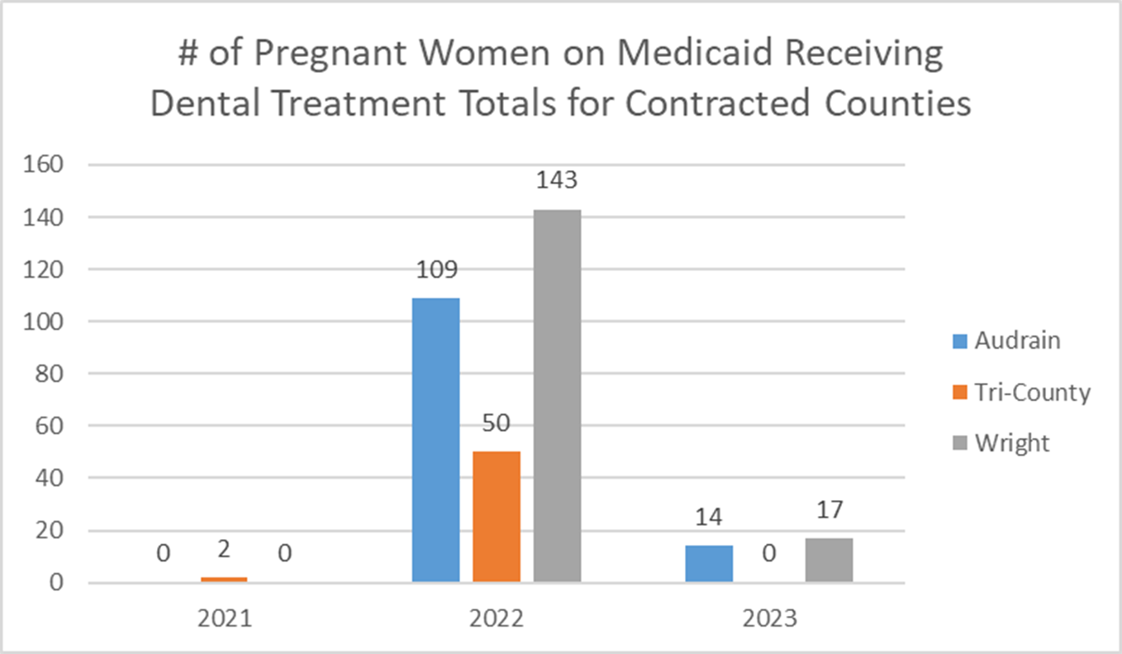
Impact of “Pregnant Moms Need Dental Visits Too”
Notes:
Starting in October 2021, we had contracts with 3 Local Public Health Agencies to educate the pregnant women who came into their agency for whatever reason, ie, WIC, immunization, etc. and we provided a small amount of funds for the LPHA to start educating the women on the importance of a dental visit while pregnant, to do a quick visual screening and fluoride varnish if the pregnant woman consented. The LPHA also made an appointment at a local dental clinic for the pregnant woman. The LPHA also educated the local OB/Gyns of the importance/safety of a dental visit while pregnant. As you can see, the # of dental visits by pregnant women increased significantly. The #s are still low in 2023 because takes Medicaid over a year to finalize it. It takes 12-18 months for Medicaid to get final numbers

Slide 10
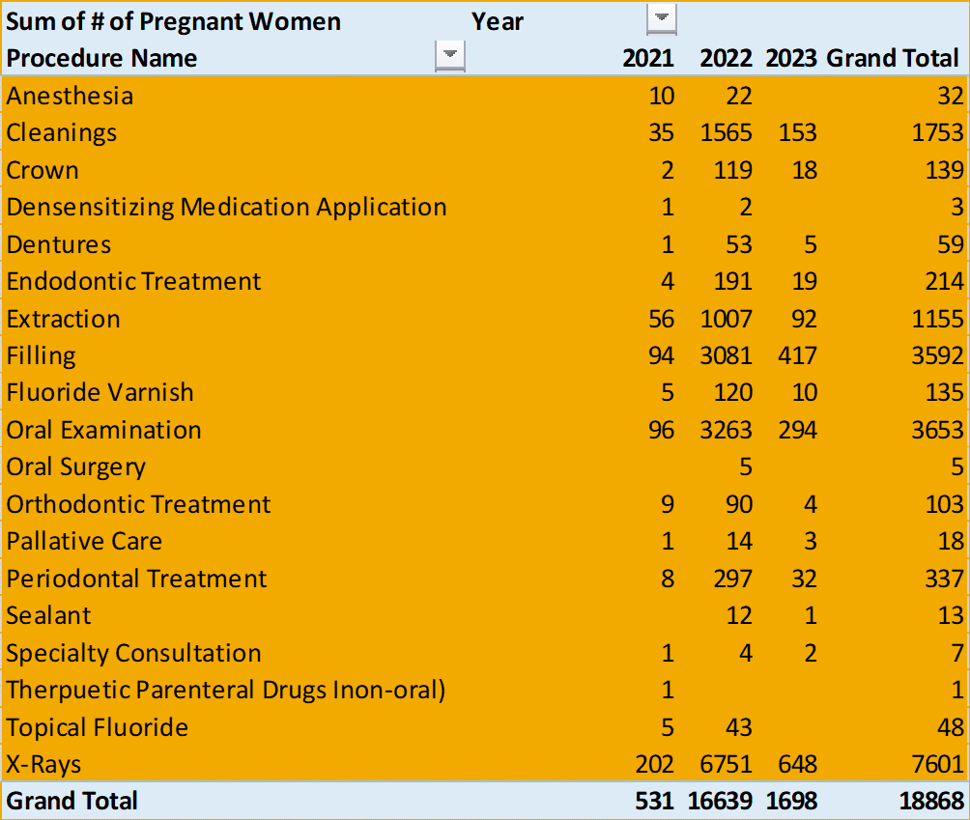
Statewide Medicaid totals of Dental Procedures - Pregnant Women
Notes:
Totals of Dental Procedures performed on pregnant women.

Slide 11
American Academy of Pediatrics on Oral Health
“Pediatricians and pediatric health care professionals should develop the knowledge base to perform oral health risk assessments on all patients beginning at 6 months of age.”
Pediatric dental disease, while largely preventable, continues to impact too many children and families, particularly those disproportionately impacted by racial and economic inequalities. Pediatricians are essential partners in keeping children’s teeth healthy but may lack the knowledge, training, or incentive to incorporate oral health promotion and disease prevention services into care provision for young children.
(Oct. 2023)
Notes:
From: the October 2023 Pediatricians and Pediatric Oral Health
Pediatric dental disease, while largely preventable, continues to impact too many children and families, particularly those disproportionately impacted by racial and economic inequalities. Pediatricians are essential partners in keeping children’s teeth healthy but may lack the knowledge, training, or incentive to incorporate oral health promotion and disease prevention services into care provision for young children.

Slide 12
Infant/Child Oral Health Program
Infant knee to knee exam allows you to counsel parent and look for decay.
Fluoride varnish application starting at age one.
Can refer patient to usual referral sources if child has decay present.
Consider adding Silver Diamine Fluoride (SDF) to pediatric and primary care offices with training.
Notes:
I have been told that each of the school nurses have been taught on how to perform an oral exam, how many of the care team here feel comfortable in performing a knee to knee exam?

Slide 13
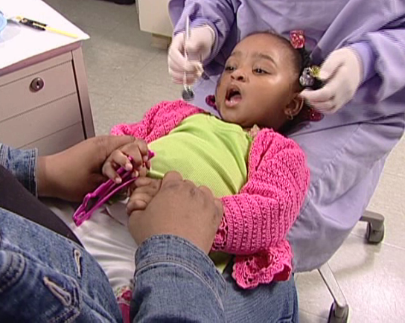
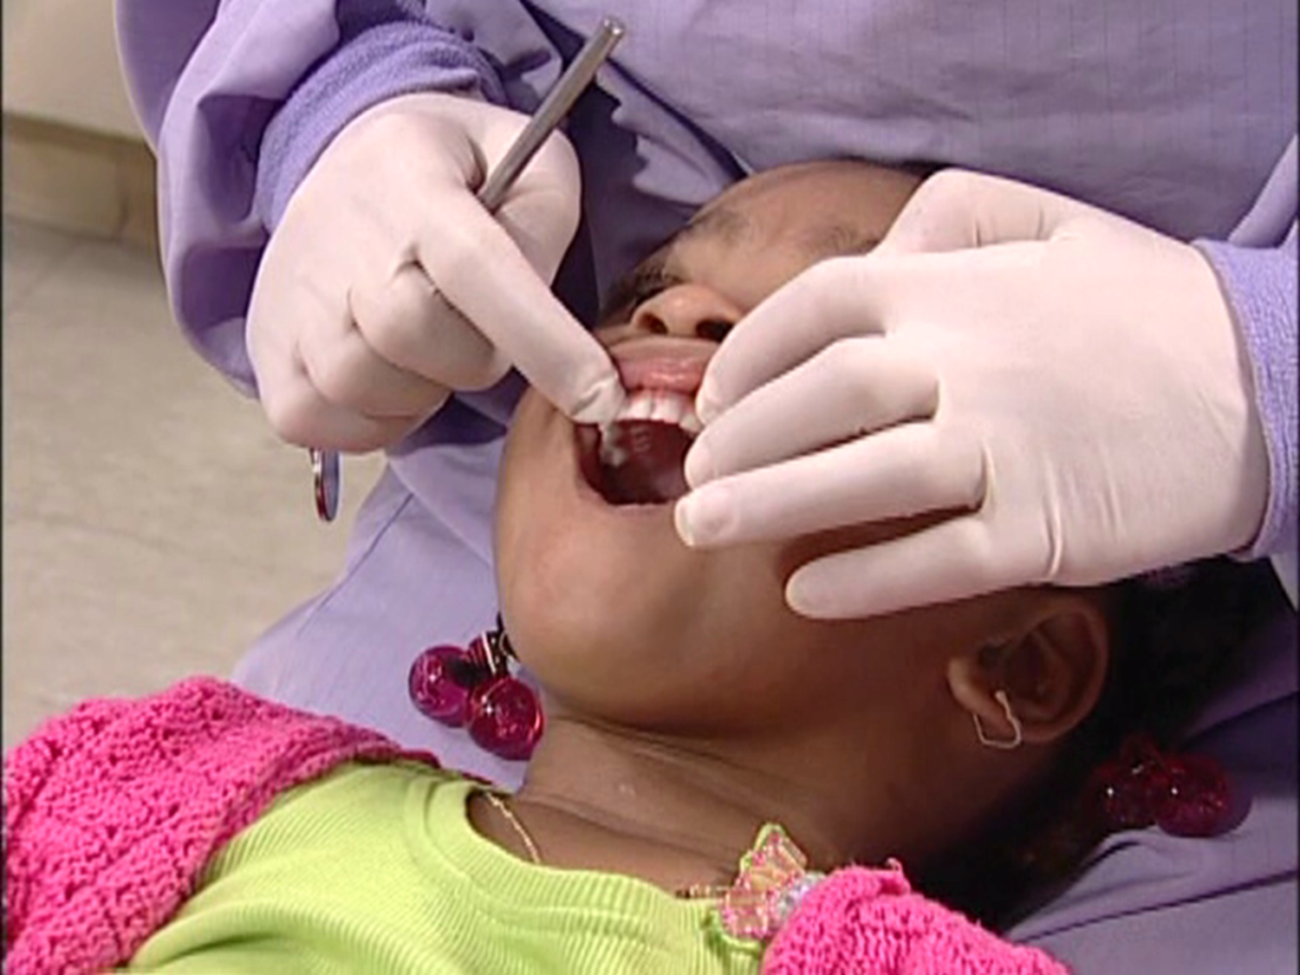

Slide 14
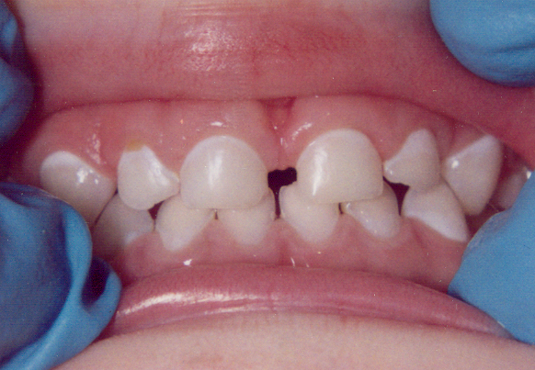
White/chalky areas can turn into brown spots (cavities)
White spots are very beginning phase of dental disease – refer to dentist.
Improved brushing, feeding habits and application of fluoride varnish, these spots can be stopped from getting worse.

Slide 15
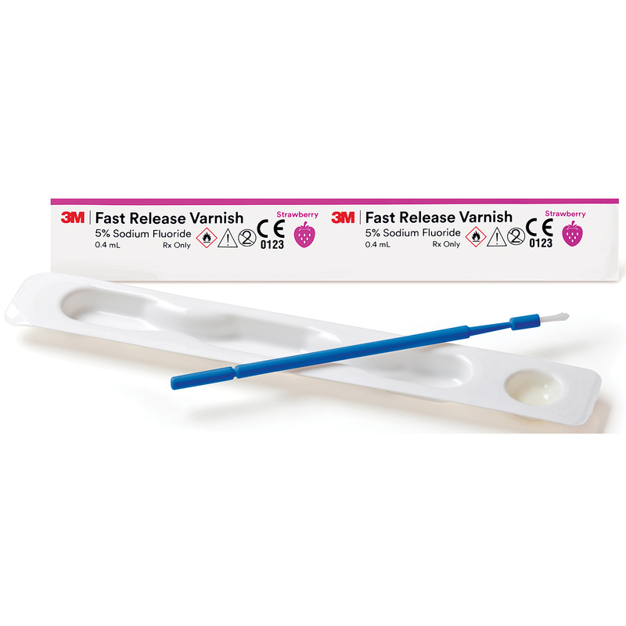
Safe if swallowed—no nausea.
Easy to learn to apply.
Easy to perform application.
Quickly completed.
Sets on contact with moisture (saliva).
Not rendered inactive by plaque.
Taste is tolerable and well accepted.
Can reverse early decay and can arrest active decay lesions.
Fluoride Varnish

Slide 16
Fluoride Varnish Application
All children aged one year and up.
Medicaid will reimburse $36 per application if completed by a dentist or dental hygienist.
Medicaid will reimburse $21.50 per application if completed by a medical provider.
Can reapply every 6 months.
The FV at a cost of about $.40-70 per application.

Slide 17
Dunklin County has added to their bottom line with fluoride varnish!!
Notes:
Dunklin county Missouri has added to their financial bottom line by utilizing fluoride varnish in their clinic, you can too by charging Medicaid for the application of Fluoride Varnish. (We couldn’t fit the entire spreadsheet of their monthly totals from the program, so that’s why the total at each of the columns don’t add up to the total amount you see at the bottom.)

Slide 18
How do I order varnish for my clinic?
Contact/Ordering information:
Nanova Biomaterials, Inc.
orders@nanovabio.com, 573-875-6682
Contract # CC211820001.
Mention your affiliation with DHSS ODH when ordering
Order minimum - 1 case = 8 boxes of 200 applications per box at $72.00 per box ($0.36 per application)
Notes:
All LPHAs can purchase Fluoride Varnish at DHSS Office of Dental Health Prices from Nanova Biomaterials, Inc., Liang Chen, Director of Dental Department – chenliang@nanovamed.com and Vickie Yang – yangvickie@nanovabio.com; or orders@nanovabio.com, 573-875-6682. Contract # CC211820001. Please mention your affiliation with MO DHSS ODH when placing an order. Order must be for 1 case, 8 boxes of 200 applications per box at $72.00 per box or $0.36 per application.

Slide 19
Silver Diamine Fluoride Application by Pediatricians
SDF is a brush-on liquid that stops cavities by strengthening affected tooth structures and keeping bacteria from growing on them. It prevents dental decay from progressing and spreading to other teeth. Unlike traditional treatments such as drilling and filling a cavity, SDF is quick, painless, and does not require local anesthesia or sedation.
Previously only dental care providers could apply SDF, but now primary care team members will be able to apply SDF to treat cavities and be reimbursed for it. The CPT code approval for SDF will benefit patients by providing many new points of access for treating tooth decay.
Notes:
Recommendations for AAP include:
Creating educational and training opportunities for pediatricians to learn about SDF.
Studying and learning from practices that have successfully implemented SDF across a variety of practice types and settings.
Championing appropriate payment for practices that implement SDF and providing coding and billing guidance.
Continuing to promote and support the critically important oral health preventive care that many pediatricians provide.
CMS is now providing reimbursement for SDF in medical offices.

Slide 20
CWF achieves 25% decay reduction in all citizens regardless of income or other socio-economic factors.
COMMUNITY WATER
FLUORIDATION (CWF)
Notes:
76.2% of the MO population is served by public water systems which receive fluoride. The ODH is supportive of all community water fluoridation in the state. CWF achieves 25% decay reduction in all citizens regardless of income or other socio-economic factors. In 2020-2021, ODH’s stance on community water fluoridation was one of a defensive nature, requiring ODH personnel to counter fifteen (15) attempted and three (3) full rollbacks (discontinuation of fluoridation). By the end of 2021 and into 2022, ODH with the assistance of the Missouri Coalition for Oral Health; local community dental health and medical health professionals; local water system personnel; and local community fluoridation advocates has shifted the community health landscape to one of initiation and education. This has brought about a new openness to consideration of community water fluoridation and the benefits it provides to communities and Missourians.
In July 2022, ODH received grant funds to assist with community water fluoridation (CWF) across the state. ODH has spent the past year increasing access to optimally fluoridated water by providing mini-grants to 26 water systems. These mini-grants were used to upgrade outdated water fluoridation equipment, including pumps, scales, bulk/day tanks and testing equipment. By providing these mini-grants, ODH was able to ensure these communities are being provided with optimally fluoridated water (0.7 milligrams per liter (mg/L)). Optimally fluoridated water assists in the prevention and reduction of tooth decay (cavities) by an additional 25% beyond other fluoridated products being used (toothpaste, mouth rinse, fluoride varnish treatments). This public health initiative has led to over 350,000 people now receiving optimally fluoridated water throughout the state.

Slide 21
76.2% of the Missouri population is served by public water systems which receive fluoride.
CWF has a very low cost of $.05 per day per person.
One dollar in CWF returns in $25 in averted dental care.
Notes:
76.2% of the MO population is served by public water systems which receive fluoride. We work with local communities that are fluoridating and ensure they are fluoridating and ensure they are meeting the public health recommended range of 0.6-1.0 ppm. If they are not, then we work with them to find out what might be causing the issue—faulty equipment, not accurate training and education or maybe they stopped without following Missouri statute RSMo 640.136. We work with funding from Delta Dental, PHHS and ARPA to upgrade and replace equipment. Work with communities that have initiated rollbacks (cessation) to educate and keep them fluoridating, work on new initiations to fluoridation and provide dental education to dental providers, decision makers and the general public about water fluoridation. These are all ways the ODH can help the LPHAs to improve medical and oral health in their areas.

Slide 22
SCHOOOL BASED SEALANT PROGRAM
Notes:
Early preventive dental visits can preempt many oral health problems. Fluoride and dental sealants can help prevent cavities and promote oral health. For example, dental sealants can prevent 80% of back teeth cavities in children. Cavities are a common problem among children in the United States. Early regular dental check-ups are particularly cost-effective and beneficial for children in high-risk populations.
America’s Health Rankings analysis of National Survey of Children's Health, U.S. Department of Health and Human Services, Health Resources and Services Administration (HRSA), Maternal and Child Health Bureau (MCHB), United Health Foundation, AmericasHealthRankings.org, accessed 2023.
ODH has a second school-based program and contracts with four dental programs around the state to offer these services. These contractors provide preventive oral health services in school settings and see a diverse range of students. The contractors complete oral health screenings, fluoride varnish treatments, dental sealant placement and connect students in need of restorative dental services with a dental home. During the 2022-2023 school year, the contractors went into 30 schools and screened 1,741 students. Of these students, 1,696 received preventive oral health services including 4,505 dental sealants being placed. Additionally, 766 students were given referrals for a new dental home for further treatment of their oral health needs.

Slide 23
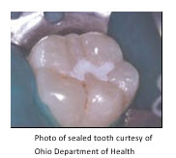
CDC Sealant Program
1611 Sealants Placed 2019-2020
CDC Funding of $354,000 per year for five years, we hope to renew the grant in August 2024.
Goal to provide sealants to students in high risk schools.
Schools that had more than 50% of children on Free or Reduced Lunch Program (FRLP) participants.
During the school year 2021-2022, 503 sealants were placed that protects the tooth from decay starting.
Five Contractors, UMKC, Jefferson County HD, Lincoln County HD, Missouri Southern State University and St. Louis Community College.
Notes:
Each tooth sealed can save $110-$250 in costs to fill one tooth without insurance
Children with sealants on their teeth have half the cavities of children without sealants.
The grant started in 2018 and was supposed to end in 2023, but they added another year due to Covid.

Slide 24
Missouri Southern State University & Rural Citizens Access to Telehealth Proposal (RCAT)
Objectives
Promote and provide oral health education
Decrease barriers and provide access to oral health education and preventive services
Extend teledentistry outreach services to McDonald and Newton County
Develop a sustainable program
Total cost for three (3) years of grant awarded was $363,000
The cost for the expansion and continuation of this program included:
Administrative coordinator salary,
Part time dental hygienist salary
Cargo van with lift
Computer tablets
Portable dental units
Intra oral cameras.
Notes:
MSSU currently provides teledentistry services to elementary students in Jasper county but lacks the resources to expand our teledentistry services to other counties in need. MSSU lacks the resources to purchase additional equipment, transport equipment, and employ an additional hygienist and administrative coordinator to verify Medicaid benefits and file claims for reimbursed services. We propose funding to purchase additional equipment, cargo van, and employ an additional hygienist and administrative coordinator for three years to provide these services to at risk children in the southwest region of Missouri. The RCAT grant will assist our students to provide teledentistry dental care to an additional 12 elementary schools which include Anderson, Benton, Central, George Washington Carver, Goodman, Noel, Pineville, Rise, Rocky Comfort, South, Southwest City, and White Rock, and approximately 3,700 students.
Background
MSSU obtained a grant with the Missouri Department of Health and Senior Services in 2020 to run through August 31, 2024. The grant has verbally been extended to August, 2025. The grant is titled: Improving Oral Health Teledentistry Sealants and is Contract # DH220050904. This grant promotes and provides education and outreach for the importance of dental sealants and services

Slide 25
Teledentistry Pilot Project
HRSA Workforce Grant – four years.
Three contracts in 2023 to provide dental services via teledentistry in nursing homes pilot project.
Received funding to provide to ATSU’s veterans program in order to provide dental care to veterans. Years 2, 3 and 4 will be asking for more funding from private sources to continue and to grow the care.
Scholarship for at least one student at ATSU who will provide care to veterans during the last year(s) and will work after graduation to provide care to veterans as their main focus of patients. Scholarship program will be in place for years 3 and 4 of HRSA grant as well.
Notes:
Using Teledentistry and Dental Team Collaboration
ODH project authorized by Missouri Dental Board in September 2022.
RDH/DA teams working under the supervision of dentists.
Using teledentistry for dentists to review and write disease control treatment plans and triage patients according to severity of need.

Slide 26
Dental Assistant Pipeline
Develop a Dental Assistant Pipeline through Missouri High School Career Centers (HSCC)
ODH project funded by Delta Dental ($100,000).
In cooperation with an HSCC, develop a 10-month educational pilot program for high school juniors and seniors.
Would allow students to graduate with high school diploma and dental assisting certificate, in the future, we would like to add expanded functions dental assistant certificates.

Slide 27
Oral Preventive Assistant-EFDA
Develop an Oral Preventive Assistant (OPA)-EFDA
ODH has received the authorization from the MDB to start this pilot project to address workforce shortages, to be carried out by the ODH and the Missouri Dental Association.
OPA EFDA would deliver oral health instruction and preventive care, including supragingival scaling on patients, under direct supervision of a dentist or hygienist.
Pilot would include curriculum development, training, testing and measurement with reporting to MDB and ODH.
Notes:
One solution the ODH is working on is the OPA-EFDA, EFDA is a proven training model, having been successfully in place in Missouri since the late 1990s.
EFDAs are trained to provide a specific, reversible skill of dental treatment, and under direct supervision. They provide safe, effective care—and are especially critical in this continued dental workforce shortage.
EFDAs can increase productivity 15-20%, because they allow dentists and hygienists to work at the top of their scopes to provide more advanced care procedures.

Slide 28
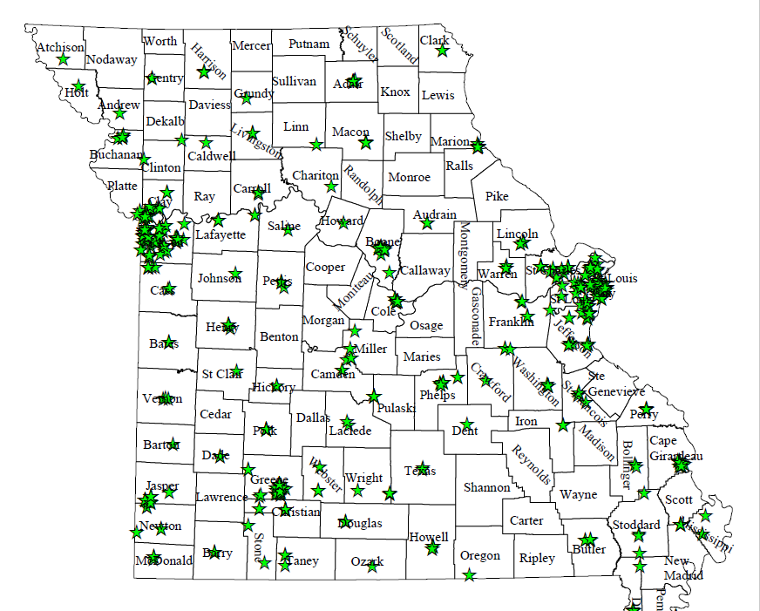
Work to increase Medicaid providers
Notes:
There are 31 FQHCs, yet 36 out of Missouri’s 114 counties have no Medicaid Providers. Some of Missouri’s most vulnerable populations are eligible for MO HealthNet benefits but only about 3 out of 10 Missouri dentists are treating these patients. This map shows the distribution of Medicaid dentists in Missouri. You can see in the Southeast and Northeast regions, many counties are without a dentist to provide Medicaid dental services. We are thankful for the 80% rate increase and are working hard to try to increase the Medicaid dental providers. Unfortunately only 27% of the dentists are signed up for Medicaid and far fewer actually treat Medicaid patients on a routine basis.

Slide 29
First-Aid/Trauma Kits
ODH has purchased items through the Maternal Child Health Block Grant for a Dental First Aid/Trauma Kit for each school in Missouri.
ODH assembled over 3,000 kits to be delivered throughout the state for school nurses.
The kits also include a dental trauma handbook for references in dental emergencies.
Notes:
The kits include items for many common dental emergencies including: containers to safely transport knocked out permanent teeth to the dentist for re-implantation, items for the control of bleeding and to remove lodged objects between teeth, wax for children with broken braces or wires, and several other useful materials for school nurses to use in the event of a dental emergency.
3 little plastic jars (with lids)
Salt packets (along with instructions) to make saline solution for a knocked out tooth (instead of milk in case it’s not available)
Oragel
floss
Mouth mirrors
8 toothbrushes (4 adult/4 junior size)
toothpaste
Tongue depressors
Tea bags
Cold pack
Gauze
tweezers
gloves
Stimudents
Orthodontic wax
Qtips
the new Oral Health Guide for Caregivers
a PSP brochure

Slide 30
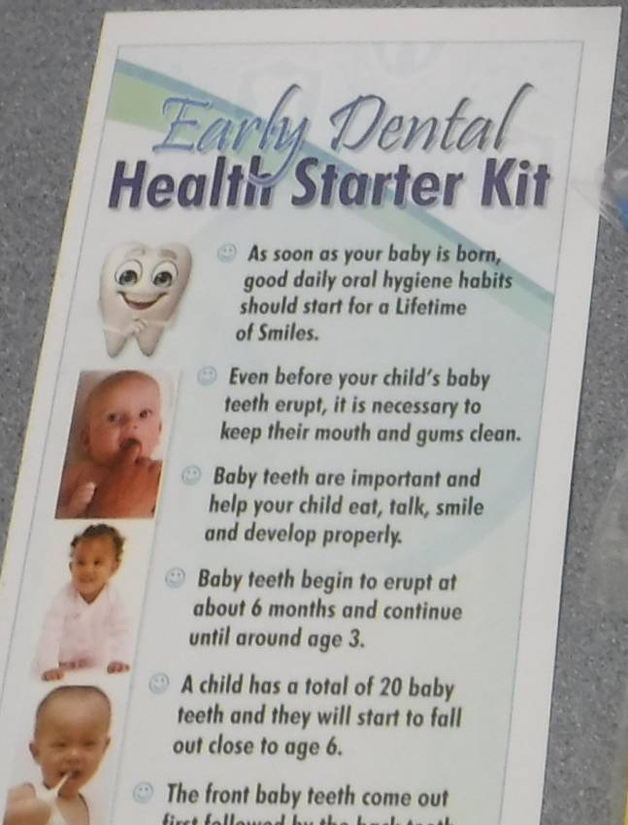
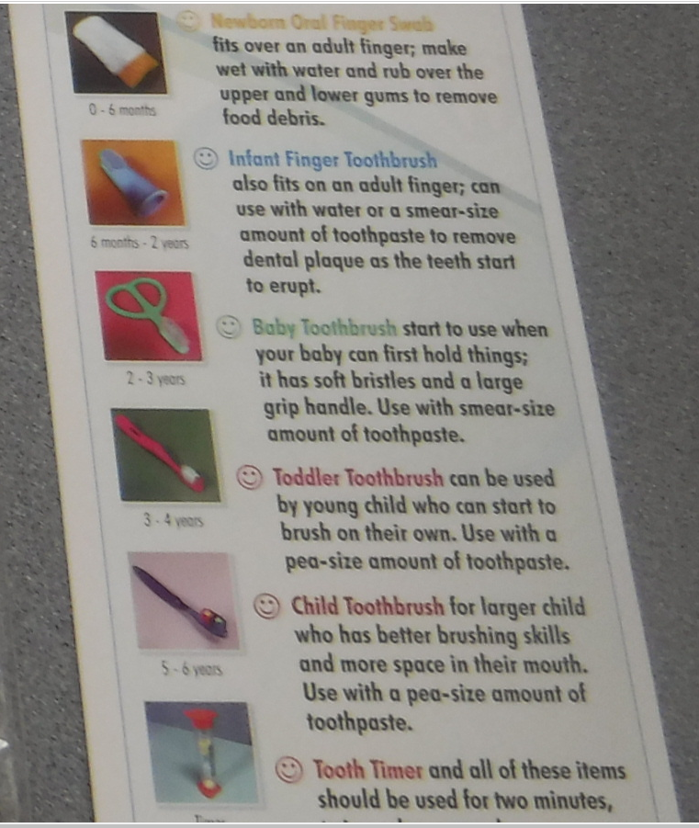
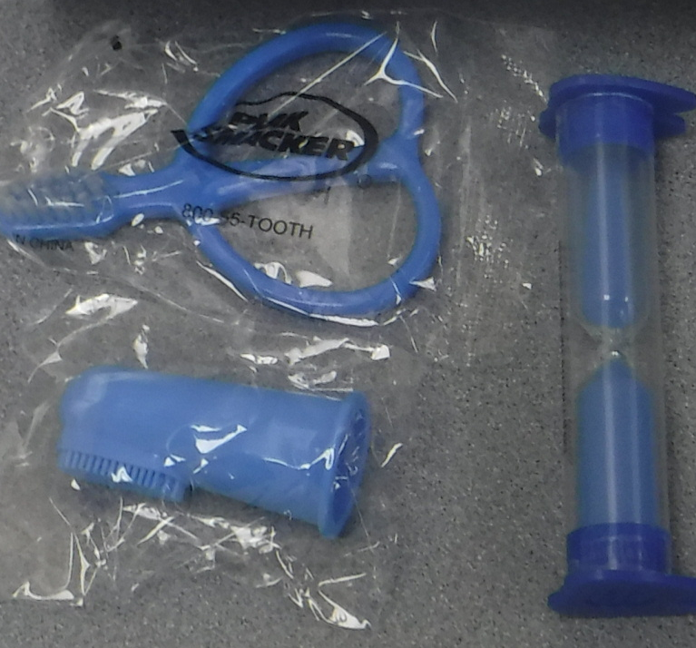
10,000 Newborn Dental Kits in Development

Slide 31
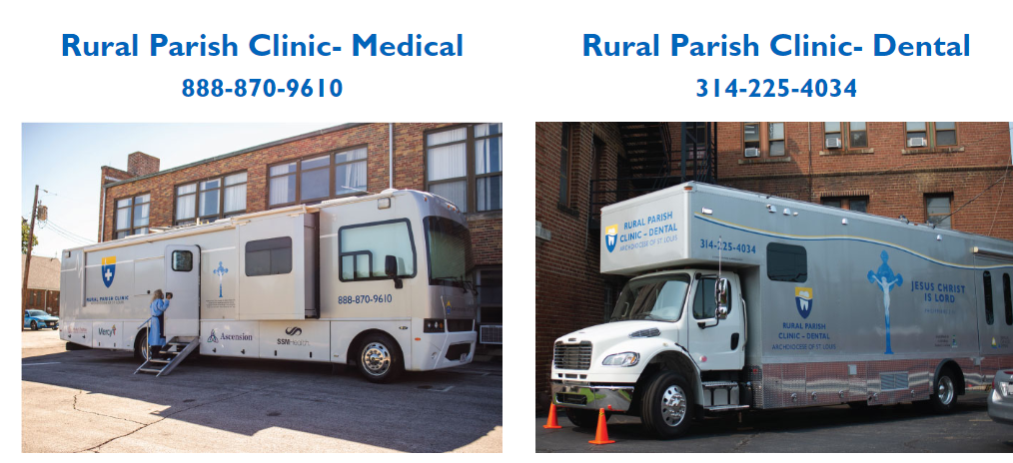
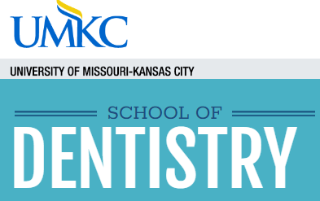
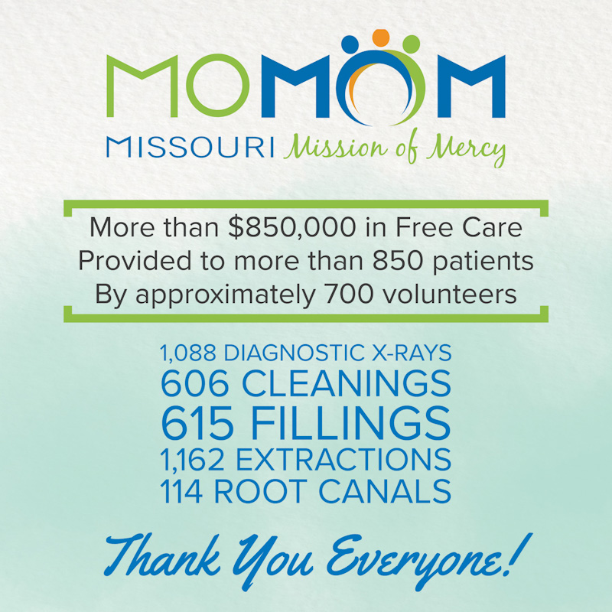
PROVIDING FREE DENTAL CARE FOR UNDERSERVED CHILDREN IN THE ST. LOUIS, MO REGION
We offer extremely affordable, quality dental care!
Only a $20 per registration!
Missouri Primary Care Association's oral health program, the Oral Health Network of Missouri, provides services to member dental clinics in support of their mission to provide comprehensive dental care to their patients.
Notes:
These are all opportunities where we can refer our patients/clients for free, low cost, sliding scale, and Medicaid dental services.

Slide 32
How can we collaborate and increase dental access?
Increase our reach with the PSP programs, ask if your school nurses participate
Offer to volunteer in a PSP event
Investigate dental care opportunities (volunteer programs, Medicaid, sliding scale fees etc.) in your areas
Start routinely using fluoride varnish in your medical/dental offices
Learn to use Silver Diamine Fluoride on primary teeth in the medical/dental offices
Encourage your own dentist to accept Medicaid
If your city is not naturally fluoridated at the optimal level, consider asking the city council about possible implementation
Encourage your high schools to start dental assistants programs to increase access to care
Support legislation that increases access to care, supports community water fluoridation, Medicaid coverage increases and increased HPV vaccination rates
Notes:
As a final note, how can we collaborate?

Slide 33
Jacqueline Miller DDS, MS, MPH
Dental Director
Jacqueline.Miller@health.mo.gov
Cell: (636) 259-0171
Notes:
ODH continues to strive towards a healthier Missouri by ensuring Missourians have better oral health, which improves overall health. In order to do this, ODH will continue to work with community partners, contractors and stakeholders to provide education, preventive services and new, innovative ideas that help work towards this goal. Thank you for what you do to help us achieve this goal! Here is my contact information, any questions?

