Slide 1
6+++++
A Glance at Health in Rural Missouri
Andrew Hunter and LeighAnna Bennett
Bureau of Health Care Analysis and Data Dissemination

Slide 2
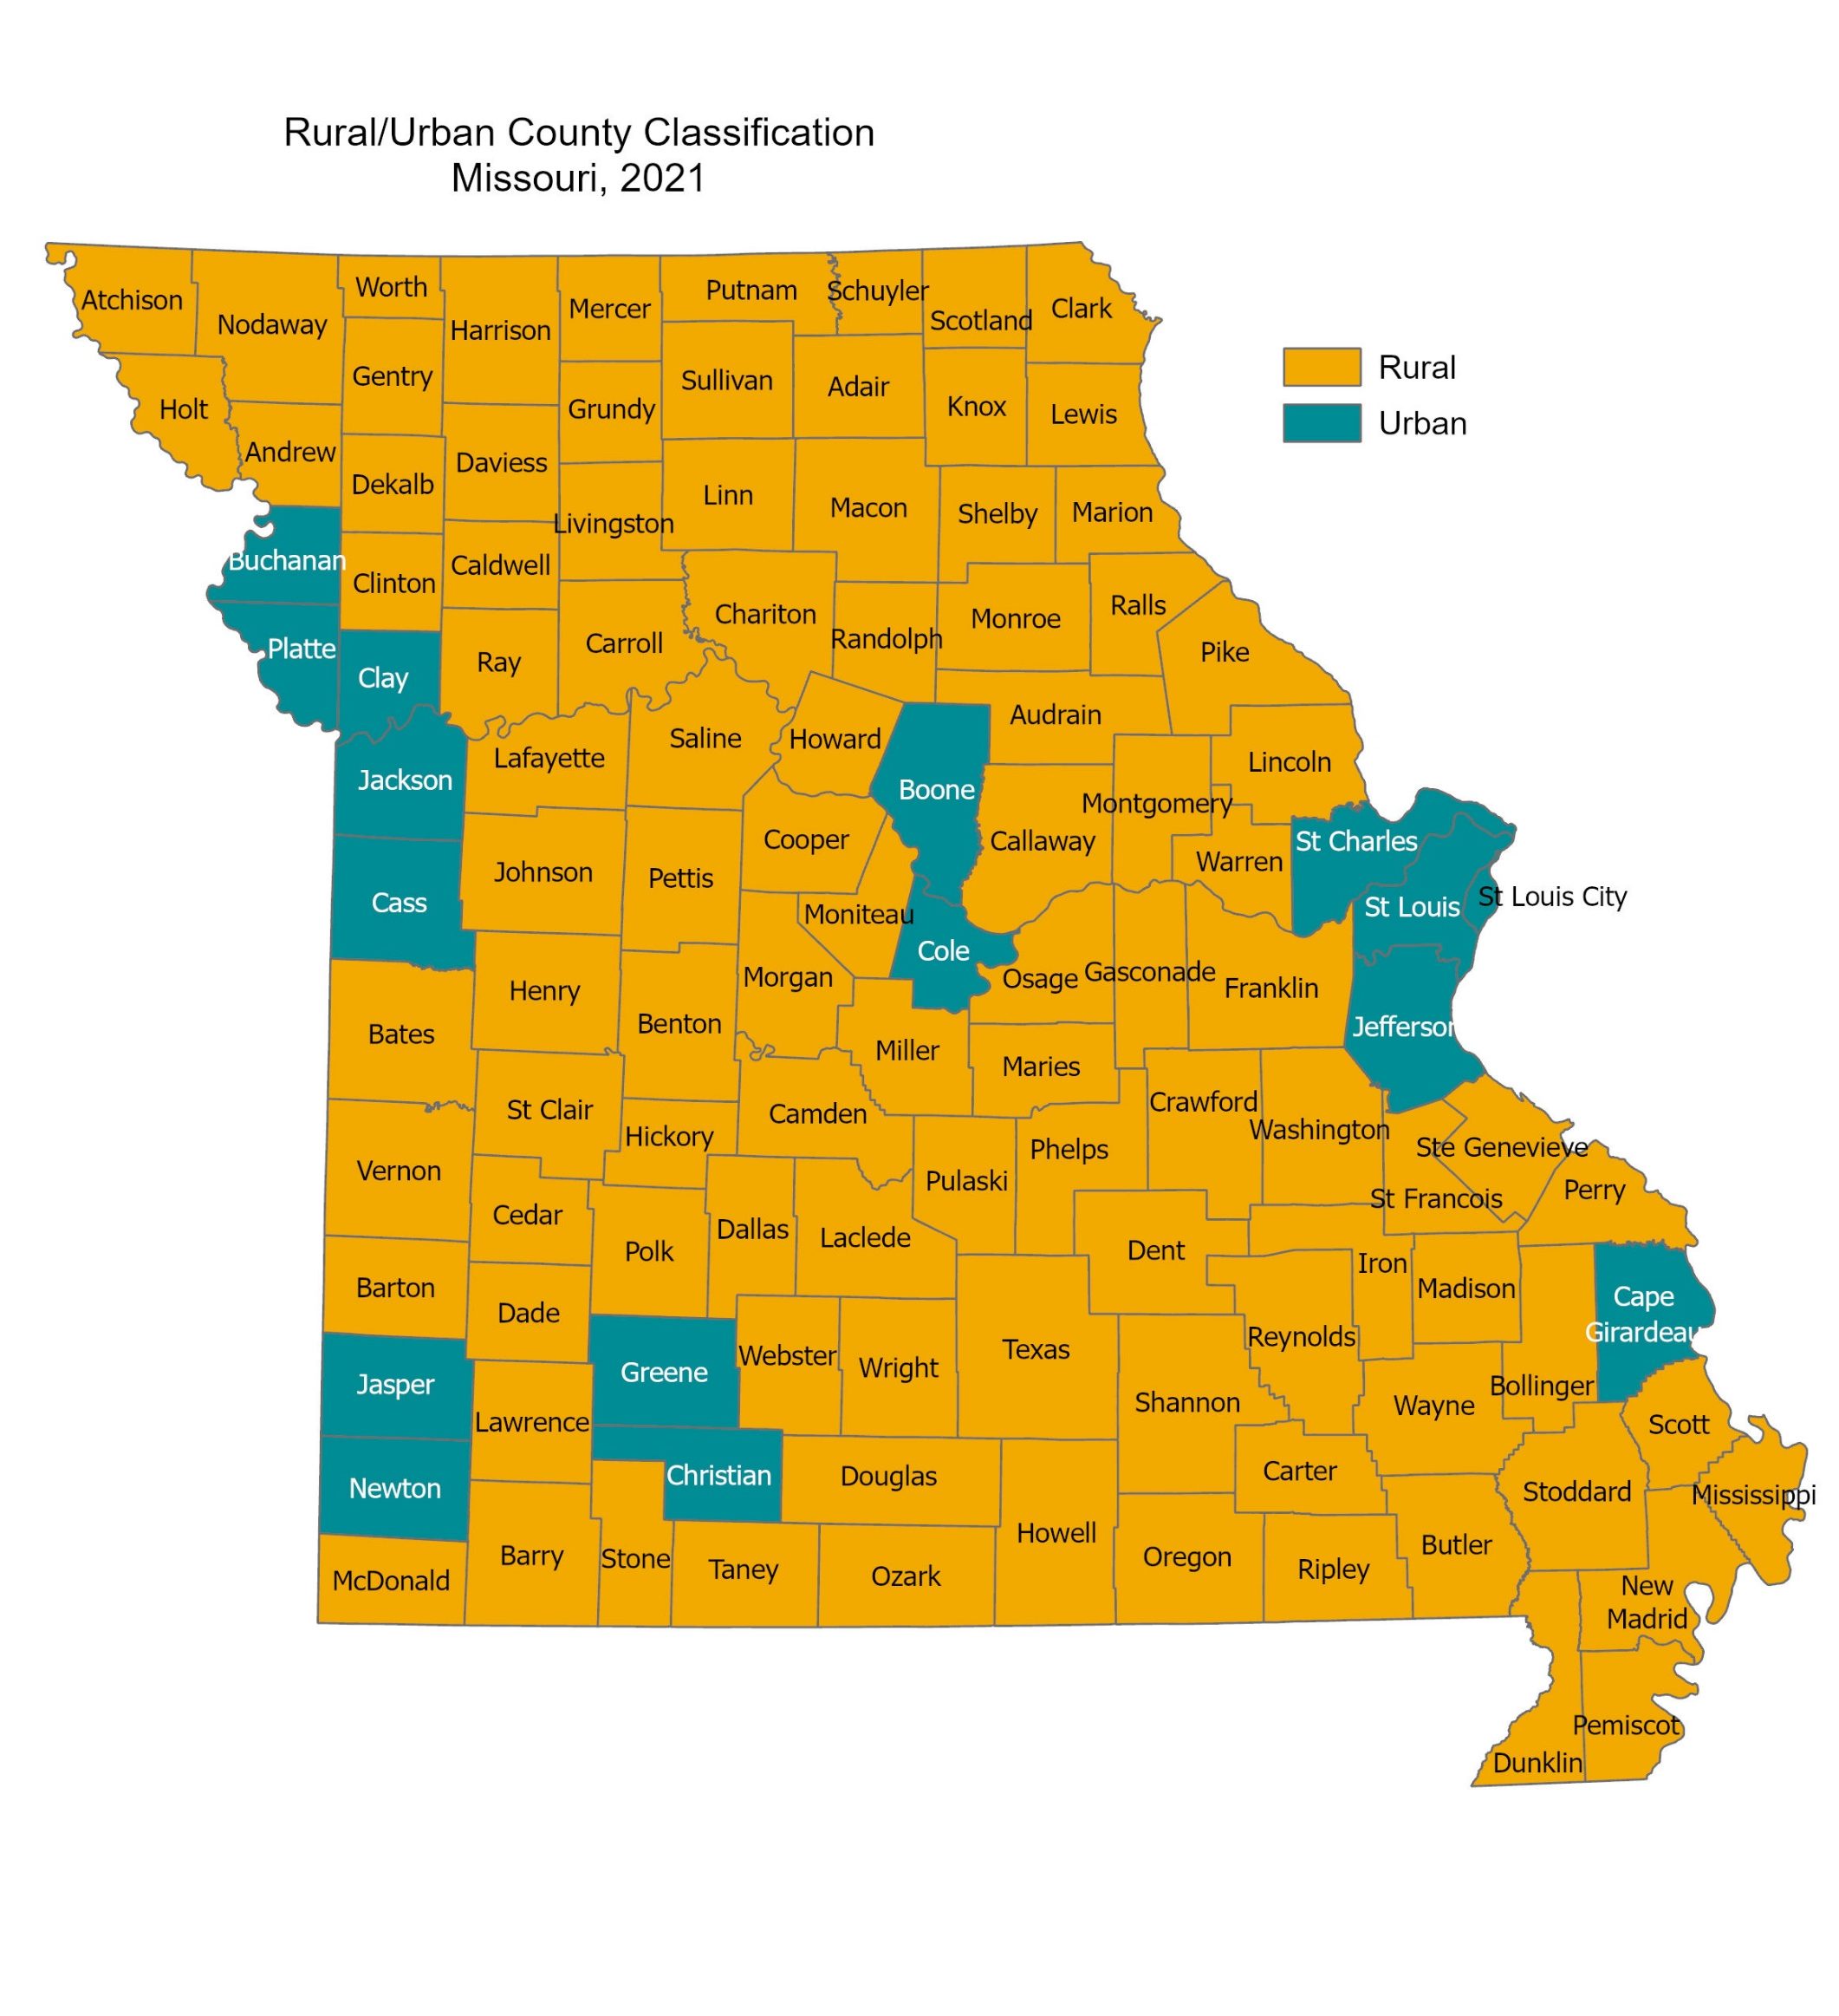
Rural vs Urban Population
A county is considered rural if:
There are less than 150 people per square mile, and
It does not contain any part of a central city in a Metropolitan Statistical Area (MSA)
Based on this criteria and using 2021 population estimates of the 115 counties in Missouri:
99 counties are rural
16 counties are urban
Source: US Census Bureau. https://www.census.gov/programs-surveys/popest/data/tables.html
Notes:
Not sure where this slide should go in the presentation..

Slide 3
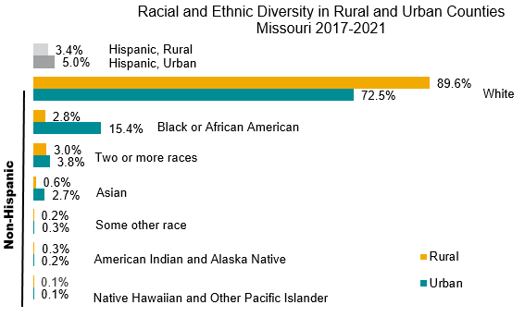
Race and Ethnicity Breakouts
From 2017-2021, the majority of Missouri identified as White, Non-Hispanic
10% of Missouri residents in rural counties identified as something other than White, Non-Hispanic.
Missouri’s Hispanic population made up approximately 5.0% of urban counties and 3.4% of rural counties.
80.3%
Source: U.S Census Bureau, 2017-2021 American Community Survey 5-Year Estimates, DP05

Slide 4
The Aging Population
Rural populations were smaller than their urban counterparts, as well as slightly older.
2020 and 2021 were the first two instances where statewide there were more deaths than births, resulting in a natural decrease.
80.3%
Source: US Census Bureau. https://www.census.gov/programs-surveys/popest/data/tables.html.

Slide 5
Social Determinants of Health
Social determinants of health (SDOH) are the conditions in the environments where people are born, live, learn, work, play, worship, and age that affect a wide range of health, functioning, and quality-of-life outcomes and risks.
Education Access & Quality
Health Care Access & Quality
1
Economic Stability
Neighborhood & Built Environment
Employment
Food Insecurity
Housing Instability
Poverty
Access to Foods That Support Healthy
Dietary Patterns
Crime and Violence
Environmental Conditions
Quality of Housing
Social &
Community Context
Early Childhood Development
and Education
Enrollment in Higher Education
High School Graduation
Language and Literacy
Civic Participation
Discrimination
Incarceration
Social Cohesion
Access to Health Services
Access to Primary Care
Health Literacy
1 Social Determinants of Health- Healthy People 2030.

Slide 6
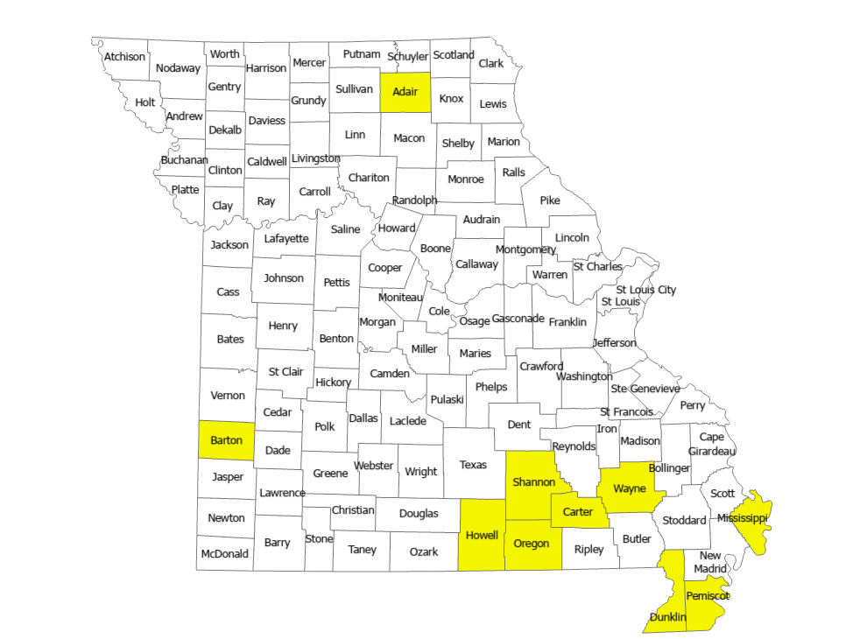
Poverty
10 Highest Poverty Rates in Missouri, 2017-2021
22.00%-27.50%
2017
2021
2021 U.S. Federal Poverty Guidelines
Persons in family/household | Poverty guideline
1 | $12,880
2 | $17,420
3 | $21,960
4 | $26,500
5 | $31,040
For families/households with more than 5 persons, add $4,540 for each additional person.
In 2021, Missouri Ranked 31st in the U.S. for percent of the population below the poverty level.
Source: Office of the Assistant Secretary for Planning and Evaluation, U.S Census Bureau, Table S1701
Notes:
Nearly one-fourth of Black/African Americans live in poverty. Black/African American Residents in both rural and urban counties had over double the percent of poverty as White residents.
Poverty was more prevalent for females in both rural and urban counties.

Slide 7
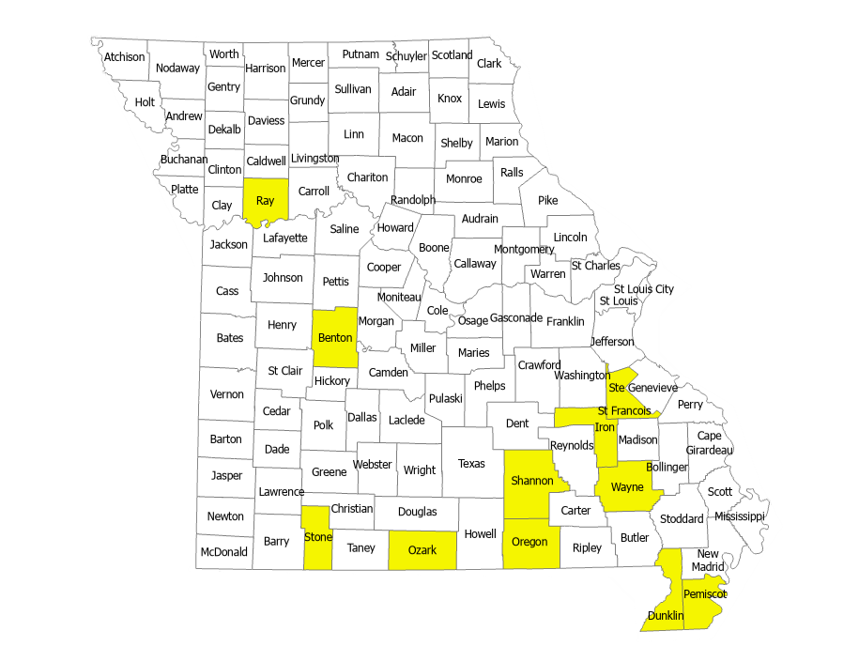
Unemployment
11 Highest Unemployment Rates in Missouri, 2017-2021
October 2022
3.1 - 3.8
* not seasonally adjusted
Rural areas in Missouri currently have a slightly higher unemployment rate than urban areas.
In 2022, Missouri ranked 9th for unemployment in the United States.
Sources: Missouri Economic Research and Information Center (MERIC). Local Area Unemployment Statistics;
U.S Bureau of Labor Statistics
Notes:
During the COVID-19 public health emergency, the unemployment rate in Missouri increased significantly. During this time the rural rate was slightly lower than the urban rate.
As of May 2023, the unemployment rate in rural counties had exceeded the urban county unemployment rate once again.

Slide 8
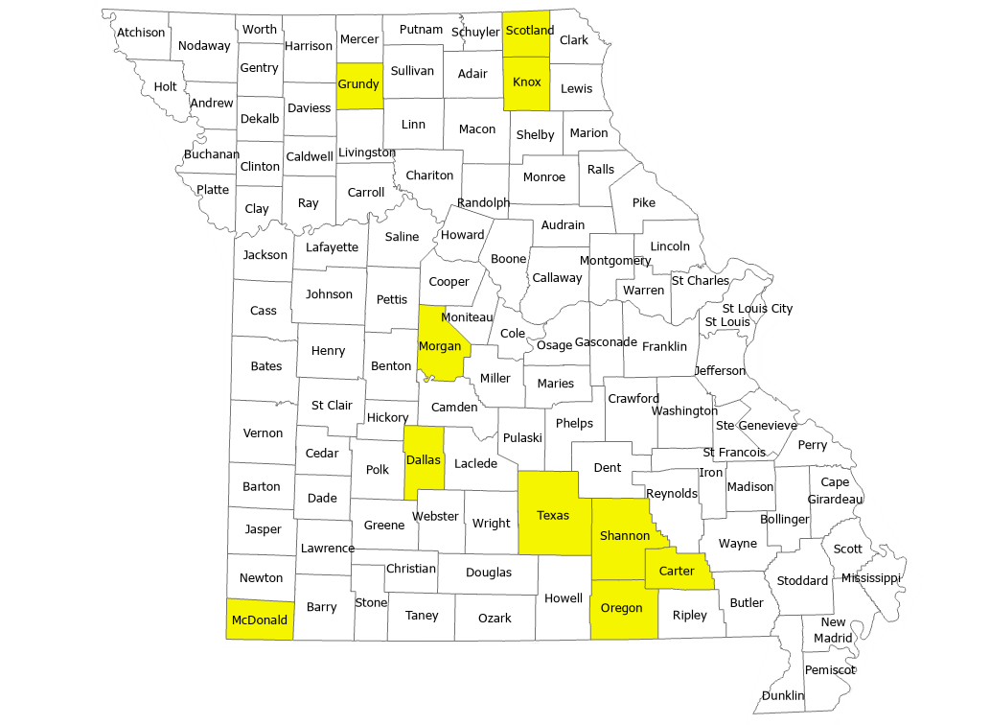
Uninsured
10 Highest Uninsured Rates in Missouri,
2017-2021
17.40%-34.70%
2017
2021
In 2021, Missouri Ranked 35th in the United States for percent of the population without health insurance.
Rural areas in Missouri are 4.2 percentage points higher than urban areas in the percent of uninsured individuals.
Source: U.S Census Bureau, 2008 - 2021 Small Area Health Insurance Estimates (SAHIE) using the American Community Survey (ACS), U.S Census Bureau, Table S2701
Notes:
Male uninsured rates are higher than females rates in both rural and urban location. This disparity is slightly higher in rural areas.
2020 shows the largest gap between rural and urban areas’ health insurance statuses since 2010.

Slide 9
Education
In rural areas 48% of adults have taken at least some college classes, compared to 66.7% of adults in urban areas.
Rural areas also have a higher percentage of persons with less than a high school diploma (12.4% vs 7.3%).
Source: U.S Census Bureau, Table S1501
Notes:
Only 13 colleges and universities in Missouri where students can earn a Bachelor’s degree are located in rural counties.

Slide 10
Maternal, Infant, and Child Health
Maternal, infant, and child health indicators provide an important source of information about the well-being of some of Missouri’s most vulnerable populations.
These indicators can also be a good gauge of the overall health status for a community.

Slide 11
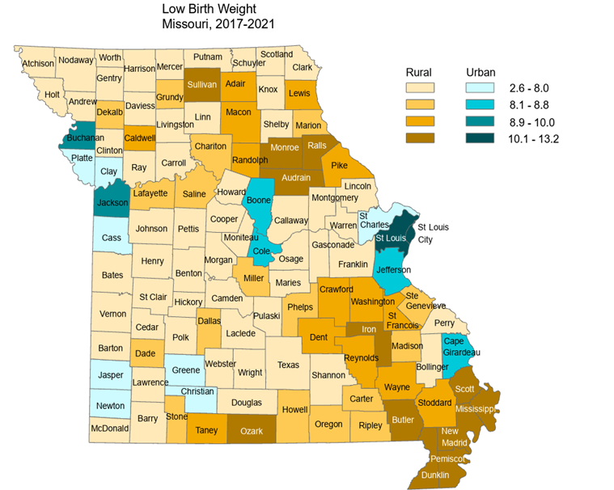
Low Birth Weight
From 2017-2021, the rate for low birth weight in rural counties was lower than the rate in urban counties.
Rates are per 100

Slide 12
Premature Birth
A premature birth is any birth that takes place before 37 weeks gestation.
Prematurity and low birth weight are indicators that are often intertwined.
Many low birth weight babies are born prematurely.
For preterm birth, the rate in rural counties was lower than the rate in urban counties.
Rates are per 100

Slide 13
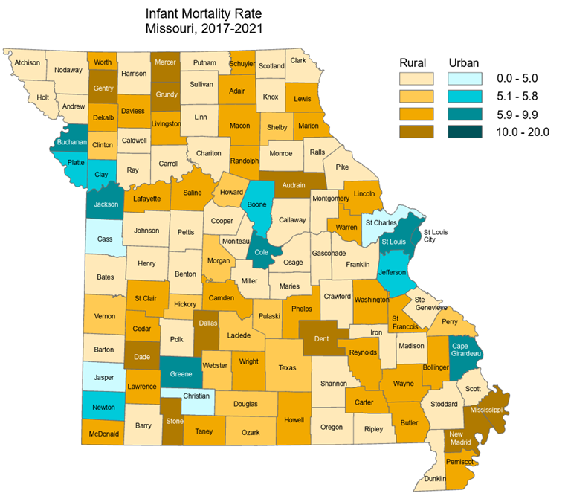
Infant Mortality
From 2017-2021, the infant mortality rate in rural counties was 7% lower than the urban county rate.
The top 10 highest infant mortality rates were all in rural counties.
Rates are per 1,000 live births

Slide 14
Mortality Indicators
Missouri’s Vital Statistics Death Certificate data can give valuable insights into some of the state’s more vulnerable populations.
This analysis revealed that rural areas exhibited significantly higher rates of death across the majority of all leading causes for the 2017-2021 time period.
COVID-19 was excluded from the Leading Causes of Death listing because it was not present in all data years analyzed. For this reason, it is broken out into a separate section that analyzes years 2020-2021.

Slide 15
All Causes of Death
In Missouri, there was a total of 334,845 deaths during the 2017-2021 time period.
Of this total, rural Missourians accounted for 130,995 deaths, with a rate of 932.2.
While urban rates have decreased from 2020 to 2021, rural rates have continued to steadily increase since 2019.
FROM 2017 TO 2021, RURAL RATES
INCREASED
BY
24.1%
Notes:
Main differences:
CLRD vs Accidents in number 3 spot, and Influenza/Pneumonia vs Suicide in number 9 spot. Suicide ranks 9th for urban. Rural leading causes replicate Missouri’s leading causes, except for number 3 spot. Missouri ranks Accidents 3rd vs rural as CLRD.

Slide 16
COVID-19
The gap between rural and urban rates of death due to COVID-19 grew between 2020 and 2021.
Rural rates were higher than both the state and urban rates.
Rural counties had higher rates for every age group, with the highest rates for both rural and urban counties in the 85 and older group.
Rates are per 100,000 residents

Slide 17
Heart Disease- Number One Leading Cause
Rural Missouri has higher rates of death due to heart disease for every year during the 2017-2021 time period.
The top 28 counties with the highest death rates from heart disease were rural. Pemiscot County had the highest rate of 407.4 during these 5 years.
Rural Black/African Americans and rural males had the highest rates of death due to heart disease.
Rates are per 100,000 residents
Notes:
4 of the 5 highest heart disease rates were in the Southwest region counties.

Slide 18
Cancer
The rural death rate due to Cancer was significantly higher than the urban rate.
The number one type of Cancer among both rural and urban Missouri was lung cancer.
According to the 2022 Behavioral Risk Factor Surveillance System (BRFSS) Survey, screening adherence for both breast and colon cancer was lower in rural areas.
Rates are per 100,000 residents

Slide 19
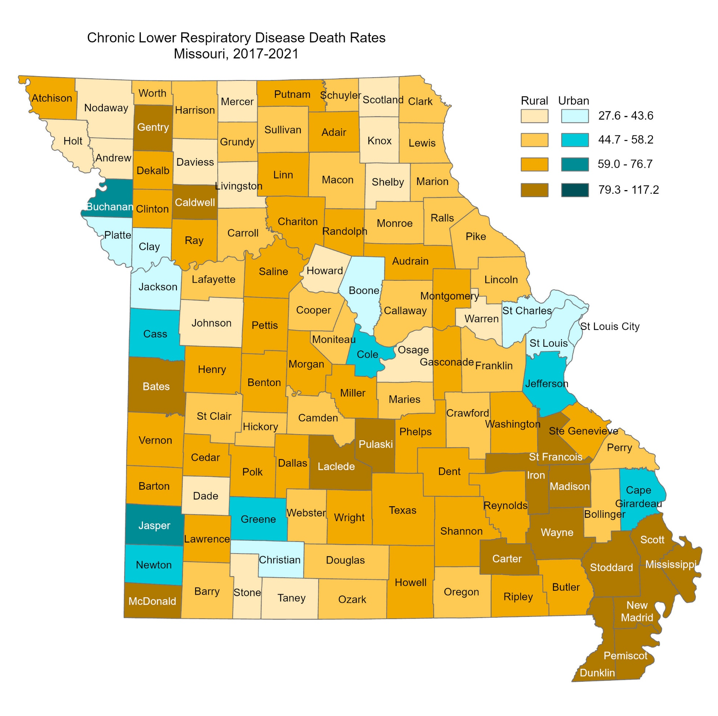
Chronic Lower Respiratory Disease (CLRD)
Rural counties historically have higher rates of death due to CLRD than urban counties, and that trend continues to hold true.
Six of the top 10 counties with the highest CLRD death rates were located in the Southeast region of Missouri.
This being said, both rural and urban counties did experience a decrease in CLRD death rates when comparing 2017 to 2021.
Rates are per 100,000 residents

Slide 20
Accidental/Unintentional Injury
The leading type of accidental/unintentional injury death for rural counties was motor vehicle accidents, while unintentional drug overdose was the leading cause for both urban areas and the state overall.
From 2012 to 2016, rural rates were 19.5% higher than urban, while from 2017 to 2021, the disparity has decreased to 2.8% higher. This is mainly due to the rise in deaths due to unintentional drug overdose in urban counties.
Despite this gap decrease between rural and urban, overall death rates for accidental/unintentional injury deaths continue to rise.
Notes:
Rural had rate of 66.1, slightly higher than urban at 64.3.

Slide 21
Drug Overdose
Drug overdose is of increasing concern for both rural and urban counties throughout the state.
Rural counties have experienced a
in opioid-involved overdose death rates since 2017.
105.6%
INCREASE
Drug overdose deaths were highest for both rural and urban counties in Eastern Missouri. St. Louis City had the highest rate, while Dent and Gasconade Counties followed in second and third respectively.
Rates are per 100,000 residents
Notes:
STL City had rate of 79.3, Dent 53.6, Gasconade 53.5

Slide 22
Stroke
While urban counties experienced a 3.5% decrease in stroke death rates from 2017 to 2021, rural counties experienced a 6.0% increase.
Black/African American individuals living in urban counties had the highest rate of death due to stroke (60.5), with rural Black/African Americans having the second highest (51.7).
Rates are per 100,000 residents

Slide 23
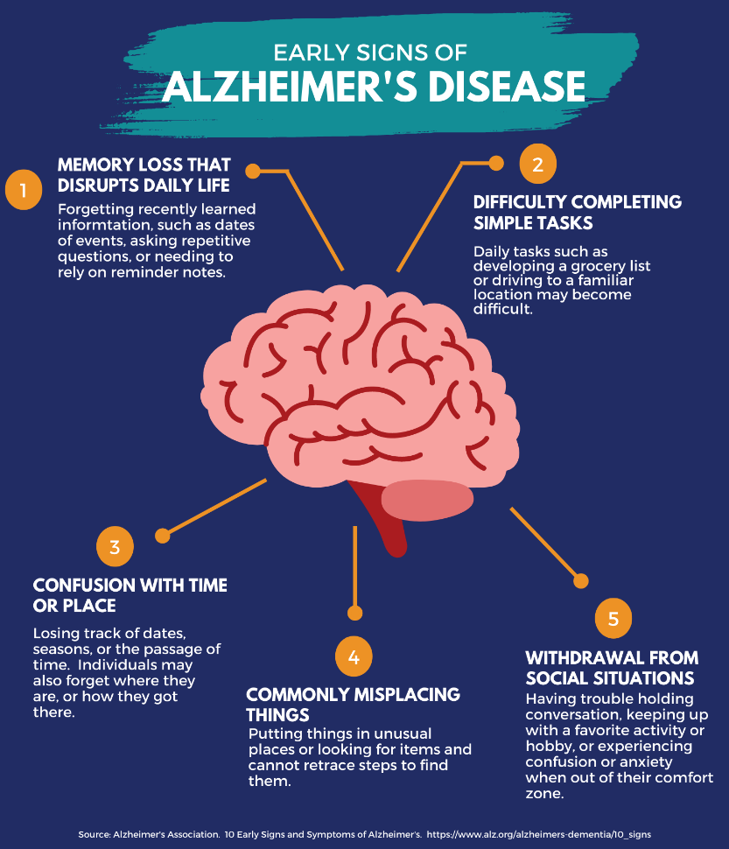
Alzheimer’s Disease (AD)
Urban Missourians had higher rates of AD than rural Missourians every year from 2017-2021.
However, the 10 counties with highest rates were all rural, with New Madrid having the highest rate (71.4)
Both rural and urban Missourians 85 years and older are over 5x more likely to die from AD than those who are age 75-84.
Rates are per 100,000 residents

Slide 24
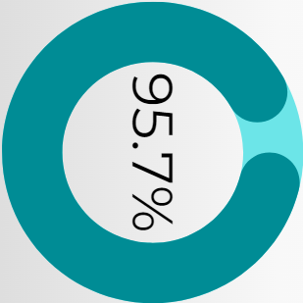
Diabetes
Diabetes death rates in rural areas have steadily risen since 2019, reaching a new high rate of 29.7 in 2021.
Black/African Americans and males in rural Missouri had the highest rates of death due to diabetes for this time period.
During the years 2017-2021, 95.7% of all Diabetes deaths were to those ages 45 and older.
Rates are per 100,000 residents

Slide 25
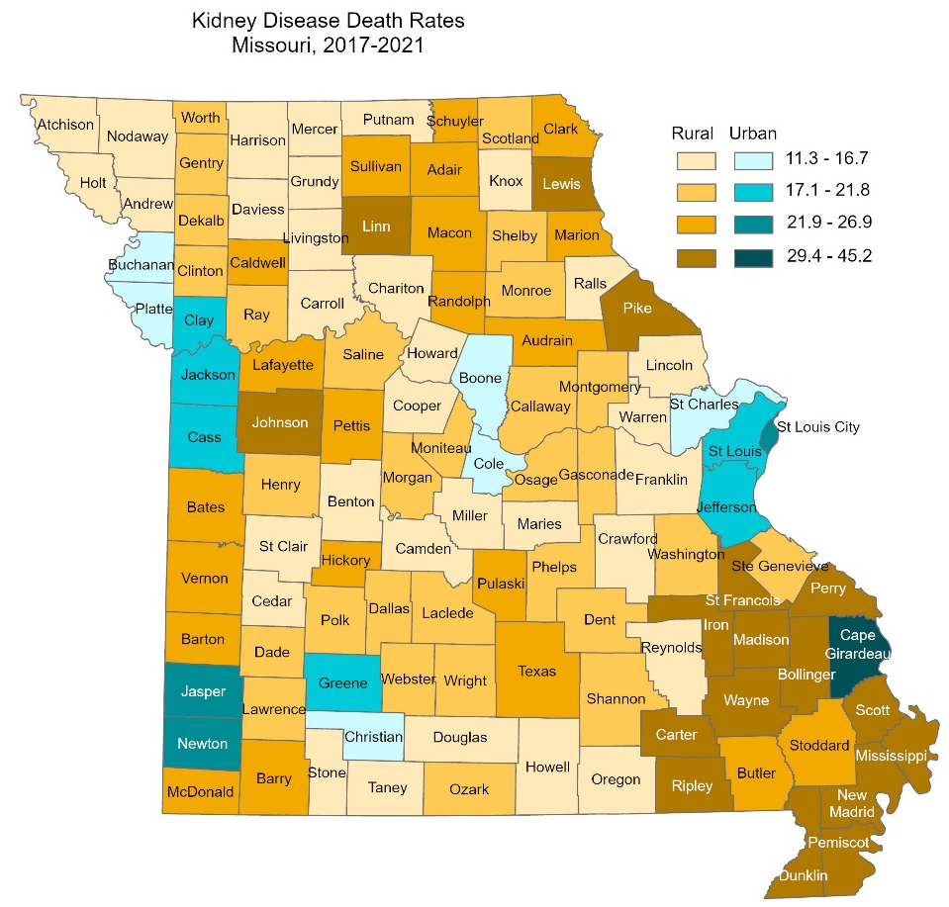
Kidney Disease
Rural Missouri had higher rates of death due to kidney disease than urban Missouri.
The top 31 counties with the highest kidney disease death rates were rural.
In 2021, the rural rate was 28.7% higher than their urban counterpart.
Rates are per 100,000 residents

Slide 26
Pneumonia and Influenza
Rural Missouri consistently had higher rates of death due to pneumonia and influenza.
Both rural and urban counties experienced overall decreases in rate since 2017.
Those aged 65 and older made up 83.0% of all pneumonia and influenza deaths in Missouri during this time period.
Rates are per 100,000 residents

Slide 27
Suicide
Rural Missouri death rates due to suicide have increased by 5.2% since 2017, while urban Missouri death rates have decreased by 1.2%.
Rural Missourians age 25 to 44 had the highest rates of suicide during this time period.
Rural males experienced a rate nearly 5 times higher than their female counter parts, and had a higher rate than urban males.
Rates are per 100,000 residents

Slide 28
In Summary…
Rural Missourians experience many challenges accessing health care and services.
Our goal with this data is to tell the story behind these individuals, and what health outcomes they are experiencing.
We encourage you all to take the data presented today and engage the communities that you work with in order to improve overall health outcomes.
For Missourians to achieve optimal health, it is going to take all of us.

Slide 29
Bureau of Health Care Analysis and Data Dissemination
Andrew Hunter:
Andrew.Hunter@health.mo.gov
LeighAnna Bennett:
LeighAnna.Bennett@health.mo.gov
Health.Mo.Gov
Thank You!
Office of Rural Health and Primary Care
Shirley Murphy:
Shirley.Murphy@health.mo.gov
Aleesha Jones:
Aleesha.Jones@health.mo.gov

